Slide 1
Statewide TMDL Advisory Group
March 11, 2024

Slide 2
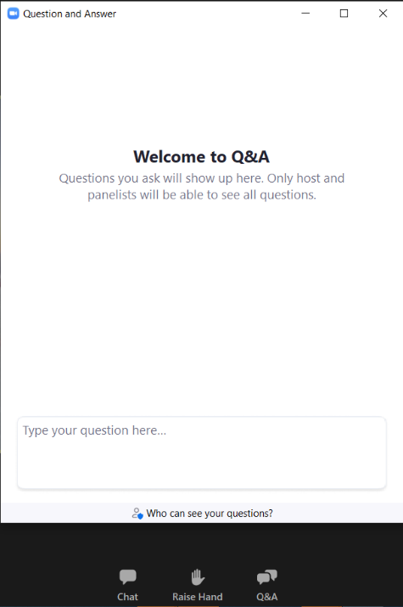
Welcome!
This meeting is a webinar
STAG members will be panelists
Members of the public can raise their hand or use the Q&A feature to ask questions during the public comment portion of the meeting
*9 raises your hand if you’re on the phone
State your name and affiliation before providing your comment
Notes:
TO CHANGE THE PHOTO: Double click the photo. Select change picture from the tool bar and select a photo from your files (or copy a photo from the end of this presentation and paste into here).

Slide 3
Water Quality Planning Bureau
Bureau Chief Andy Ulven
QA Manager Erin Louden
Water Quality Standards & Modeling Katie Makarowski
Monitoring & Assessment Darrin Kron
TMDLs Christina Staten
Nonpoint Source & Wetlands Hannah Riedl
Notes:
TO CHANGE THE ICON: Scroll to the end of the presentation to find the icon section. Select the icon you want and copy and paste into this page.

Slide 4
STAG Roll Call
STAG Member & Affiliation | Representing | Term End Date
Karli Johnson Montana Farm Bureau | Farming-Oriented Agriculture | January 31, 2026
Ellie Brighton Montana Stockgrowers Association | Livestock-Oriented Agriculture | January 31, 2026
Frank Szollosi Montana Wildlife Federation | Conservation or Environmental Interest | January 31, 2026
David Brooks Montana Trout Unlimited | Water-Based Recreation | January 31, 2026
Brian Sugden Sugden Forest Environmental, LLC | Forestry Industry | January 31, 2026
Ryan Leland City of Helena | Municipalities | January 31, 2026
Brian Heaston City of Bozeman | Point Source Dischargers | January 31, 2026
Greg Bryce Hydrometrics | Mining | January 31, 2026
Vacant | Federal Land Management Agencies
Jeff Schmalenberg Dept. of Natural Resources & Conservation | State Trust Land Management Agencies | January 31, 2026
Vacant (Substitute: Becca Boslough) Montana Association of Conservation Districts | Conservation District Supervisor – East
Vacant (Substitute: Becca Boslough) Montana Association of Conservation Districts | Conservation District Supervisor – West
Jordan Tollefson Northwestern Energy | Hydroelectric Industry | January 31, 2026
Mike Bias Fishing Outfitters Association of Montana | Fishing-Related Business | January 31, 2026
Notes:
TO CHANGE THE ICON: Scroll to the end of the presentation to find the icon section. Select the icon you want and copy and paste into this page.

Slide 5
Agenda
STAG Overview
Member Roles and Responsibilities
Discussion of STAG Chair Position
TMDL Prioritization Framework and TMDL Priority Areas
Overview of TMDLs and Prioritization Framework
Current and Planned TMDL Priority Areas
Water Quality Monitoring & Assessment Activities
2024 Water Quality Monitoring Projects
Water Quality Integrated Report Update
Assessment Methods Development & Comment Opportunities
Update on Nutrient Water Quality Standards
Status of SB358 Rulemaking to Interpret Narrative Standards and Develop an Adaptive Management Program
Public Comment & Close of Meeting
Discussion of Next Meeting Topics and Meeting Date
Public Comment
As Time Allows: Nonpoint Source & Wetlands Program Updates
Call for Applications
Alternative Restoration Plans
Notes:
TO CHANGE THE PHOTO: Double click the photo. Select change picture from the tool bar and select a photo from your files (or copy a photo from the end of this presentation and paste into here).

Slide 6
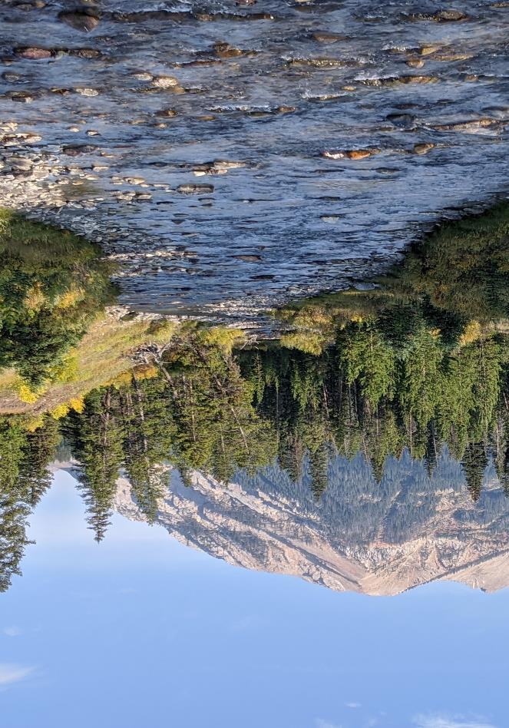
Statewide TMDL Advisory Group Overview
- Christina Staten, TMDL Section Supervisor
Notes:
TO CHANGE THE PHOTO: Double click the photo. Select change picture from the tool bar and select a photo from your files (or copy a photo from the end of this presentation and paste into here).

Slide 7
STAG Advisory Role
Authorized under 75-5-702(10), MCA
Comprised of 14 members representing broad base of water-related interests
Members are appointed by DEQ Director
Does not have officers, require quorums, or have decision-making authority
Members serve in advisory capacity to the department on topics such as:
TMDL development priorities
Water quality assessment methods
TMDL implementation monitoring
Because of the STAG’s diversity in representation of interest groups across Montana, it can play an important role in formulating Montana’s water quality policy
Notes:
TO CHANGE THE PHOTO: Double click the photo. Select change picture from the tool bar and select a photo from your files (or copy a photo from the end of this presentation and paste into here).

Slide 8
Member Responsibilities
You are representing an interest group in Montana
Attend meetings twice a year
Renewable two-year term limit (solicitations occur at term end dates)
Notify the department if you’re stepping down from your position
Notes:
TO CHANGE THE PHOTO: Double click the photo. Select change picture from the tool bar and select a photo from your files (or copy a photo from the end of this presentation and paste into here).

Slide 9
STAG Chair Discussion
Informal
Meeting facilitation assistance
Agenda feedback
Notes:
TO CHANGE THE PHOTO: Double click the photo. Select change picture from the tool bar and select a photo from your files (or copy a photo from the end of this presentation and paste into here).

Slide 10
TMDL Overview
- Christina Staten, TMDL Section Supervisor
Notes:
TO CHANGE THE PHOTO: Double click the photo. Select change picture from the tool bar and select a photo from your files (or copy a photo from the end of this presentation and paste into here).

Slide 11
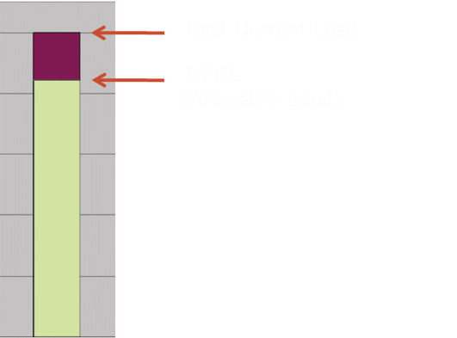
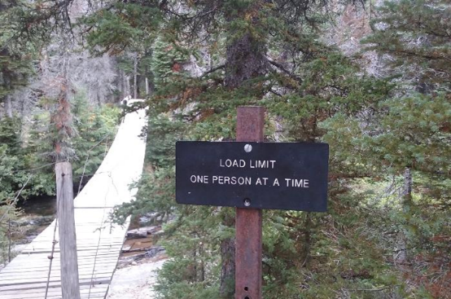
Total Maximum Daily Loads (TMDLs)
“Math and the path”
Pollution budget or diet for a waterbody
TMDLs are developed for each waterbody-pollutant impairment identified on the impaired waters list
Notes:
A Total Maximum Daily Load is the maximum amount of a pollutant that a waterbody can receive and still meet water quality standards.
TMDL documents include the calculation of how much of a pollutant a waterbody can receive and still meet the standard + the path to restoring the waterbody and aid to local community and landowners to identify the best ways to protect water quality.
The MT WQ Act requires DEQ to write TMDLs for pollutant causes of impairment.
Total Maximum Daily Load is the maximum amount of a pollutant that a waterbody can receive and still meet water quality standards.
TMDLs must be developed for each waterbody-pollutant impairment identified on the impaired waters list.
The graph is a concept of a TMDL. The bar chart is the total current of a particular pollutant in a water body. The green portion represents the TMDL allowable load allocation. The purple portion is the amount of the pollutant that needs to be removed to meet the TMDL and water quality standards.

Slide 12
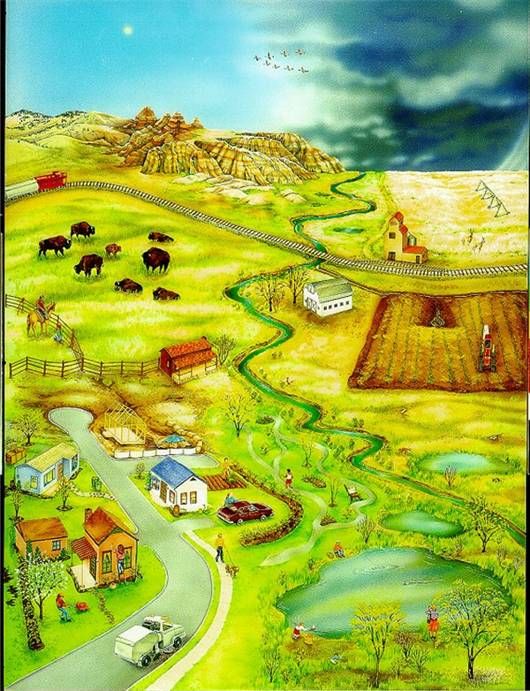
Benefits of TMDLs
Incorporate multiple source types, both regulated and non-regulated
Address cumulative impacts
Guide future restoration work and prioritization of projects
Help the local community and landowners identify the best ways to protect water quality
Notes:
Watershed with multiple sources of pollutants

Slide 13
TMDL Priority Areas
- Christina Staten, TMDL Section Supervisor
Notes:
TO CHANGE THE PHOTO: Double click the photo. Select change picture from the tool bar and select a photo from your files (or copy a photo from the end of this presentation and paste into here).

Slide 14
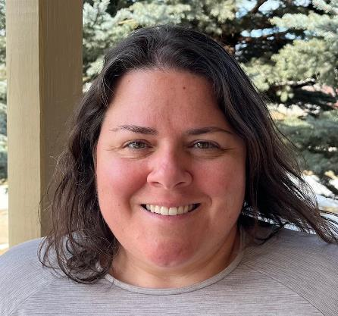
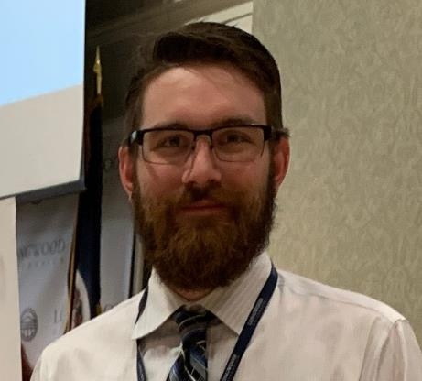
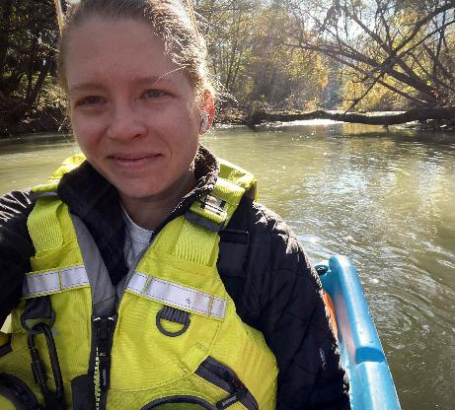
TMDL Section Staff
5 TMDL Planners
Heather Henry
Troy Clift
Lisa Anderson
Kylie Bodle
1 planner in hiring process
1 Adaptive Management Program Scientist
Kyle Milke
Kyle
Heather
Troy
Lisa

Slide 15
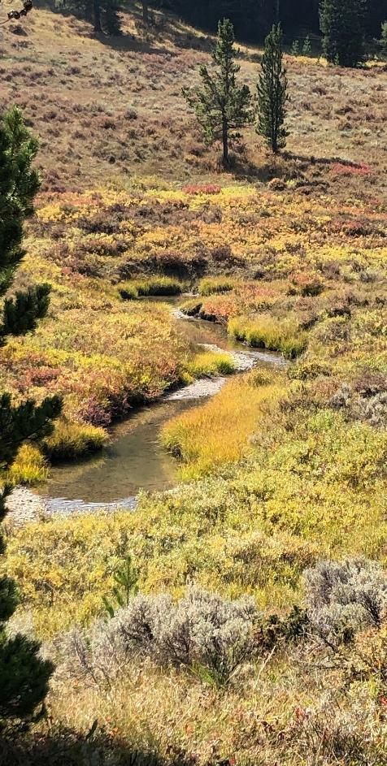
2023-2024 TMDL Priorities
Bridge Metric:
Bitterroot River Nutrient Protection Plan (completion)
Beaverhead Watershed Nutrient TMDLs (development)
Red Rock Watershed Nutrient TMDLs (development)
Ashley Creek (Flathead-Stillwater) Nutrient & Sediment Addendum (development)
Notes:
In 2013, EPA’s initial Long-Term (10-year) Vision for Assessment, Restoration and Protection under the Clean Water Act Section 303(d) program encouraged focusing attention on priority waters and acknowledges that states have flexibility in using available tools beyond TMDLs (protection plans, ARPs, etc.) to attain beneficial uses.
Vision 2.0 was just released as final. Renewal of 2013 Vision and associated goals, with additional Focus Areas for the 303(d) program. Goals outline aspirations and highlight opportunities to implement CWA Section 303(d) program activities in the following categories – Planning and Prioritization, Restoration, Protection, Data and Analysis, and Partnerships. New focus items for consideration in CWA Section 303(d) program implementation include Environmental Justice, Climate Change, Tribal Water Quality and Program Development, and Program Capacity Building.
The Bridge Metric bridges the gap to Vision 2.0 (EPA FY 2023-2024) and required project commitments for this period, which are shown on this slide. Our project commitments include waterbody-pollutant pairings and anticipated status on September 30, 2024. Commitment to projects can be made at the full completion status (approved by EPA by the deadline) or development status (draft document, significant progress toward completion).
With the projects shown here, the Bitterroot River Nutrient Protection Plan is nearly complete (finalizing edits after public comment period) and anticipated in the first half of 2023. We committed to the Beaverhead, Red Rock, and Ashley Creek projects at the development level in light of ongoing rulemaking for narrative nutrient standards. Ideally, these projects can be completed by the September 30, 2024, but the commitment level errs on the side of caution. The plan is to start on the projects during this period of time and edit iteratively to reflect final rule adoption. If these projects are completed during the Bridge Metric period, we would receive extra credit in the way EPA evaluates our progress.
The nutrient TMDLs remain near the top of our priority list because of the substantial monitoring efforts and potential for implementation within those watersheds. To the extent possible, as detailed on the previous slide, TMDL development for the Beaverhead and Ashley Creek will incorporate any AMP activity and reflect that in WLAs. The Red Rock watershed does not have permitted dischargers and is not anticipated to have WLAs.

Slide 16
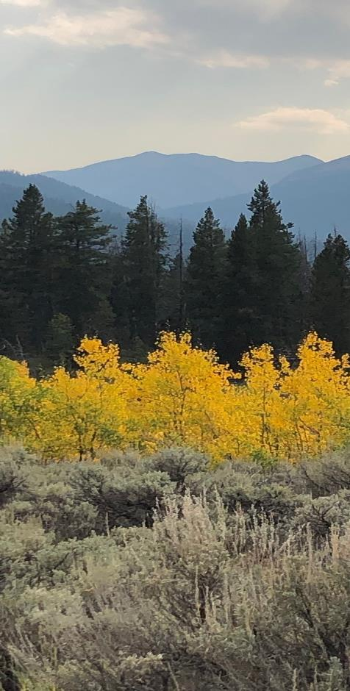
Draft TMDL Priorities Beyond 2024 (Vision 2.0)
Upper Gallatin - excess algae
Smith River - nutrients
Upper Missouri River - nutrients, metals
Clarks Fork Yellowstone River
TMDL revisions and consideration of ARPs in tandem w/AMP
Notes:
Listed here are draft priorities for TMDL development beyond 2024. We will continue to commit to projects in 2-year increments as described for the Bridge Metric. Many of these projects have been ongoing or recently started monitoring and assessment work, which Darrin will delve into more shortly. If projects from the previous page are still in development as we transition into the Vision 2.0 period, they would likely receive a “complete” commitment for the subsequent 2-year period.
Any thoughts on the list of projects on this slide?

Slide 17
TMDL Development Status & Schedule
Notes:
Pause for TMDL questions

Slide 18
STAG Feedback / Discussion
Notes:
TO CHANGE THE PHOTO: Double click the photo. Select change picture from the tool bar and select a photo from your files (or copy a photo from the end of this presentation and paste into here).

Slide 19
TMDL Prioritization Framework
- Christina Staten, TMDL Section Supervisor
Notes:
TO CHANGE THE PHOTO: Double click the photo. Select change picture from the tool bar and select a photo from your files (or copy a photo from the end of this presentation and paste into here).

Slide 20
Vision 2.0 Prioritization Approach
Watershed scale approach by TMDL planning areas
State law prioritization factors (75-5-702, MCA)
New individual MPDES permit applications
Adaptive Management Plan (AMP) considerations
STAG input
Notes:
Listed here are draft priorities for TMDL development beyond 2024. We will continue to commit to projects in 2-year increments as described for the Bridge Metric. Many of these projects have been ongoing or recently started monitoring and assessment work, which Darrin will delve into more shortly. If projects from the previous page are still in development as we transition into the Vision 2.0 period, they would likely receive a “complete” commitment for the subsequent 2-year period.
Any thoughts on the list of projects on this slide?

Slide 21
TMDL Prioritization Factors
New, individual discharge permit application
TMDL implementation considerations
Program coordination
Resource value
Potential impact to use (human health and aquatic life)
Impairment characteristics (severity and magnitude)
Court determinations
General waterbody characteristics (size, importance)
Per 75-5-702, MCA, DEQ must consult with the STAG when prioritizing waters for TMDL development
Notes:
Listed here are draft priorities for TMDL development beyond 2024. We will continue to commit to projects in 2-year increments as described for the Bridge Metric. Many of these projects have been ongoing or recently started monitoring and assessment work, which Darrin will delve into more shortly. If projects from the previous page are still in development as we transition into the Vision 2.0 period, they would likely receive a “complete” commitment for the subsequent 2-year period.
Any thoughts on the list of projects on this slide?

Slide 22
AMP Considerations
TMDL development or revision may be coordinated with active AMPs, to the extent possible
TMDL revision will be prioritized when data collected by a permittee indicate a different nutrient target is more appropriate
For watersheds without existing nutrient TMDLs, AMPs may be submitted to EPA as advance restoration plans. Acceptance by EPA may prompt DEQ to lower the TMDL priority ranking.
TMDL revisions and ARP development will still be prioritized in accordance with 75-5-702, MCA, and in consultation with the STAG
Notes:
Listed here are draft priorities for TMDL development beyond 2024. We will continue to commit to projects in 2-year increments as described for the Bridge Metric. Many of these projects have been ongoing or recently started monitoring and assessment work, which Darrin will delve into more shortly. If projects from the previous page are still in development as we transition into the Vision 2.0 period, they would likely receive a “complete” commitment for the subsequent 2-year period.
Any thoughts on the list of projects on this slide?

Slide 23
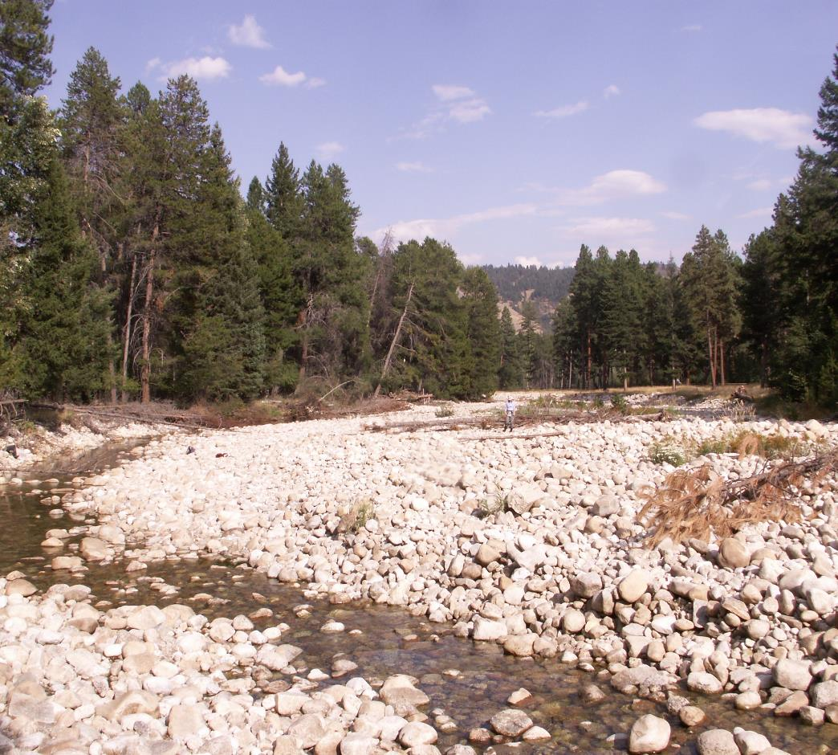
Addressing Environmental Justice and Climate Change
Required for Vision 2.0 framework
Not inherently part of Montana’s priority factors
EJ addressed by:
Collaborating with tribal governments
Traveling to local watershed for meetings
Accommodating ranching/farming needs when scheduling meetings
Notes:
Listed here are draft priorities for TMDL development beyond 2024. We will continue to commit to projects in 2-year increments as described for the Bridge Metric. Many of these projects have been ongoing or recently started monitoring and assessment work, which Darrin will delve into more shortly. If projects from the previous page are still in development as we transition into the Vision 2.0 period, they would likely receive a “complete” commitment for the subsequent 2-year period.
Any thoughts on the list of projects on this slide?

Slide 24
Addressing Climate Change
Prioritizing watersheds more vulnerable to increased stream temperatures (excess algae listings)
Developing protection plans for areas susceptible to impairment
Addressing HABs when developing lake TMDLs for eutrophication
Evaluating future flow conditions as part of source assessment for pollutants tied to flow
TMDL implementation: recommending and funding floodplain and water storage improvement projects

Slide 25
STAG Feedback / Discussion
Notes:
TO CHANGE THE PHOTO: Double click the photo. Select change picture from the tool bar and select a photo from your files (or copy a photo from the end of this presentation and paste into here).

Slide 26
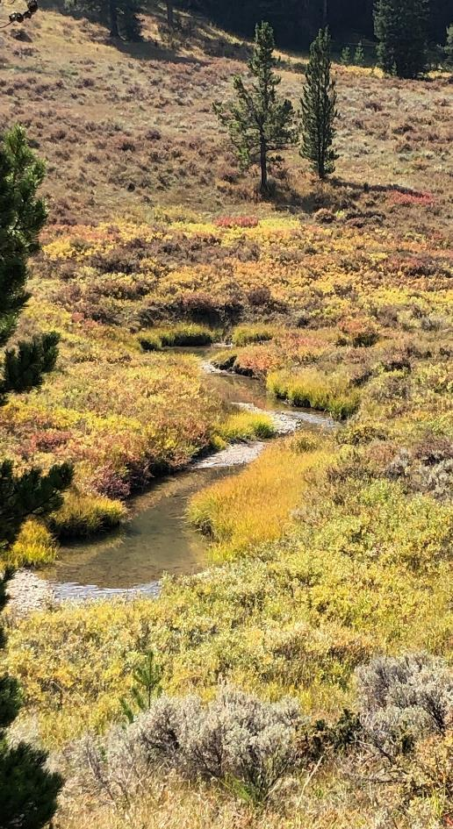
Water Quality Monitoring & Assessment Activities for 2024
Darrin Kron, Monitoring & Assessment Section Supervisor
Notes:
TO CHANGE THE PHOTO: Double click the photo. Select change picture from the tool bar and select a photo from your files (or copy a photo from the end of this presentation and paste into here).

Slide 27
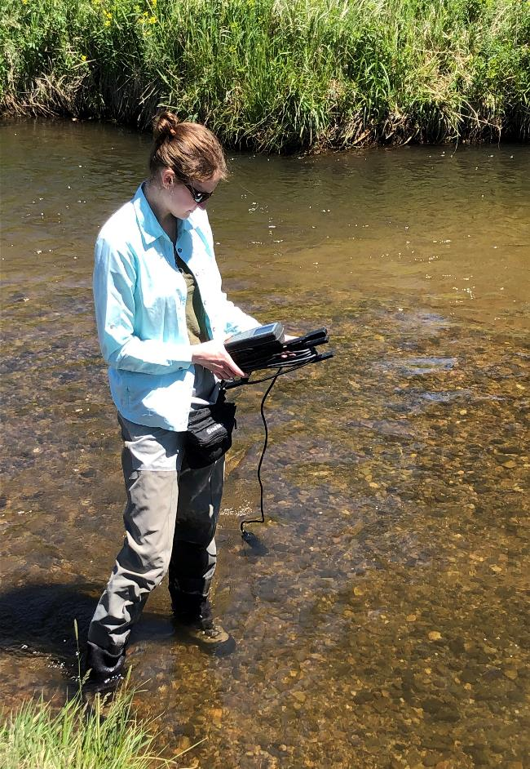
Water Quality Monitoring & Assessment Activities
Darrin Kron, Water Quality Monitoring and Assessment Section Supervisor
Gallatin River Assessment Request
Under provision 75-5-702(3)
Excessive Algae Growth Impairment
Addended 2020 IR
Next IR Submittal will be combined 2022/2024
Call for data and assessment work
Data organization and partial analysis
Delayed by implementation of narrative nutrient standards and implementing more pollutant assessment methods
Notes:
TO CHANGE THE PHOTO: Double click the photo. Select change picture from the tool bar and select a photo from your files (or copy a photo from the end of this presentation and paste into here).

Slide 28
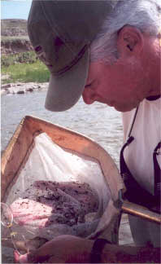
Water Quality Monitoring & Assessment Activities
Ongoing Monitoring or 303d Assessment Projects:
Yellowstone River
Upper Missouri River
Smith River
South Fork Judith
Upper Gallatin
Gallatin Focus Area
Bitterroot Focus Area
Clark Fork River
Volunteer Monitoring Support Program
Big Spring Creek
Clark Canyon Reservoir
Lake Mary Ronan
Rattlesnake Creek
Kennedy Creek
Goat Creek
Lake Koocanusa/Kootenai River
PFAS Statewide
Clarks Fork of Yellowstone
Notes:
TO CHANGE THE PHOTO: Double click the photo. Select change picture from the tool bar and select a photo from your files (or copy a photo from the end of this presentation and paste into here).

Slide 29
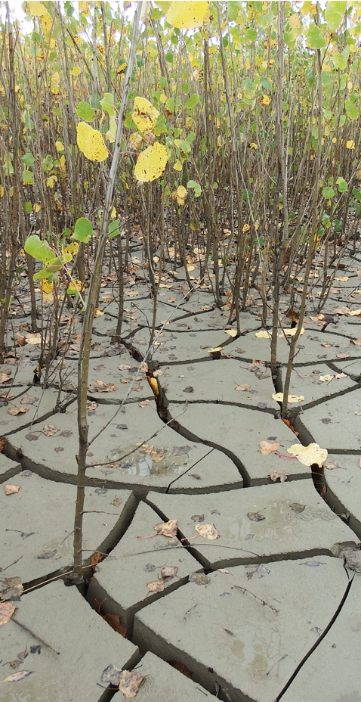
Water Quality Monitoring & Assessment Activities
Assessment Method Development:
Phase I – Spring 2024
Dissolved Oxygen – All waters
pH – All waters
Ammonia – All waters
Temperature – Streams/Rivers
Phase II – With 2022/24 IR
Wadable Stream Nutrient Assessment Method Update - to coincide or follow SB358 rules
Lake and Reservoir Eutrophication (Algae, HABs, Nutrients)
Large River Eutrophication
(Algae, Nutrients)
Use of Fish Tissue Toxics Data (Mercury, PCBs, Dioxins)
Notes:
TO CHANGE THE PHOTO: Double click the photo. Select change picture from the tool bar and select a photo from your files (or copy a photo from the end of this presentation and paste into here).

Slide 30
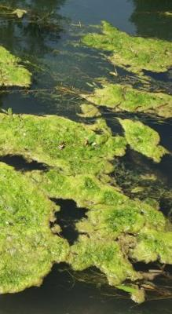
Update on Nutrient Water Quality Standards
- Katie Makarowski,
Water Quality Standards & Modeling Section Supervisor
Notes:
TO CHANGE THE PHOTO: Double click the photo. Select change picture from the tool bar and select a photo from your files (or copy a photo from the end of this presentation and paste into here).

Slide 31
Transition to Narrative Nutrient Standards
Senate Bill 358 (2021) required DEQ to:
Adopt rules related to narrative nutrient standards
Delete references to numeric nutrient standards
Develop an Adaptive Management Program (incremental watershed approach to protecting water quality).
Consultation with Nutrient Work Group
45 meetings since August 2020
40 since SB 358 signed into law in April 2021
Notes:
TO CHANGE THE PHOTO: Double click the photo. Select change picture from the tool bar and select a photo from your files (or copy a photo from the end of this presentation and paste into here).

Slide 32
Narrative Nutrient Rulemaking
New Rule I - TRANSLATION OF NARRATIVE NUTRIENT STANDARDS
Translators identify causal and response variables and thresholds to protect beneficial uses; used to determine if narrative nutrient standard is met
New Rule II - IMPLEMENTATION OF THE ADAPTIVE MANAGEMENT PROGRAM FOR NARRATIVE NUTRIENT STANDARDS
New, optional compliance approach implemented within MPDES permitting program to address nutrient sources in watersheds
Circular DEQ-15
Amend and repeal related rules
Notes:
TO CHANGE THE PHOTO: Double click the photo. Select change picture from the tool bar and select a photo from your files (or copy a photo from the end of this presentation and paste into here).

Slide 33
2021 to 2024 - Conceptual review and initial drafting; Consultation with Nutrient Work Group
Rulemaking Timeline
*dates subject to change
March 8, 2024 – Revised rule package to NWG and WPCAC
March 15, 2024 - Rulemaking update to WPCAC
March 18, 2024 - Rulemaking overview to WPIC
April 16, 2024 - File proposal notice with SOS
April 26, 2024 - Proposal notice published in MAR
April 26 – June 10, 2024 - Public comment period
NWG = Nutrient Work Group
WPCAC = Water Pollution Control Advisory Council
WPIC = Water Policy Interim Committee
SOS = Secretary of State
MAR = Montana Administrative Record
June 10, 2024 - Public hearing
Respond to comments; modify adoption notice
September 24, 2024 - File adoption notice with SOS
October 4, 2024 - Adoption notice published in MAR
Submit to EPA
Notes:
TO CHANGE THE PHOTO: Double click the photo. Select change picture from the tool bar and select a photo from your files (or copy a photo from the end of this presentation and paste into here).

Slide 34
Nonpoint Source & Wetlands Program
Hannah Riedl
Funding available now! Apply by April 5th, 2024
Planning and project implementation
Capacity building* and education and outreach
Notes:
TO CHANGE THE PHOTO: Double click the photo. Select change picture from the tool bar and select a photo from your files (or copy a photo from the end of this presentation and paste into here).

Slide 35
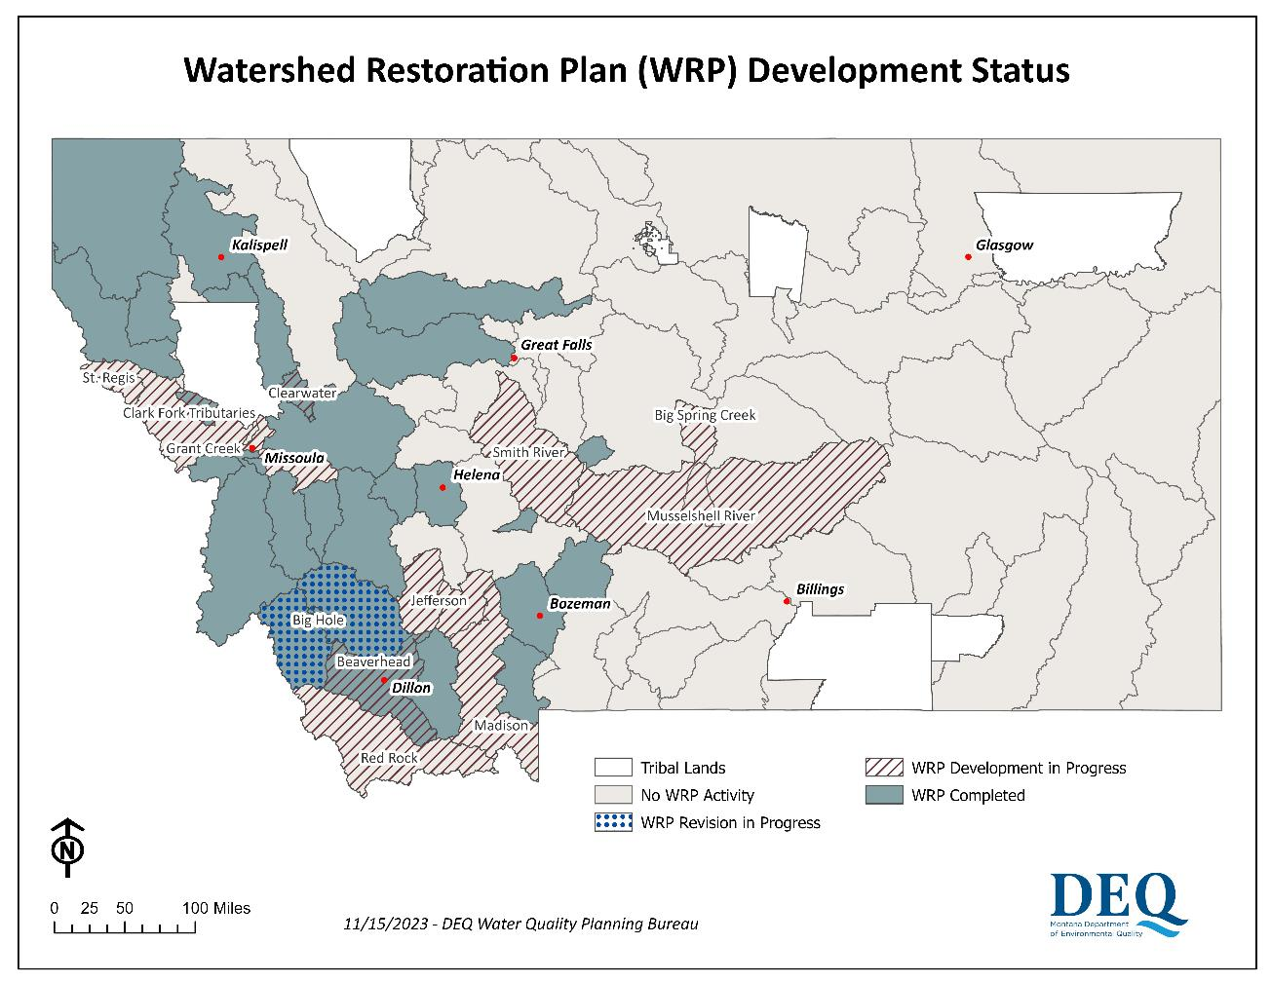
WRP Development Status
Notes:
TO CHANGE THE PHOTO: Double click the photo. Select change picture from the tool bar and select a photo from your files (or copy a photo from the end of this presentation and paste into here).

Slide 36
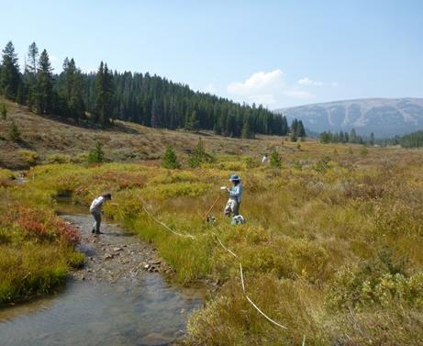
Alternative Watershed Restoration Plans
When the impairment is not specific to a pollutant.
When responding to a NPS pollution emergency or urgent NPS public health risk.
When protecting assessed unimpaired/high quality waters.
When addressing an isolated, small-scale water quality problem resulting from one or a few sources of pollution.
Notes:
TO CHANGE THE PHOTO: Double click the photo. Select change picture from the tool bar and select a photo from your files (or copy a photo from the end of this presentation and paste into here).

Slide 37
Alternative Watershed Restoration Plans
Nine-element Watershed Restoration Plans
Identification of causes of impairment and sources of pollution.
An estimate of the pollutant load reductions needed to achieve water quality standard
A description of the nonpoint source management measures needed to achieve pollutant load reductions.
An estimate of the technical and financial assistance needed to implement the management measures.
An education and outreach component to encourage public participation in designing and implementing the management measures.
A reasonable schedule for implementing the management measures.
Milestones to gauge progress in implementing the management measures.
Criteria for determining to what extent management measures are reducing pollutant loads and improving water quality over time.
A monitoring plan for collecting the data necessary to evaluate improvements based on the criteria above.
Identification of causes of impairment and sources of pollution.
An estimate of the pollutant load reductions needed to achieve water quality standard
A description of the nonpoint source management measures needed to achieve pollutant load reductions.
An estimate of the technical and financial assistance needed to implement the management measures.
An education and outreach component to encourage public participation in designing and implementing the management measures.
A reasonable schedule for implementing the management measures.
Milestones to gauge progress in implementing the management measures.
Criteria for determining to what extent management measures are reducing pollutant loads and improving water quality over time.
A monitoring plan for collecting the data necessary to evaluate improvements based on the criteria above.
37
Notes:
TO CHANGE THE PHOTO: Double click the photo. Select change picture from the tool bar and select a photo from your files (or copy a photo from the end of this presentation and paste into here).

Slide 38
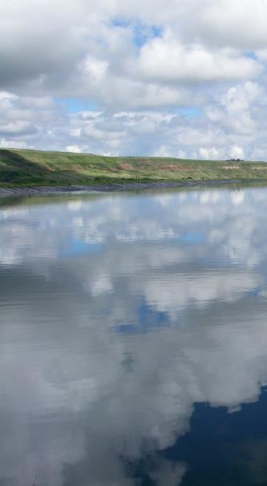
Close of Meeting
Discussion of Next Meeting Topics and Meeting Date
Public Comment
Notes:
Next meeting: sometime in May or June? We have been meeting twice per year of late.
Topics: what would you like us to cover? Continuation of these or new topics?
Expect solicitations from DEQ for board membership term renewal (2-year terms) in January. You will be asked to indicate your continued interest. We also have several vacancies and would appreciate any recommendations from this group. A new chair will be selected once the membership is updated for 2023.

Slide 39
Questions/ Comments
Raise hand (*9 if on the phone) or type questions into the Q&A
DEQ will unmute you if you wish to provide your comment orally
If calling by phone, press*6 to unmute
State your name and affiliation before providing your comment
Notes:
TO CHANGE THE PHOTO: Double click the photo. Select change picture from the tool bar and select a photo from your files (or copy a photo from the end of this presentation and paste into here).

Slide 40
Thanks for Joining Us
Contact:​
Christina Staten, CStaten@mt.gov
https://deq.mt.gov/water/councils
Notes:
TO CHANGE THE PHOTO: Double click the photo. Select change picture from the tool bar and select a photo from your files (or copy a photo from the end of this presentation and paste into here).

