Slide 1
Nutrient Offset Trading Workgroup
September 21, 2026

Slide 2

Preliminaries
Roll Call
Approve August 20, 2026 meeting minutes and share any post-meeting thoughts or ideas
Agenda

Slide 3
Agenda
Discussion Topics
  DEQ-13 Proposed Updates Review
    Improvement ratio
  Topics to revisit from August 20th
    Draft application form
    Optimization credits
  Estimating Nutrient Reduction Credit Methods
    Riparian fencing
    Riparian revegetation
    Wetland development
  Update on Rulemaking Timeline
  MEANSS model questions
  Ideas for Topics to Revisit
General + Public Comment

Slide 4

DEQ-13 Proposed Updates Review

Slide 5
Circular DEQ-13 II(7) Trading Credits
Trading RatioCredits: All nutrient trades must result in a net decrease in nutrient loading within the United States geological survey-designated 12-digit HUC subbasin, or immediately adjacent 12-digit HUC (Section IV.4), at the time of project implementation. A net decrease must also be maintained after the trading credit is applied in a permit.
For projects that result in a net decrease in nutrient loading at the time of implementation, For nutrient reductions that satisfy Section IV. 3 - 4., the offset or trading credit must be 100% of a reduction from point source discharges; 80% of a reduction from an up-gradient, nonpoint source discharge; or 50% of a reduction from a down-gradient, nonpoint source discharge.
Notes:
Reminder of the before

Slide 6
Circular DEQ-13 II(7) Trading Credits
For point source to point source trades, Tto ensure the net decrease in nutrient loading is maintained after it takes effect in a permit, the trading applicant may need to apply an “improvement ratio” to the credit if the trade does not result in a net reduction in nutrient loading within the 12-digit HUC subbasin, or immediately adjacent 12-digit HUC subbasin.. The applicant may use a 90% improvement ratio, or recommend their own improvement ratio for DEQ approval. DEQ will approve proposed improvement ratios (expressed as a percent of the load reduced below baseline) only when the associated net decrease in nutrient load for the HUC12 watershed is greater than the coefficient of variation (CV, expressed as a percentage) of the relevant discharge monitoring report data:
Reduction (%) > CV(%)
where Reduction (%) = 100 – Improvement Ratio (%)
The period of record for calculating CVs should equal the period of record used to develop permit limits (typically 5 years). An exception may be granted to the typical 5 year period of record for facility operational changes. If an exception is granted, the period of record will span from the date of the facility operational change to the present. For example, if the past five years of monthly average and seasonal average effluent concentration data for the permitted season have a CV of 8% and 3% respectively, then the applicant must propose an improvement ratio less than 92%, see the below example calculation..
Example % Reduction Calculation:
Reduction (9%) > CV (8%)
where Reduction (%) = 100% – 91% = 9%
Credits acquired equals 91%
Notes:
Reminder of the before

Slide 7

Topics to Revisit from August 20th

Slide 8
Draft Application Form

Slide 9
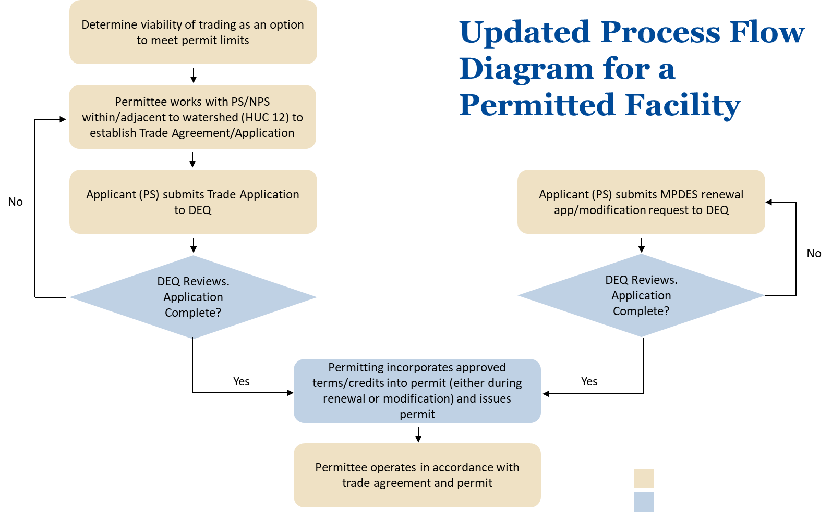

Updated Process Flow Diagram for a Permitted Facility
1
Note that in the case of a PS to PS trade, the seller must also submit a renewal/modification application to DEQ
Notes:
¹ Note that in the case of a PS to PS trade, the seller must also submit a modification request to DEQ
Again stress that the only thing that really has to happen is that the credit has to be approved before we can incorporate credit into permit.
Should I include admin cont’d as a possibility here. Or keep it simple.

Slide 10
Optimization to meet credits
Yes, optimization can be used improve discharge characteristics and generate credits
  Assumptions: Baseline is met
Notes:
I think this question had come up because there are permits that do require Optimization as part of the compliance schedule to meet an upcoming limit. But it’s not really a broad requirement that facilities be optimized; as long as facility is meeting permit limits, not an issue/requirement and can be used to generate credits below baseline.

Slide 11
Estimating Nutrient Reduction Credit Methods

Slide 12
HB-736, Section 4(a)
(4) (a) The department shall establish acceptable methodologies, based on readily available watershed characteristics, to determine the reduction in nutrient loading for nonpoint sources, including for:​
riparian fencing programs based on the number of feet of streambank;​
riparian vegetation programs based on the number of acres vegetated;​
development of wetlands in areas of irrigation water return flows based on the number of acres associated with the return flows; or​
removal of septic systems based on the number and size of septic systems removed.​
Notes:
Reminder of the before

Slide 13
Basic Process
Estimate the pre-BMP nitrogen and phosphorus loads from surrounding land uses
Identify reference values for nutrient removal efficiencies
Apply the removal efficiencies to the pre-BMP loads based on the caveats from HB-736
Notes:
Reminder of the before

Slide 14
Estimating the pre-BMP Nitrogen and Phosphorus Loads From Surrounding Land Uses
Pollutant Load Estimation Tool (PLET)
Web-based model developed by EPA
Useful for estimating nutrient loads from different land uses “based on readily available watershed characteristics” (e.g., precipitation data, land use type, acreage, etc.)
Notes:
Reminder of the before

Slide 15
2. Identify Reference Values for Nutrient Removal Efficiencies
Ellis (2008)
  Riparian fencing
  Riparian revegetation
Land et al (2016)
  Wetlands associated with irrigation return flows
Native Riparian Buffer
Notes:
Reminder of the before

Slide 16
Ellis (2008)
Table 1 – Nitrogen Removal Efficiencies
Table 2 – Phosphorus Removal Efficiencies
Percent Removed (median) | Buffer Width (median) | Author of Study
100 | 100 | Muscutt et al 1993
89 | 62 | Shisler et al 1987
86 | 164 | Peterjohn and Correll 1984
67 | 70 | Young et al 1980
39.5 | 37.5 | Schmitt et al 1999
Percent Removed (median) | Buffer Width (median) | Author of Study
100 | 200 | Horner and Mar 1982
80 | 62 | Shisler et al 1987
78.5 | 164 | Peterjohn and Correll 1984
74 | 79 | Mander et al 1997
83 | 80 | Young et al 1980
80.5 | 39.5 | Vought et al 1994
Notes:
Reminder of the before

Slide 17
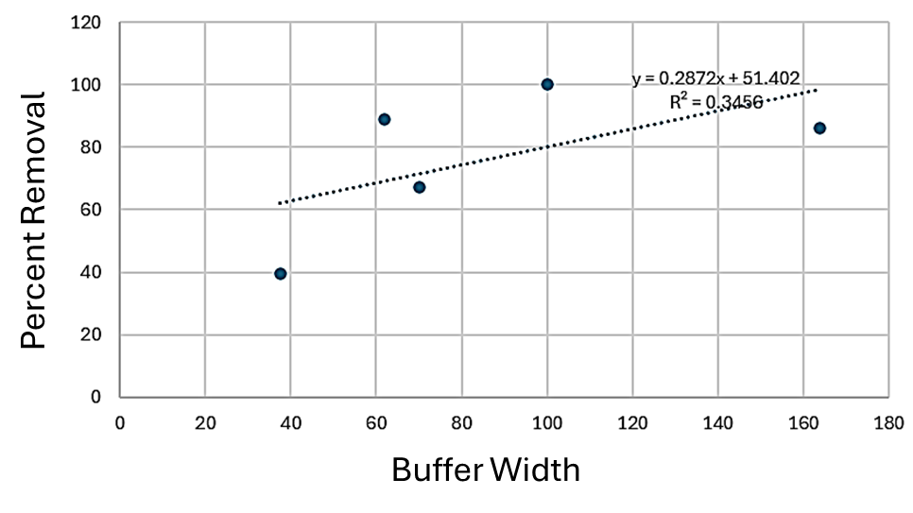
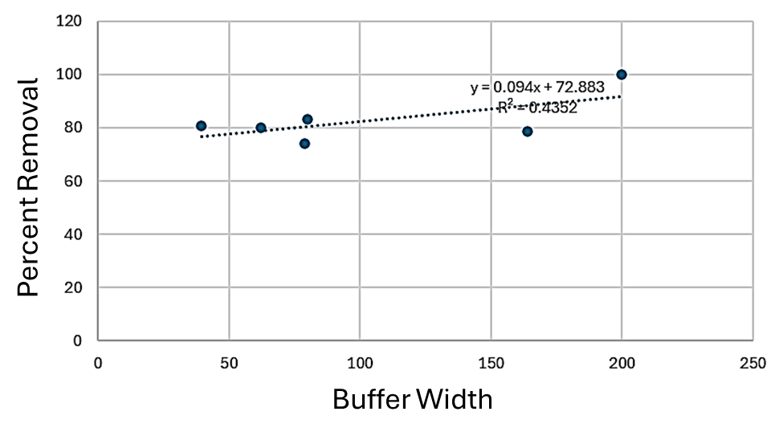
Ellis (2008) (Cont'd)
Figure 1 – Nitrogen Removal Efficiencies
Figure 2 – Phosphorus Removal Efficiencies
Notes:
Reminder of the before

Slide 18
Land et al. (2016)
Extensive, quality-controlled analysis of available studies on the nitrogen and phosphorus removal efficiencies of wetlands.
The median Total Nitrogen removal efficiency across 93 studies was 37% and the median Total Phosphorus removal efficiency was 46%.
Notes:
Reminder of the before

Slide 19
3. Apply the Removal Efficiencies to the pre-BMP Loads Based on the Caveats From HB-736
Riparian fencing programs based on the number of feet of streambank;
Riparian vegetation programs based on the number of acres vegetated;
Development of wetlands in areas of irrigation water return flows based on the number of acres associated with the return flows;
Notes:
Reminder of the before

Slide 20
Riparian Fencing Programs Based on the Number of Feet of Streambank
Method Assumptions
The fenced, riparian buffer will be fully vegetated with native, site-appropriate vegetation
The buffer will not be mowed, cropped or hayed
Weed control will be limited to mechanical removal or spot-spraying
Notes:
Reminder of the before

Slide 21
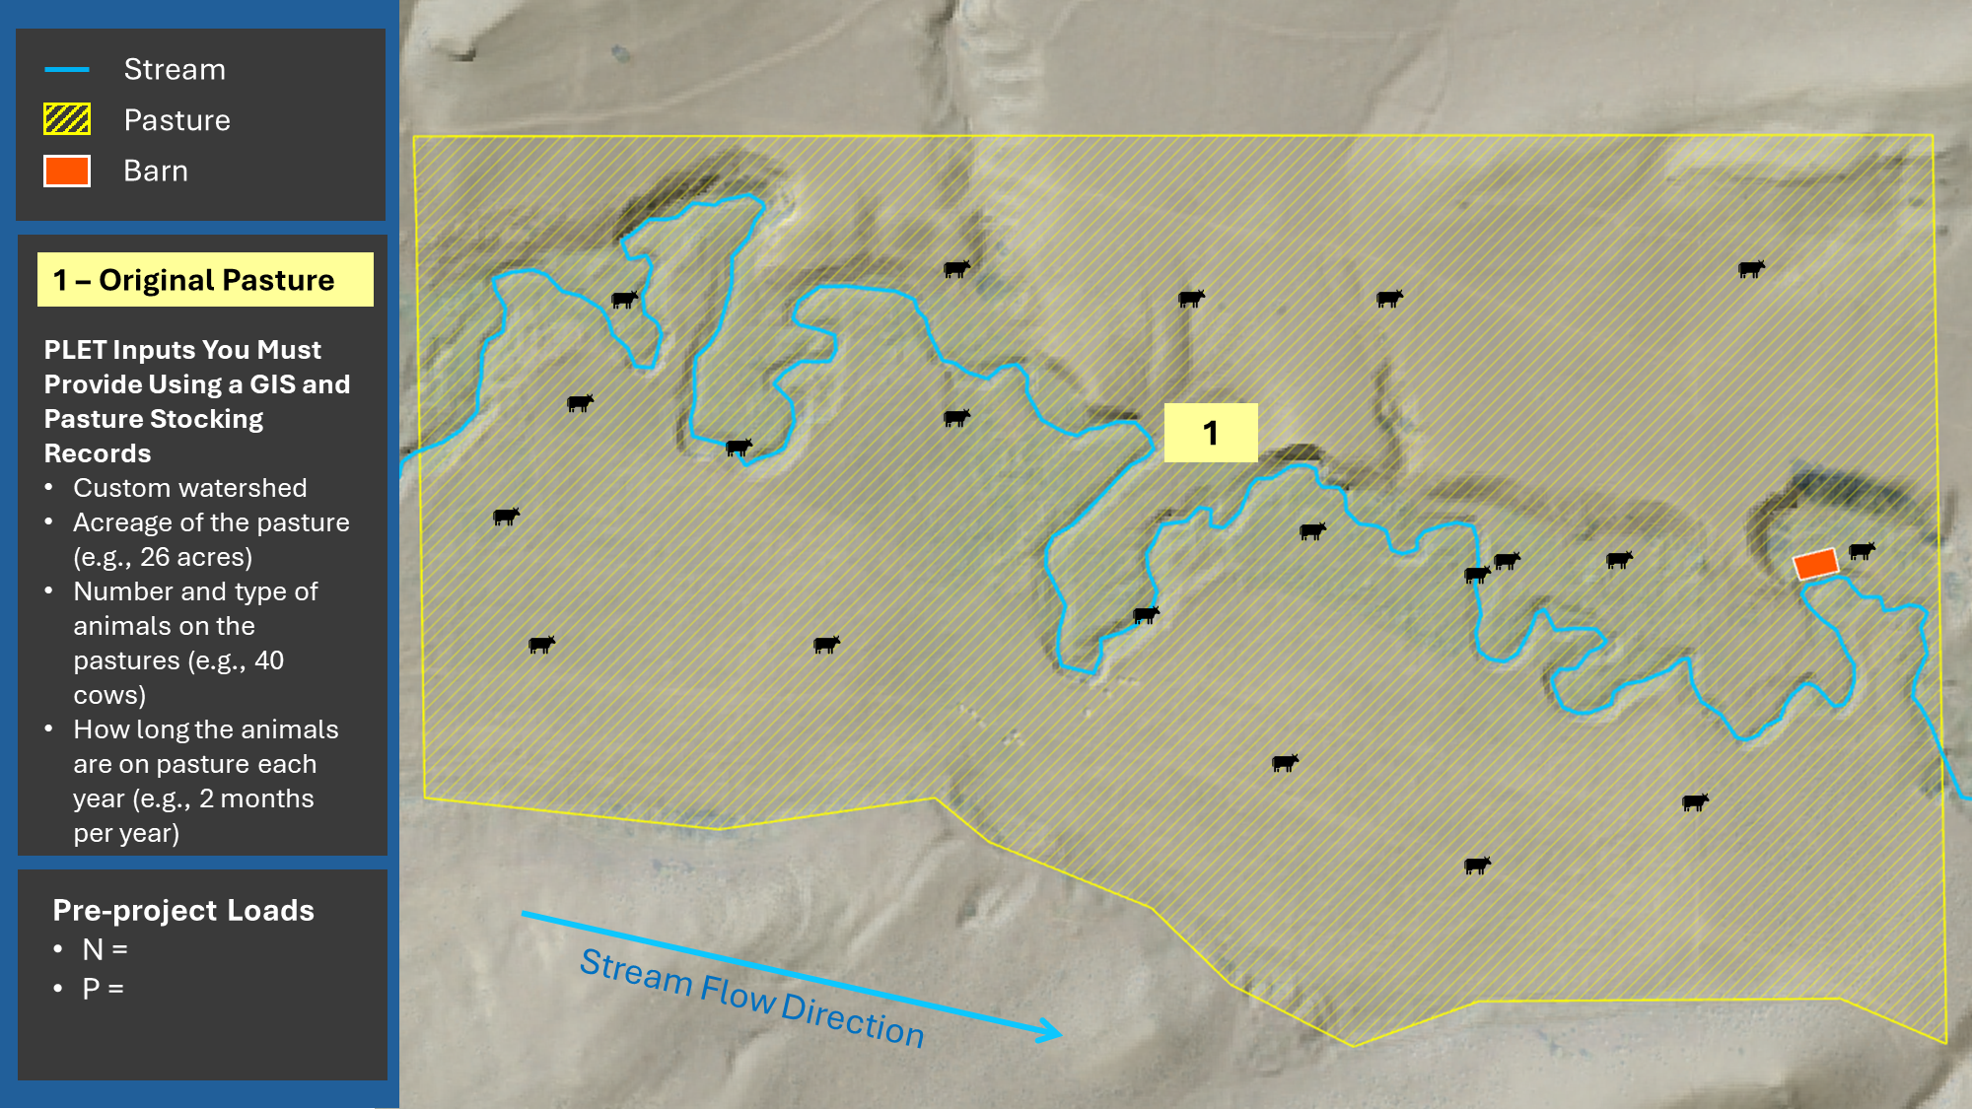
PLET Original Pasture
Notes:
Reminder of the before

Slide 22
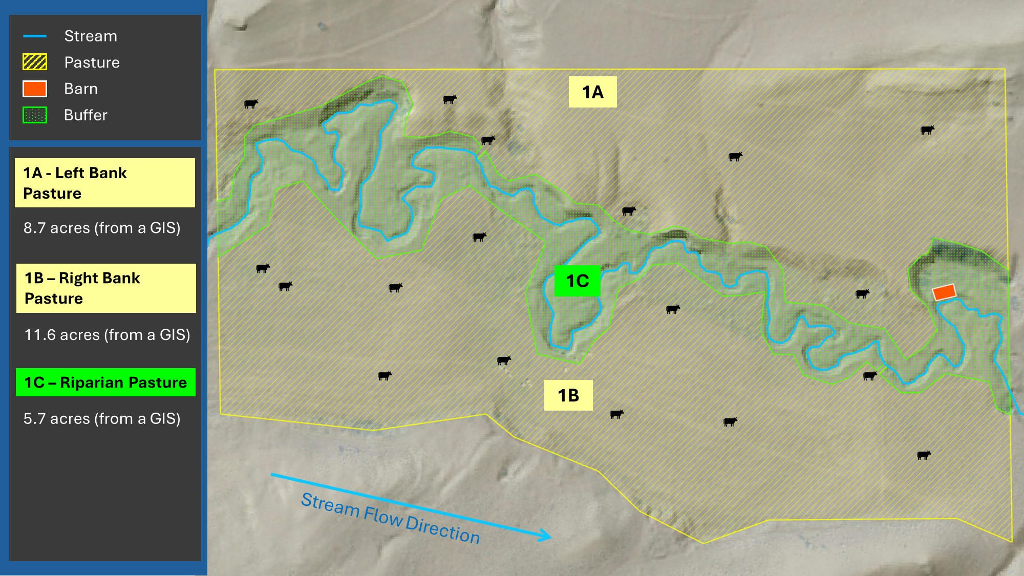
PLET Banks and Riparian Pasture Pre-Project
Notes:
Reminder of the before

Slide 23
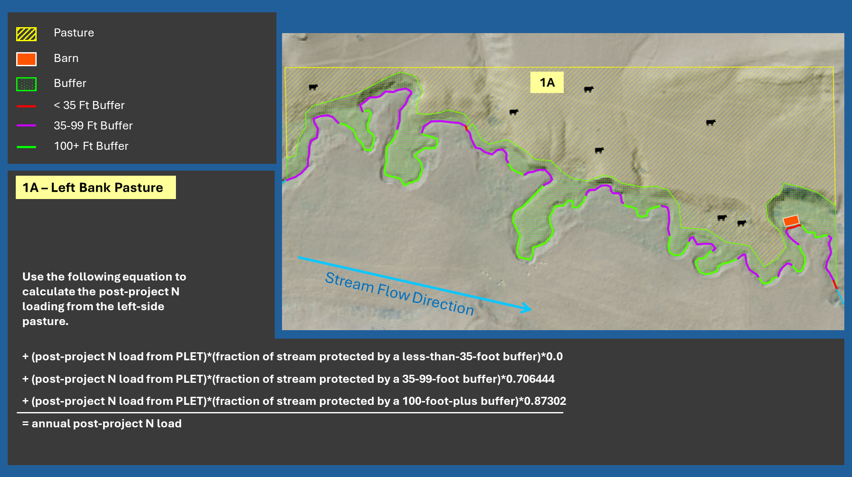
PLET Left Bank Pasture Post-Project Nitrogen
Notes:
Reminder of the before

Slide 24
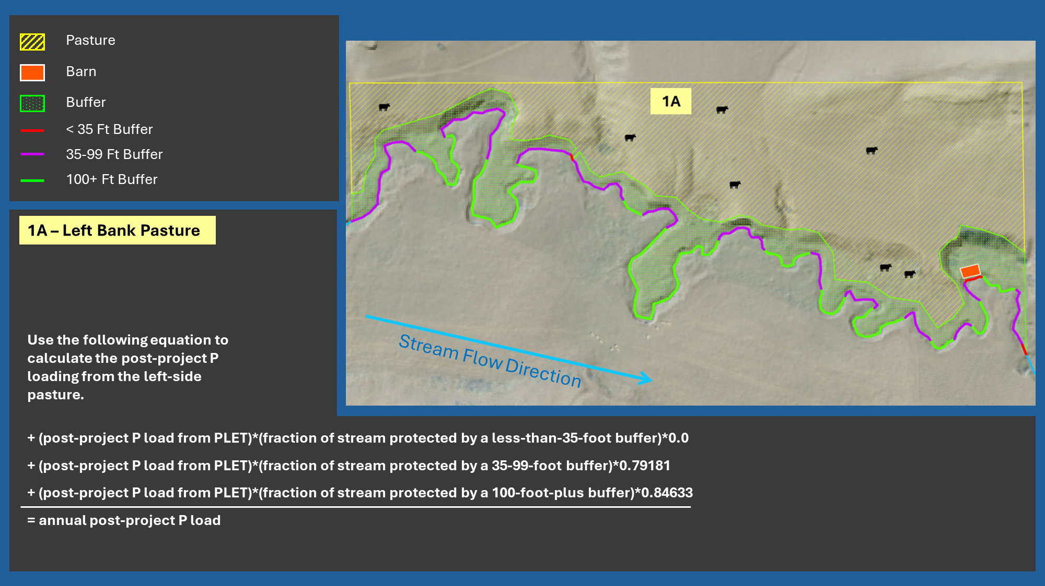
PLET left Bank Post-Project Phosphorus
Notes:
Reminder of the before

Slide 25
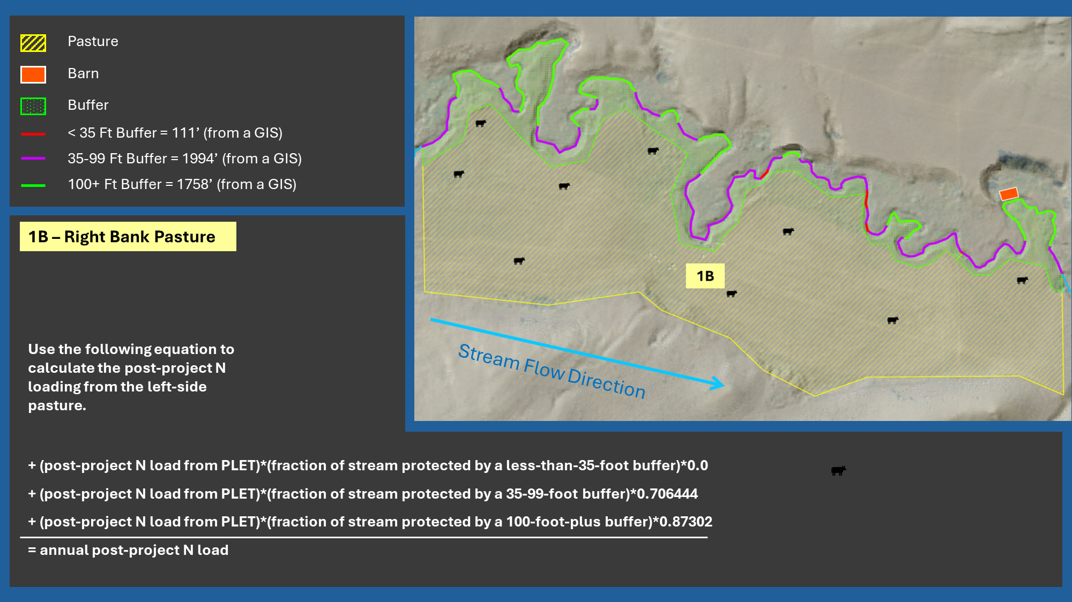
PLET Right Bank Post-Project Nitrogen
Notes:
Reminder of the before

Slide 26
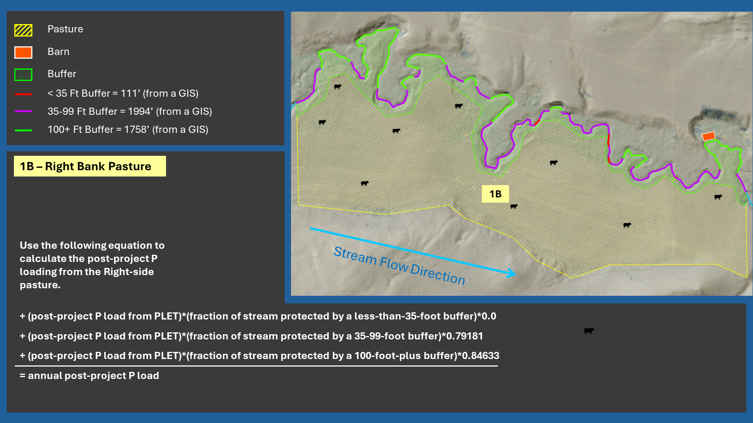
PLET Right Bank Post-Project Phosphorus
Notes:
Reminder of the before

Slide 27
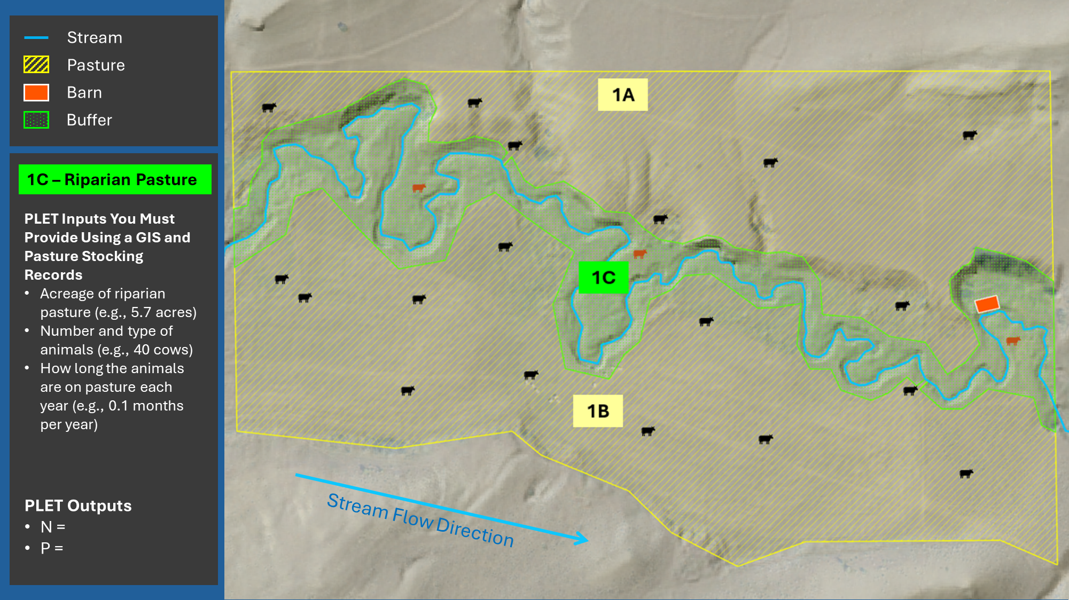
PLET Riparian Pasture
Notes:
Reminder of the before

Slide 28
Riparian Fencing Programs Based on the Number of Feet of Streambank
Use the following equations to calculate the load reduction attributable to the fencing project. Note: this will be the load reduction before applying any applicable trading ratios or accounting for grazing in the fenced buffer.
+ (pre-project N load estimate from PLET)
(left side pasture post-project N load)
(right side pasture post-project N load)
(post-project riparian pasture N load)
= N Load Reduction
+ (pre-project P load estimate from PLET)
(left side pasture post-project P load)
(right side pasture post-project P load)
(post-project riparian pasture P load)
= P Load Reduction
Notes:
Reminder of the before

Slide 29
Riparian Vegetation Programs Based on the Number of Acres Vegetated
Method Assumptions
The revegetated riparian buffer will be fully vegetated with native, site-appropriate vegetation, including native trees and shrubs where appropriate.
The revegetated riparian buffer will not be grazed, cropped, mowed, or hayed.
Weed control within the revegetated riparian buffer will be limited to mechanical removal or spot-spraying.
The buffer will not include any infrastructure (e.g., roads, trails, boat ramps, bridges, buildings, etc) within 35 feet of the ordinary high water mark (the edge of the streambank).
The revegetated riparian buffer will be at least 35 feet wide throughout. The buffer width must be calculated as a perpendicular, horizontal line drawn from the ordinary high water mark outward to the edge of the buffer strip or the nearest infrastructure, whichever is closer.
Notes:
Reminder of the before

Slide 30
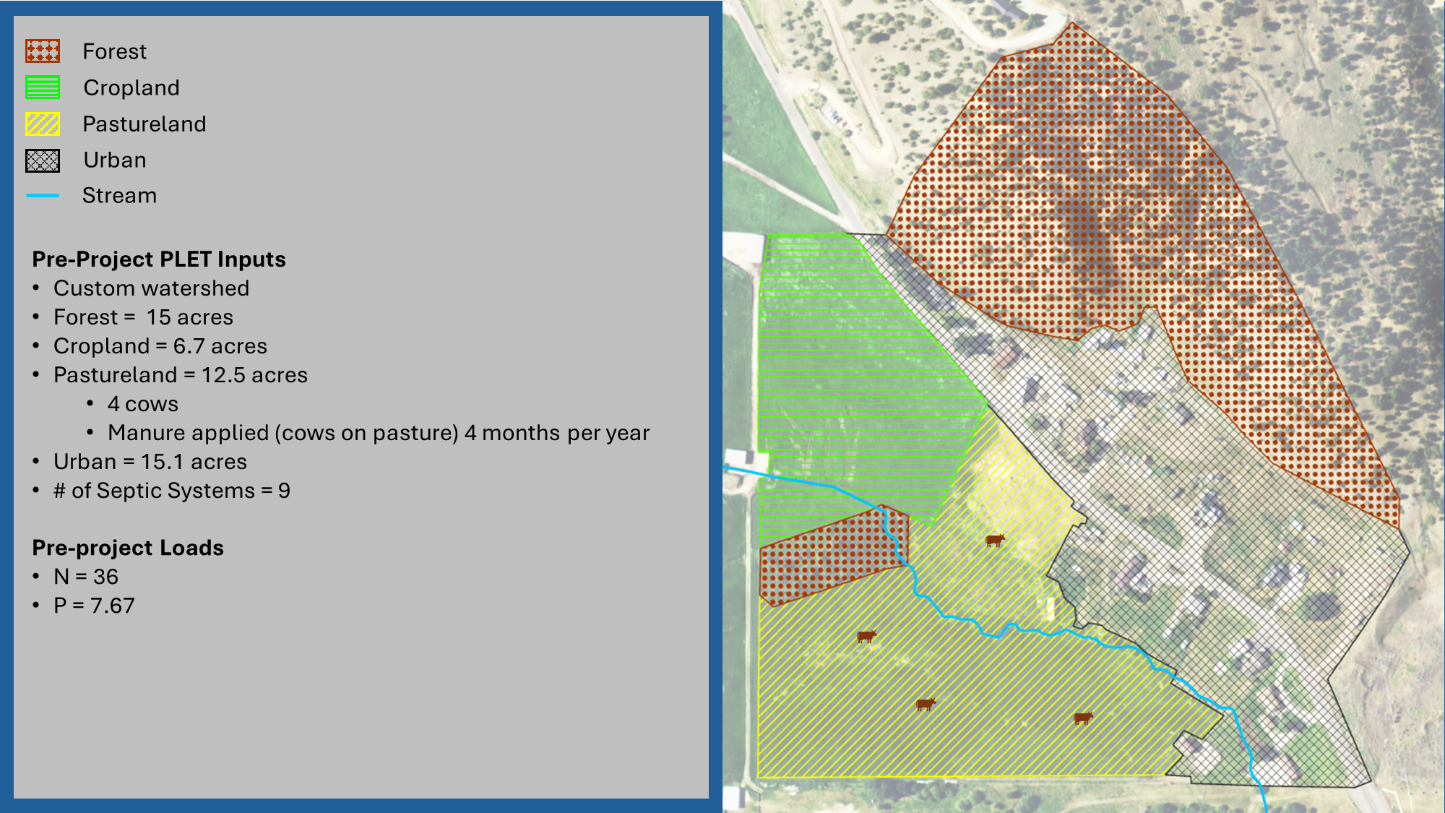
PLET Pre-Project Loads
Notes:
Reminder of the before

Slide 31
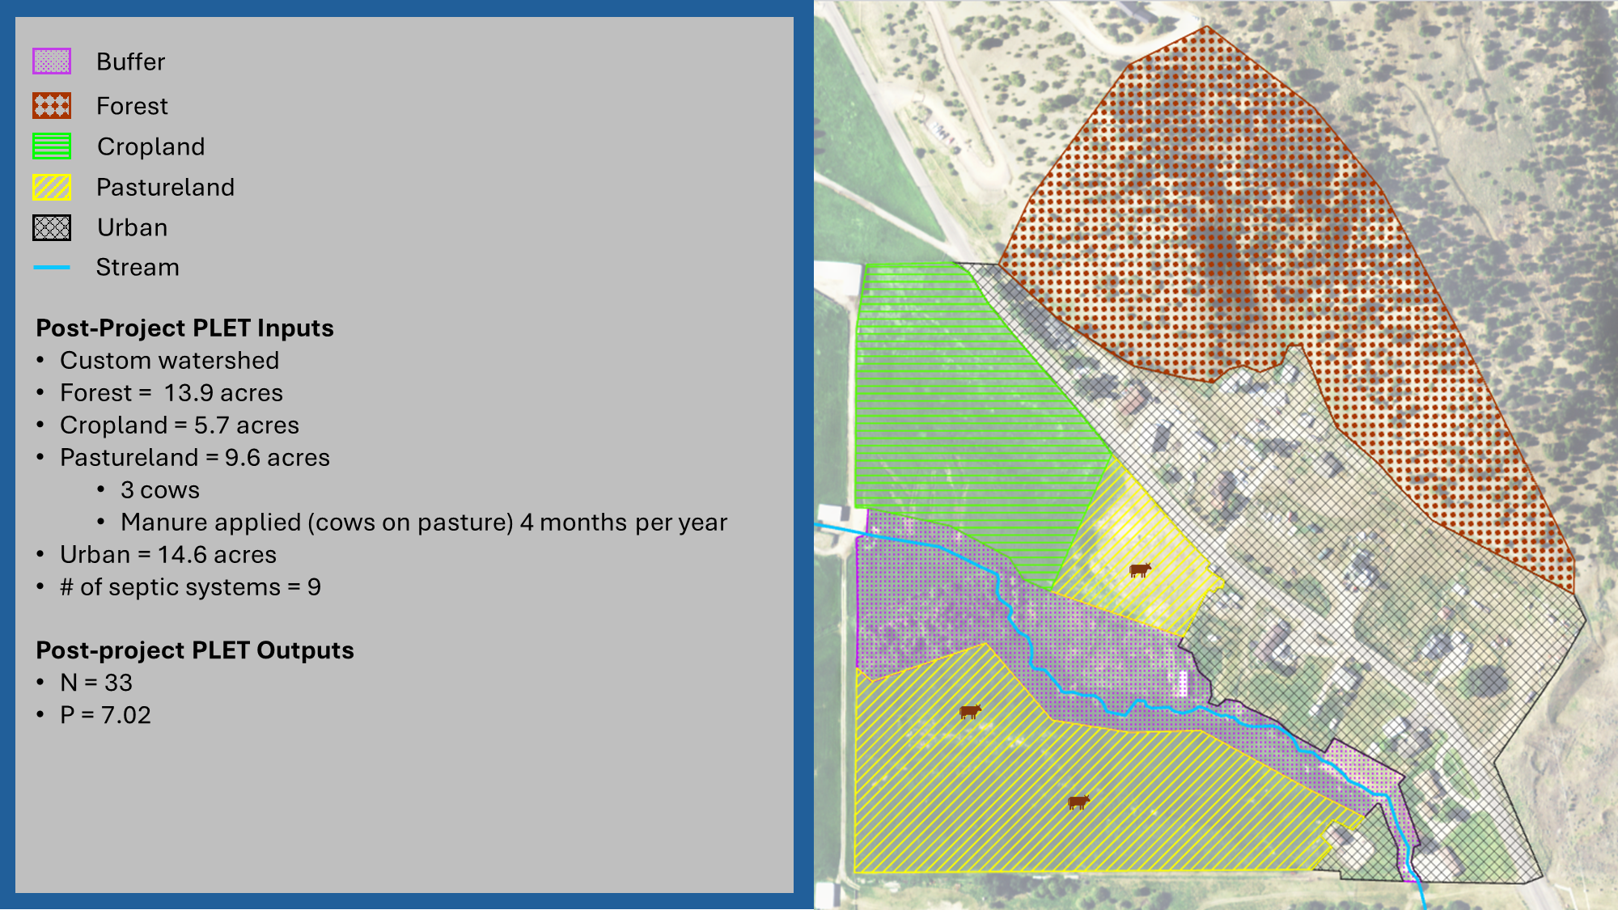
PLET Post-Project Loads
Notes:
Reminder of the before

Slide 32
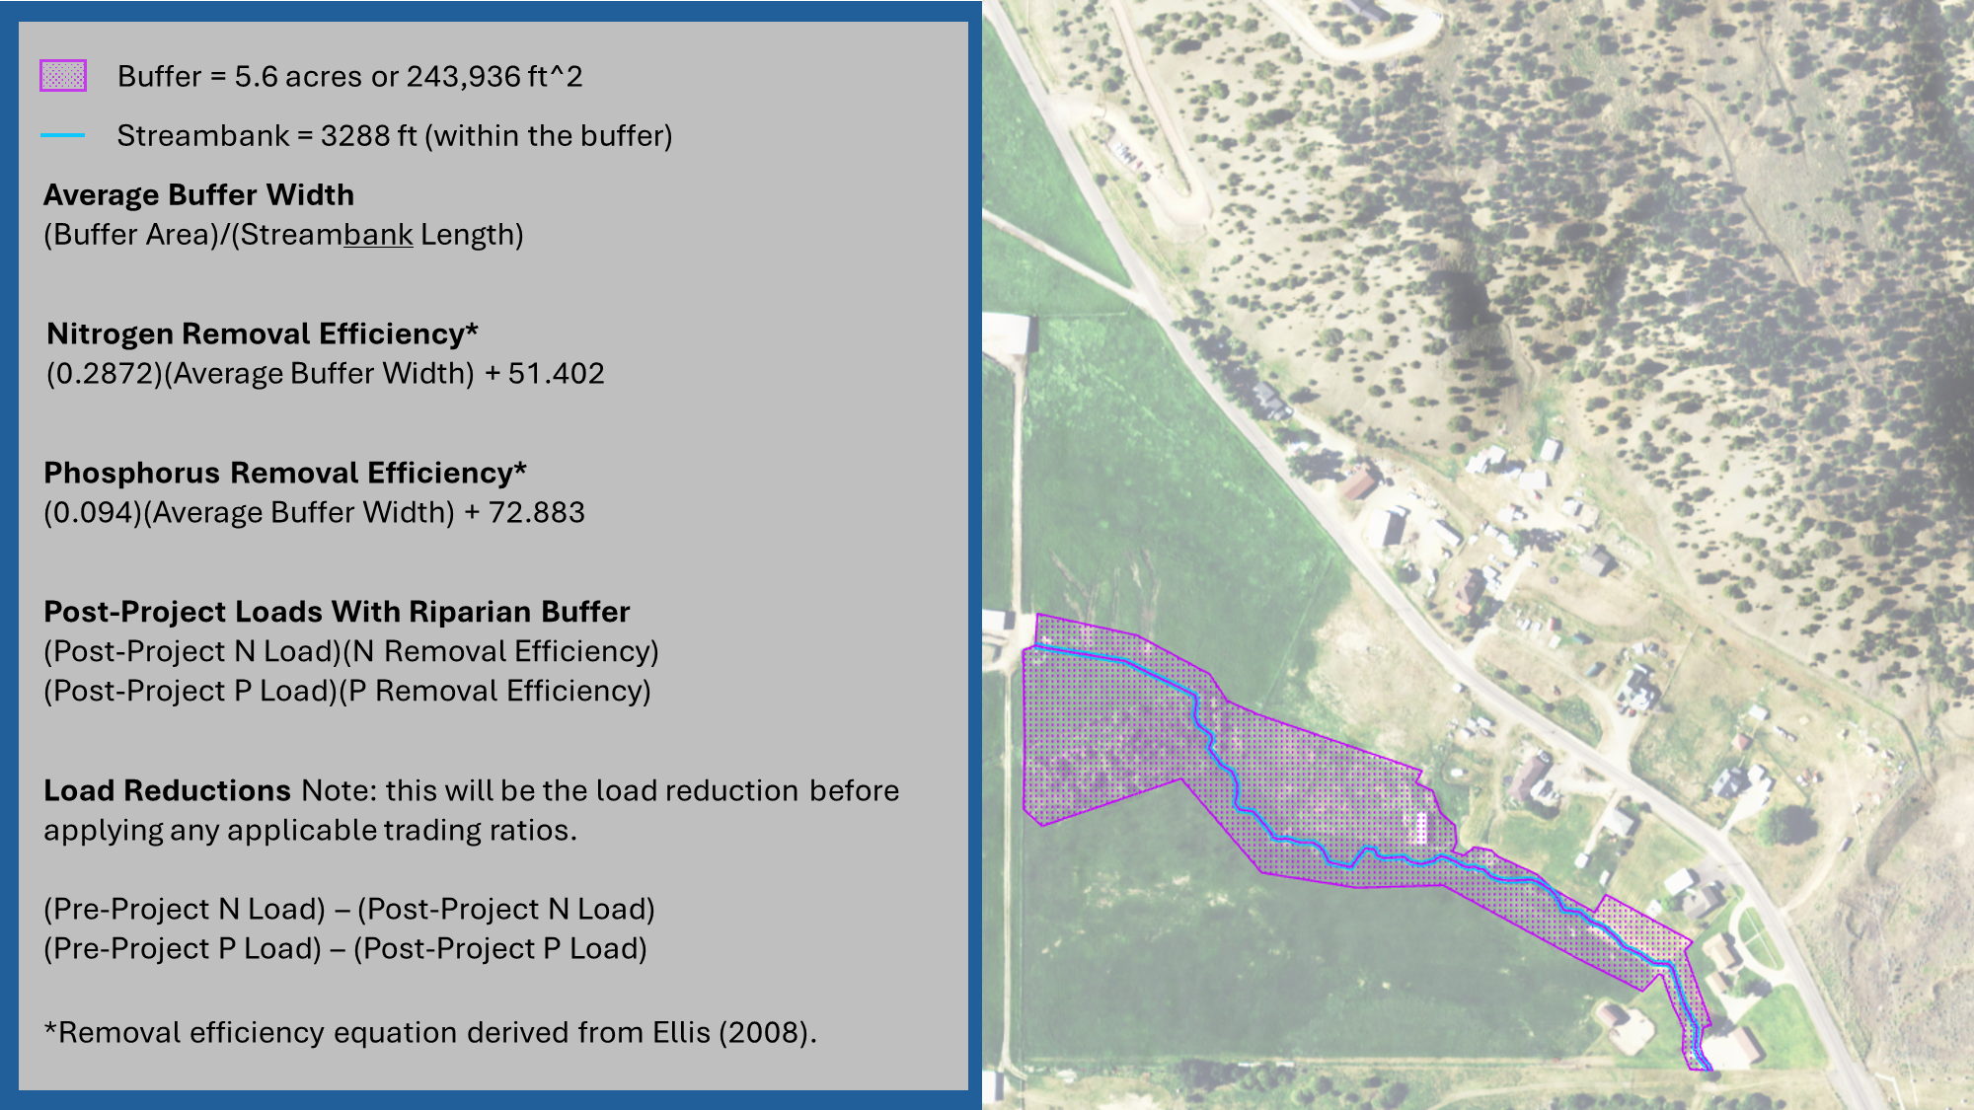
PLET Load Reduction Calculations
Notes:
Reminder of the before

Slide 33
Development of Wetlands in Areas of Irrigation Water Return Flows Based on the Number of Acres Associated With the Return Flows
Method Assumptions
The water entering the wetlands will be a mixture of unused irrigation water (sometimes referred to as irrigation tailwater), surface runoff from irrigated agricultural fields, incidental flows from stormwater runoff and groundwater return flows from irrigated ag lands.
The wetlands will be vegetated with native, site appropriate vegetation.
The wetlands will not be grazed, cropped, mowed, or hayed.
Weed control within the wetlands will be limited to mechanical removal or spot-spraying.
Notes:
Reminder of the before

Slide 34
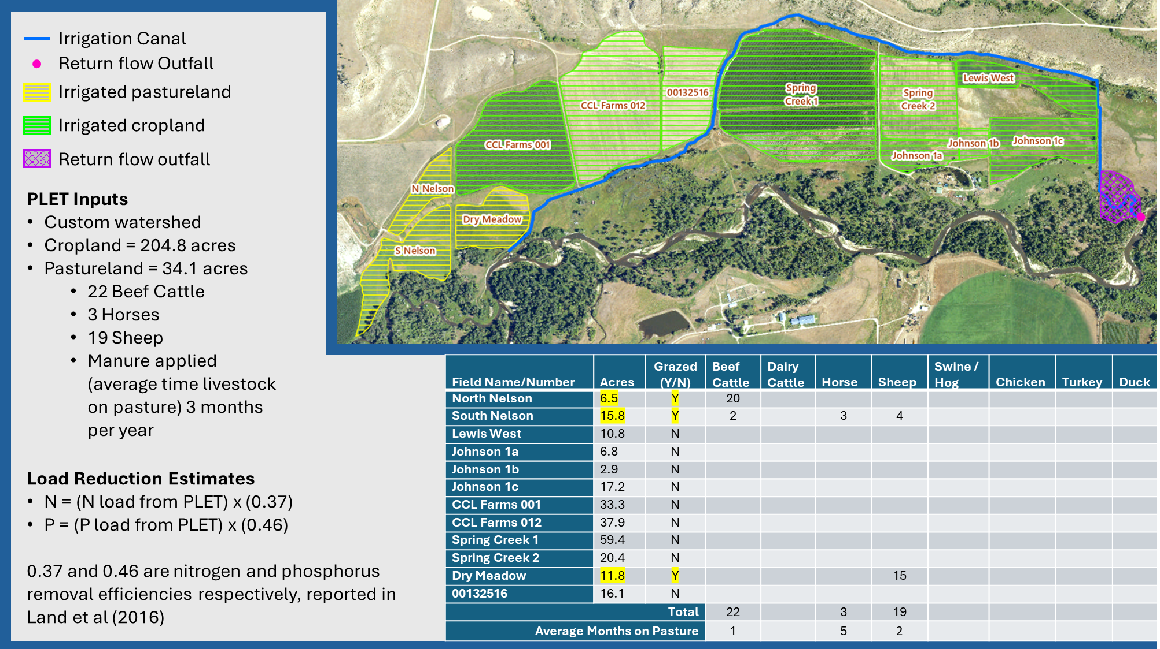
PLET Irrigation Canal Load Reduction Estimates
Notes:
Reminder of the before

Slide 35
Removal of Septic Systems Based on the Number and Size of Septic Systems Removed
Use the Method for Estimating Attenuation of Nutrients from Septic Systems (MEANSS model)
More info to come . . .
Notes:
Reminder of the before

Slide 36
Rulemaking Timeline Overview

Slide 37
Ideas for Future Topics

Slide 38

Questions/ Comments
Raise hand (*9 if on the phone) or type questions into the Q&A
DEQ will unmute you if you wish to provide your comment orally
If calling by phone, press*6 to unmute
State your name and affiliation before providing your comment

Slide 39
Net Reductions: House Bill 736
1(2)
Nutrient loading offsets and trading credits may be authorized for increases in or continuation of nutrient discharges when a net decrease in nutrient loading within the United States geological survey designated 12-digit hydrologic unit code subbasin, or immediately adjacent 12-digit hydrologic unit code subbasin when the project is in close proximity to the adjacent 12-digit hydrologic unit code subbasin, is achieved through reductions from other point sources or nonpoint sources within the subbasin, either up gradient or down gradient of the applicant.
1(3)
For reductions that satisfy subsections (2) and (4), the offset or trading credit must be measured as:
  100% of a reduction from point source discharges;
  80% of a reduction from an up-gradient, nonpoint source discharge; or
  50% of a reduction from a down-gradient, nonpoint source discharge.
Notes:
Reminder of the before

Slide 40
PS:PS Trades Coefficient of Variation (CV) Examples
Permit # | Facility | Duration (growing seasons) | Monthly Average CV¹ |  | Seasonal Average CV¹
 |  |  | TN | TP | TN | TP
MT0022608 | Bozeman | 2021-2025 | 0.19 | 0.34 | 0.13 | 0.23
MT0022012 | Butte-Silver Bow |  | N/A | 2.09 | N/A | 1.65
MT0022641 | Helena |  | 0.12 | 0.34 | 0.11 | 0.14
¹Average CV = Standard Deviation/Average
CV is based on the last 5 years of DMR data
  Could be truncated if there was an operational change (same as period of record for permit)
This process aligns with the methods permitting already uses
Taking a 90% improvement ratio may be the better option in some cases

