Slide 1
Nutrient Offset Trading Workgroup
July 9, 2026

Slide 2

Preliminaries
Roll Call
Approve May 21, 2026 meeting minutes and share any post-meeting thoughts or ideas
Agenda

Slide 3
Agenda
Discussion Topics
  DEQ-13 Proposed Updates Review
  Topics to revisit from May 21st
    PS to PS trades
    Addressing HB 736 4(c)
Wetland Credit Method
Program Promotion
General + Public Comment
Field trip

Slide 4

DEQ-13 and ARM
Proposed Updates Review

Slide 5

Topics to Revisit from May 21st

Slide 6
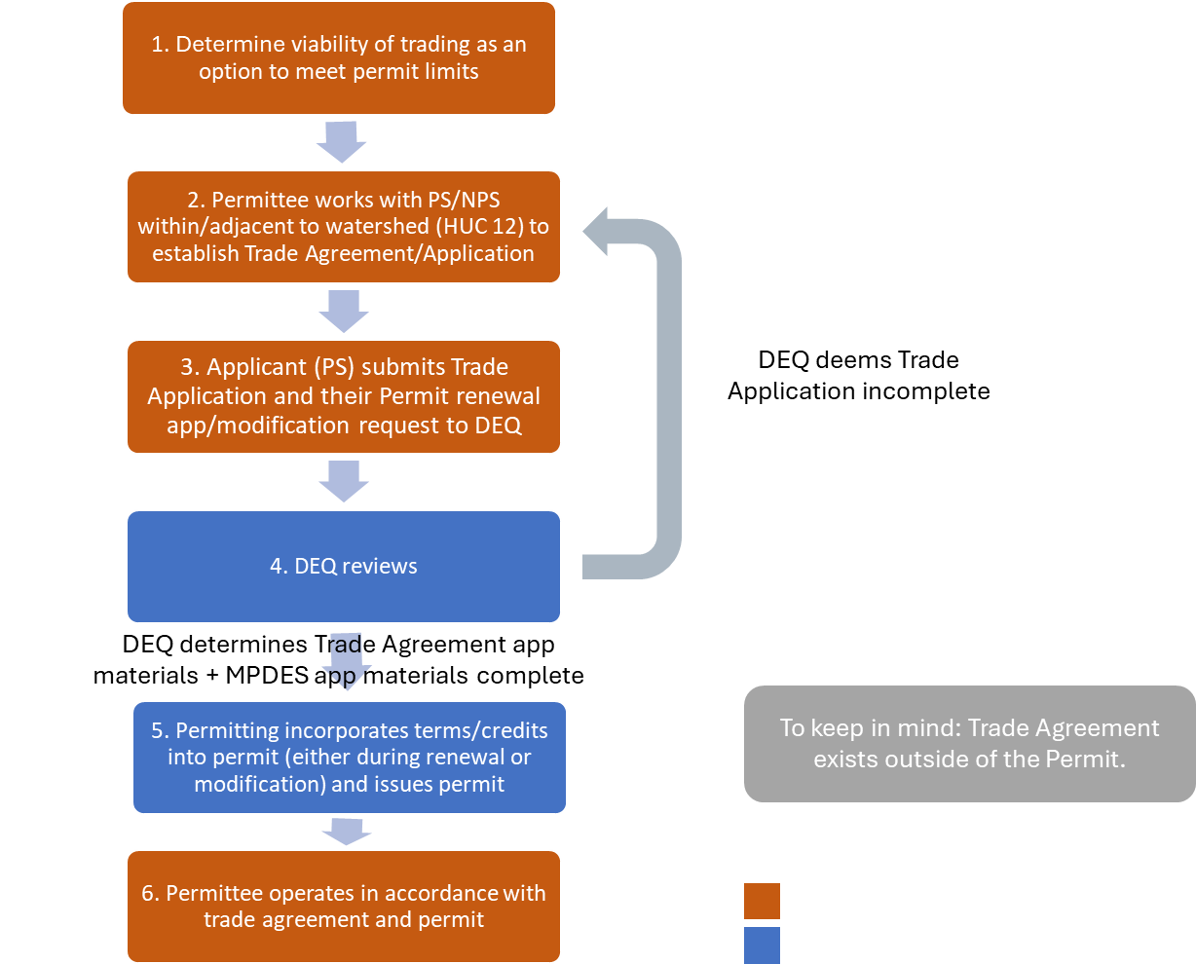
Process Flow presented during April 16 Meeting
= Permittee responsibility
= DEQ responsibility
Notes:
Reminder of the before

Slide 7
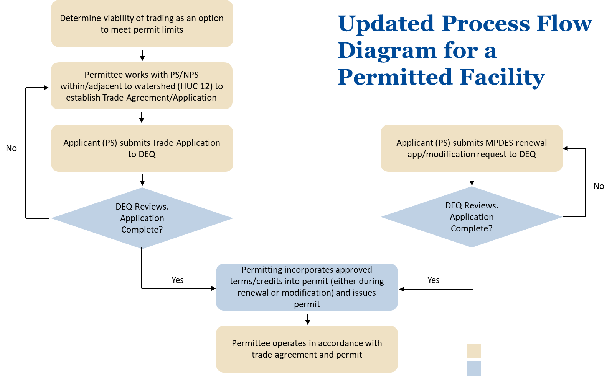
Updated Process Flow Diagram for a Permitted Facility
= Permittee responsibility
= DEQ responsibility
Notes:
Again stress that the only thing that really has to happen is that the credit has to be approved before we can incorporate credit into permit.
Should I include admin cont’d as a possibility here. Or keep it simple.

Slide 8
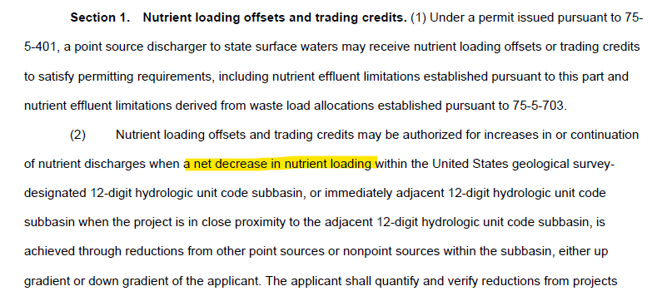
PS to PS Trades
HB 736:

Slide 9
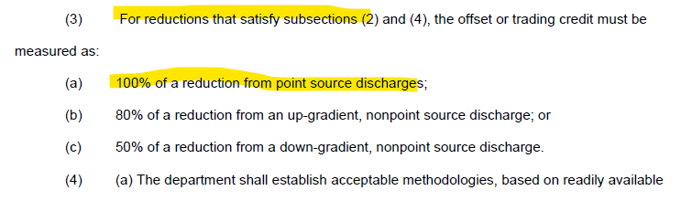
HB 736 Section 1 Cont’d:

Slide 10
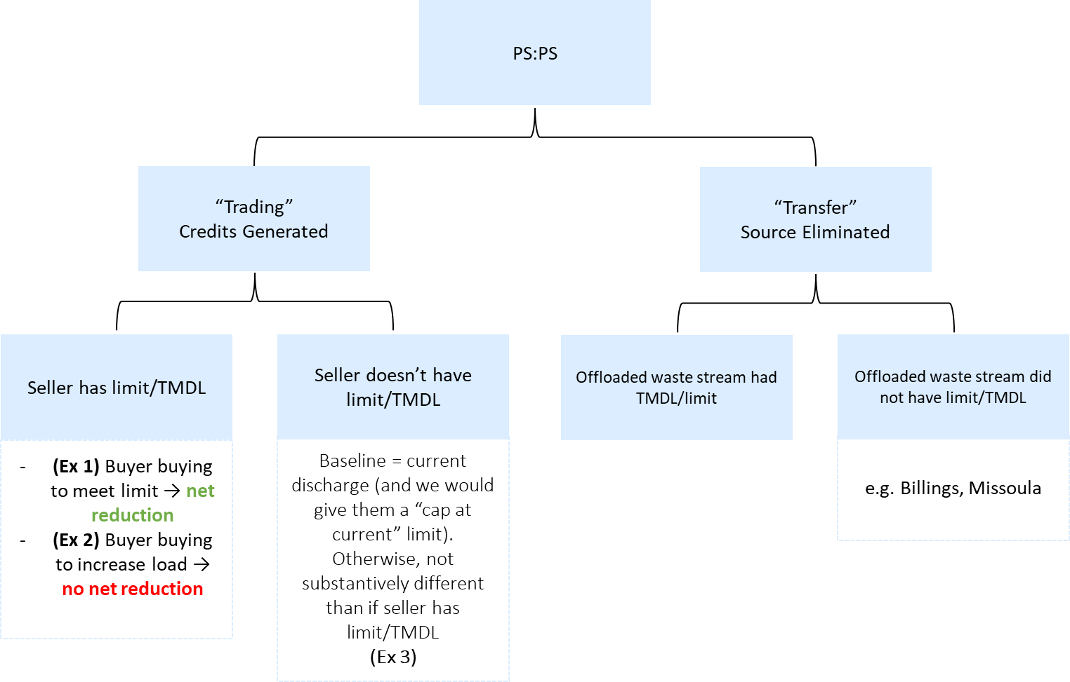
Point Source to Point Source Trades/Transfers

Slide 11
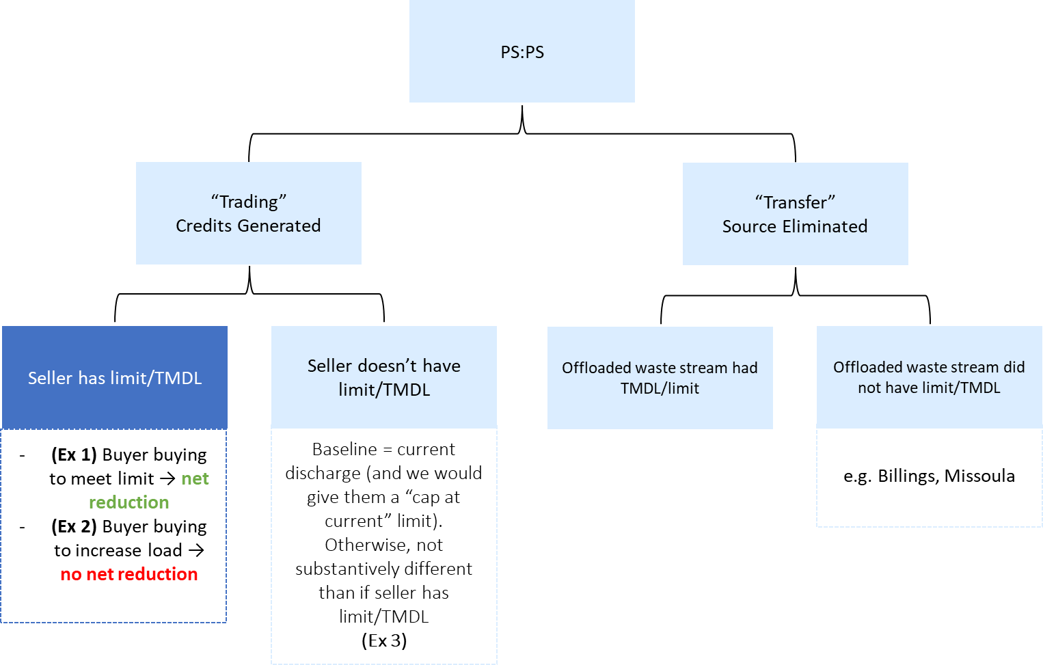
Point Source to Point Source Trades/Transfers (Cont’d)

Slide 12
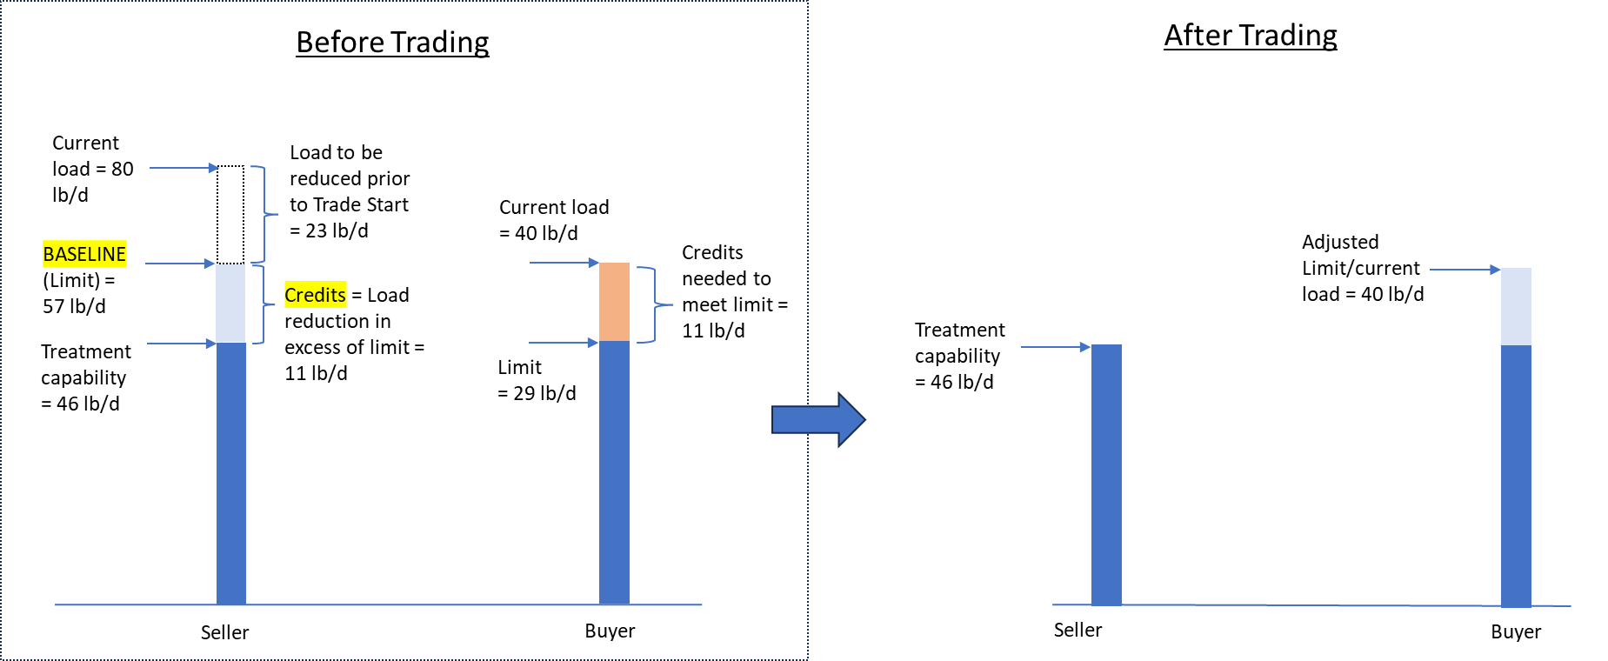
(Ex 1) Watershed Trading – Seller has limit/WLA.
→ “Buyer” buying to meet limit
Watershed load after trading = 46 + 40 = 86
97 → 86 Net Reduction
Watershed load once seller reaches baseline = 57 + 40 = 97

Slide 13
Point Source to Point Source Trades/Transfers (Cont’d)

Slide 14
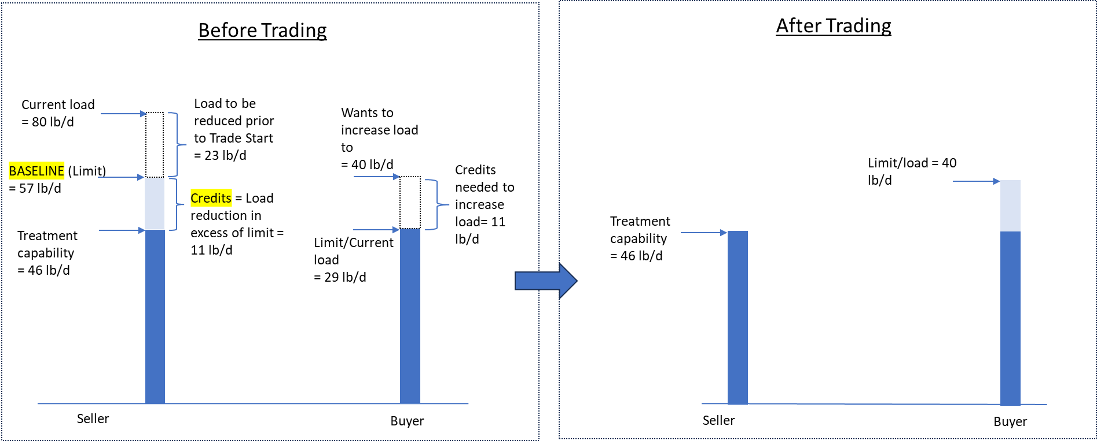
(Ex 2) Watershed Trading – Seller has limit/WLA
→ “Buyer” buying to increase load
Watershed load after trading = 46 + 40 = 86
86 → 86 No Net Reduction
Watershed load once seller reaches baseline = 57 + 29 = 86
Notes:
Narrative nonsig criteria: no measureable change to aq. Life.
To prevent oneself from being considered an increased source. are you meeting the mass-bass limits you had before.
AS: nonsig review and limit setting/wqbels. 2 separate processes.
Keep old mass-based limit.
Assim cap of receiving water hasn’t changed. But OK if net reduction.
Circular language about new/inc source.
Ver 3: Buyer just wants to increase load. Anticipating future not-meeting, though, I guess. So maybe this scenario doesn’t even make sense? I don’t think it does. I think they’d still have to calculate how many credits they would need based on that future hook-up or whatever. So when calculating, would probably be looking not at that current load of 29, but the anticipated future load of xx. ((so this would still be an issue of “meeting limit” bc they’d have that same limit they’d have to meet)
ER– could be scenario of trying to avoid nondeg. Trading in order to not be a new/inc source.
(KEEP THISS LIDE IN) this is ok, can trade to inc load, not jsust meet limit.
Nondeg probably ok in this scenario for above scenario.
Kurt: just make sure statute/regs check out IR%-wise
Doesn’t need help meeting limits. In this case, would just be moving stuff around
Let’s say there was TMDL cap of 57+29 = 86. TMDL cap would be met. (in this scenario, there’s no real difference between “TMDL” and “limit.)
Is nondeg bypassed here because net decrease?? I’m

Slide 15
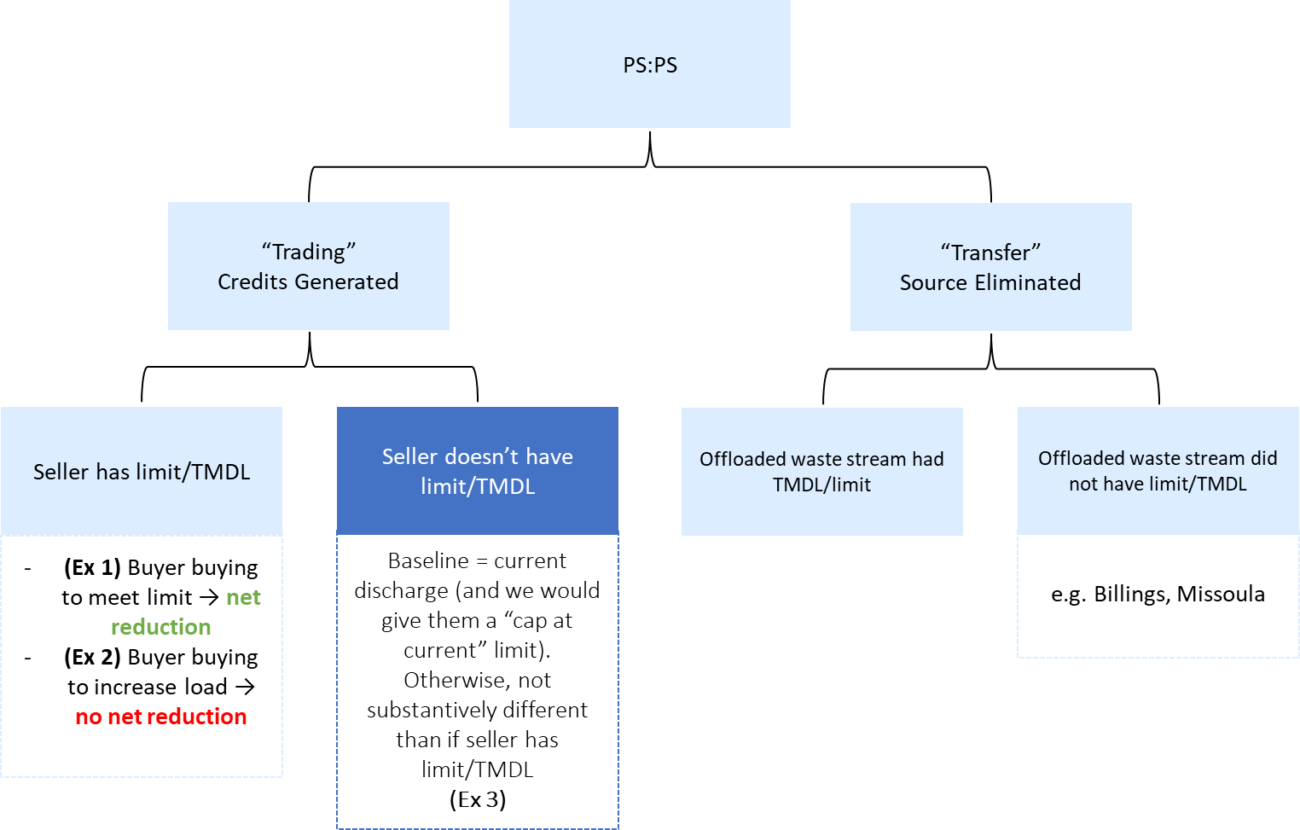
Point Source to Point Source Trades/Transfers (Cont’d)

Slide 16
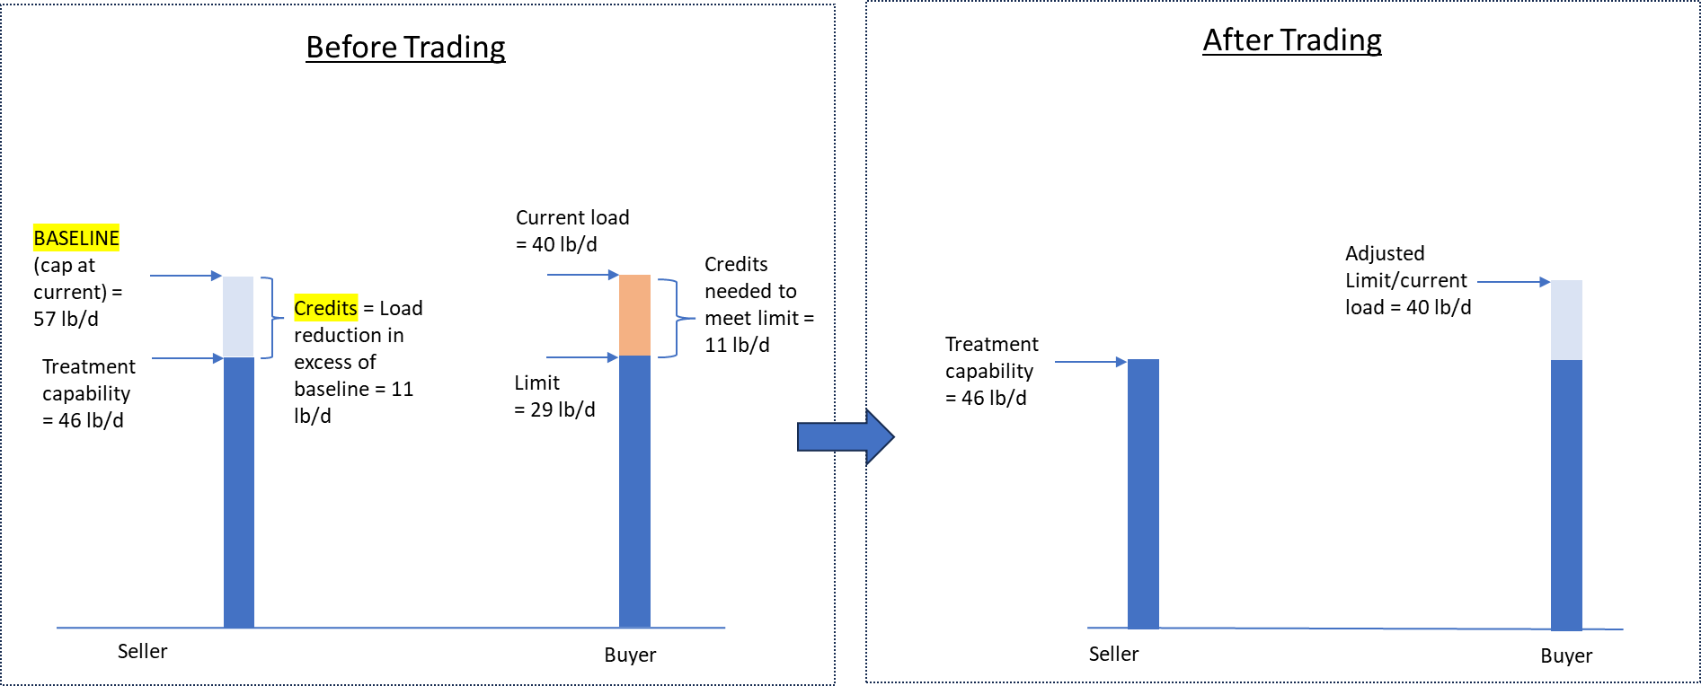
(Ex 1) Watershed Trading – Seller has limit/WLA.
→ “Buyer” buying to meet limit
Watershed load after trading = 46 + 40 = 86
97 → 86 Net Reduction
Watershed load once seller reaches baseline = 57 + 40 = 97
Notes:
Essentially, this would look similar to if the seller did have a limit, except they wouldn’t have to treat down to anything first. Their Current Load would just act as their baseline, and they can trade whatever credits they can generate below baseline. We would just look to see whether a net reduction has occurred or not.
______
Timing considerations
Pre-TMDL trading (EPA) doc. Right before they get WLA. Look for this doc. Kyle added to chat/site. Similar concept. Trading to get ahead of something.

Slide 17
PS:PS Trades (cont’d)
Trade must result in net reduction of nutrient load in watershed
  Where net reduction is not achieved: Improvement Ratio (90%)

Slide 18
Other Changes Required for Successful Implementation
Notes:
Other ideas for building in practice standards?

Slide 19
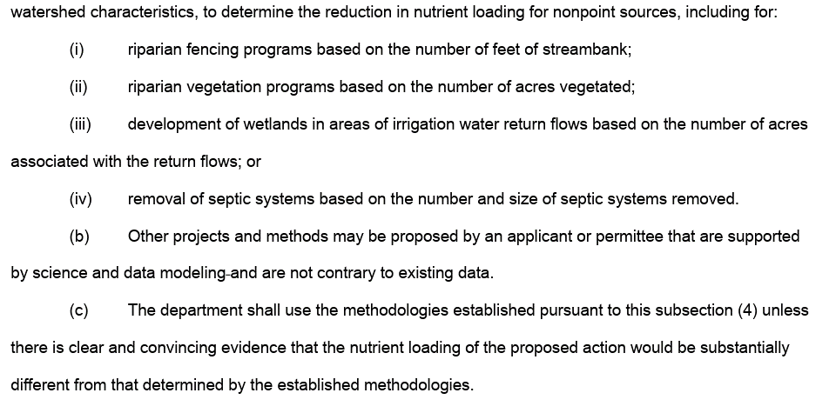
HB736 Section 4c

Slide 20
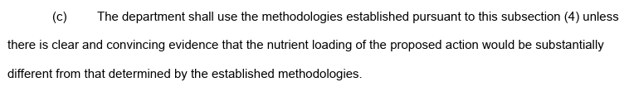
Other Changes
↑ HB 736 versus ↓ Current DEQ-13
A person proposing to implement a BMP may calculate load credits using an applicable method described in Appendix A as guidance. Alternatively, a person may calculate load credits using any other method applicable to the site where a BMP will be implemented. DEQ will review each proposed load calculation during the application process prior to approving its use in a MPDES permit.
Notes:
Last meeting team did not think these were in conflict

Slide 21
Consider….
3. Examples of Obtaining Nutrient Credits
Credits may be obtained by: a) implementing any of the options listed below, or b) implementing other options that may be proposed on a case-by-case basis through the MPDES public participation process.
A person proposing to implement a BMP may calculate load credits using an applicable method described in Appendix A as guidance. Alternatively, a person may calculate load credits using any other method applicable to the site where a BMP will be implemented. DEQ will review each proposed load calculation during the application process prior to approving its use in a MPDES permit.
Use of standard methodologies and limited exception under 75-5-412(4)(c), MCA. The department shall use the standard methodologies established in this circular (Appendix A) to quantify nutrient loading and load reductions for offsets and trading credits. The department may establish additional methods by approving those proposed by an applicant if they are supported by science and data modeling and not contrary to existing data. The department may depart from or materially adjust a standard methodology for a specific project only if it determines, based on clear and convincing evidence, that use of the standard methodology would result in nutrient loading or load reductions that are substantially different from the expected nutrient loading or load reductions provided by the standard methodology. Any departure or adjustment under this subsection must be documented. The documentation must identify the applicable standard methodology, describe the evidence relied upon, and explain why that evidence satisfies the clear-and-convincing standard and supports the alternative method or adjustment.
Notes:
Retain clear and convincing in the definition section.

Slide 22
Other Changes
DEQ will review the application to trade and evaluate it based upon the requirements described in this policy. DEQ may approve the application, approve it with conditions, or deny the application. The approved trade will be included in a draft MPDES permit and public comment on the trade will be accepted during the formal public comment period required for all MPDES permits. DEQ approval is not final until the MPDES permit is issued incorporating the trade.
↑ Current DEQ-13 ↓ Proposed DEQ-13
Consistent with ARM 17.30.1701, an owner or operator of a point source discharge may submit an application for nutrient trading to DEQ prior to or concurrent with an application for a new, renewed, or modified MPDES permit. DEQ will review the application to trade and evaluate whether the proposal is suitable for inclusion in a draft MPDES permit, based upon the requirements described in this circular. Based on this evaluation, DEQ may determine that the proposal is acceptable as submitted, acceptable only with additional conditions, or not acceptable. A trading proposal that DEQ determines is acceptable will be described in a draft MPDES permit and will be subject to public comment during the formal public comment period required for MPDES permits. A trade is not approved or effective until DEQ issues a final MPDES permit incorporating the trade as enforceable permit conditions.
Notes:
Last meeting team did not think these were in conflict

Slide 23
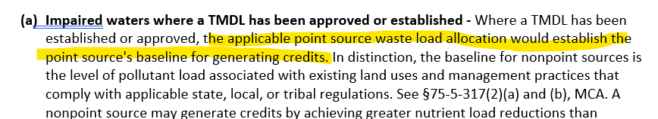
Other Changes
Current Circular-13, Section II(1)(a):
Proposed language for highlighted portion:
“the baseline for point sources would be established by the final water quality-based effluent limitation based on the applicable point source wasteload allocation.”

Slide 24
Wetland Credit Method

Slide 25
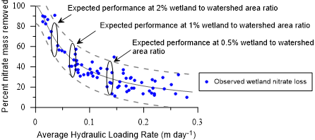
Wetland Credit Method
"development of wetlands in areas of irrigation water return flows based on the number of acres associated with the return flows."
No existing state program addresses irrigation return flow wetlands in precisely this way.
Iowa’s Conservation Reserve Enhancement Program
  Context: tile drainage systems
  Mass balance monitoring (inflow-outflow) of representative subset of enrolled wetlands
Estimated TN and TP removals based on wetland/service area ratio
Wetland/Service Area Ratio | Estimated TN Removal | Estimated TP Removal
< 0.5% | Not eligible | Not eligible
0.5%–1.0% | 40–50% | 20–30%
1.0%–2.0% | 50–70% | 30–45%
> 2.0% | Up to 90% (measured only) | Up to 55% (measured only)
Notes:
Annual.

Slide 26
Wetland Credit Method
TN and TP load reductions from two study wetlands (Selkirk and Mandeville) using monitoring data
Study Wetland | Wetland Acreage | Acreage Assoc. w/ Irrigation Return | Wetland Acreage (%) | TN Load Reduction (lbs/day) Measured | TP Load Reduction (lbs/day) Measured | TN Load Reduction (%) | TP Load Reduction (%)
Selkirk | 73 | 362 | 20 | 0* | 0.014 | 0* | 21
Mandeville | 19 | 8738 | 0.2 | 21.2 | 3.4 | 59 | 76
TN and TP load reductions using PLET
Study Wetland | TN Load In PLET (lbs/day) | TP Load In PLET (lbs/day) | TN Load Reduction (lbs/day) Modeled | TP Load Reduction (lbs/day) Modeled
Selkirk | 1.7 | 0.26 | 1.0 | 0.098
Mandeville | 8.2 | 1.8 | 3.7 | 0.45
Estimated TN and TP removals based on wetland/service area ratio
Wetland/Service Area Ratio | Estimated TN Removal | Estimated TP Removal
< 0.5% | Not eligible | Not eligible
0.5%–1.0% | 40–50% | 20–30%
1.0%–2.0% | 50–70% | 30–45%
> 2.0% | Up to 90% (measured only) | Up to 55% (measured only)
All credits likely to begin with modeled reductions (mid-range of estimated removal efficiencies)
Measured reductions can always generate additional credit, applicable for the the next 5 year renewal cycle
Life span = 15 years for modeled credits, in perpetuity for consistently measured credits
Notes:
Annual.

Slide 27
Program Promotion

Slide 28
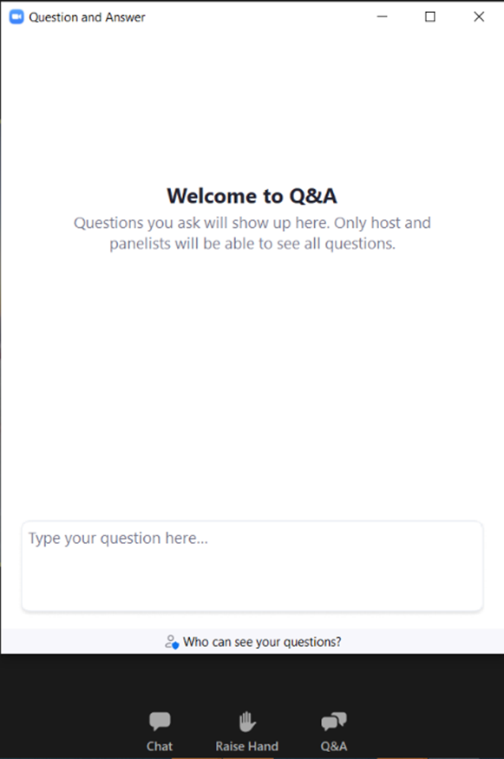
Questions/ Comments
Raise hand (*9 if on the phone) or type questions into the Q&A
DEQ will unmute you if you wish to provide your comment orally
If calling by phone, press*6 to unmute
State your name and affiliation before providing your comment

