Slide 5
Past Highlights (2015 – 2022)

Slide 6
Past Energy Storage Highlights - Summary
Project | Analysis | Completion
Beck Hill Microgrid |  | 2015
Blunt, SD | 2017 - 2019
Twin Bridges | 2020
West Thumb Microgrid |  | 2020
Missoula KWL Testing | 2020
Bechler Microgrid |  | 2021
Madison Valley & Melville | 2021
Geraldine (2.4MW – ~4 hrs) | 2022 | 2024 (est.)
RRR Analysis (36 sites) | 2022-2023

Slide 7
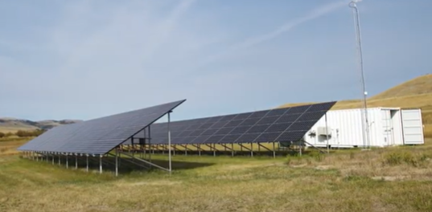
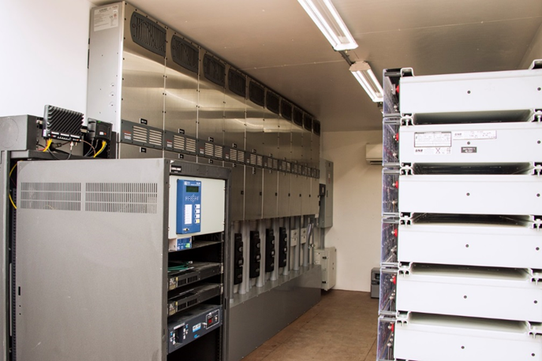
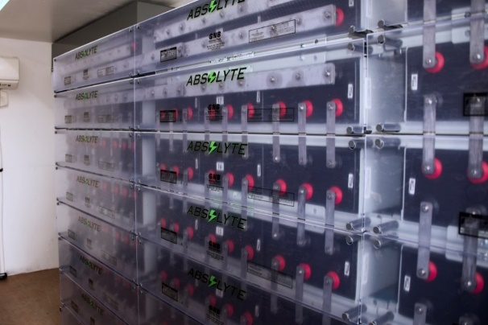
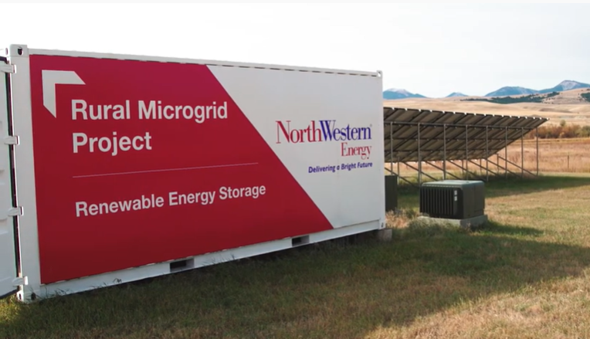
Beck Hill Rural Microgrid (MT)
Beck Hill (2015)
Purpose:
Proof of concept demonstration of grid connected energy storage & solar PV, for the purpose of supplying backup power to 17 homes in a rural subdivision upstream outages. System operates as an islanded microgrid during outage events.
Overview (Off-grid):
Lead Acid Batteries
80 KVA
130 kWh to 80% discharge
48 volt DC
40 kW S
32 kW DC Coupled
8 kW AC Coupled
Inverters
Battery 10 – 8 kW
Solar 10 – 4 kW
SEL RTAC – Automation Control
Notes:
Enclosure is visible from I-90
Transformer
Gridco unit – in-line power regulator

Slide 8
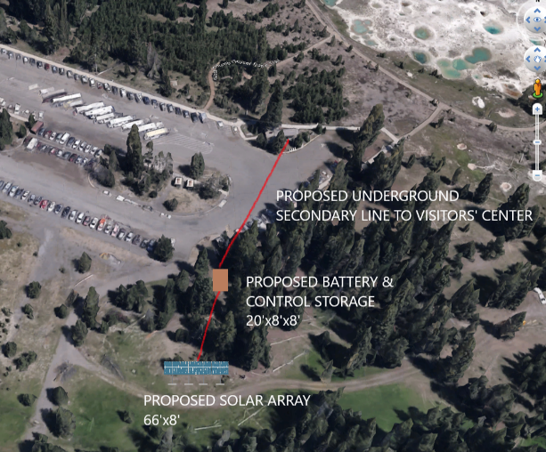
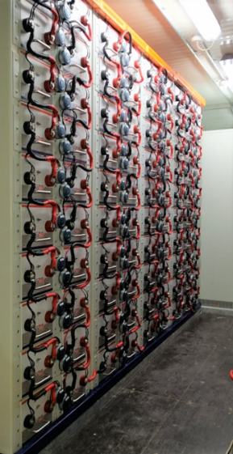
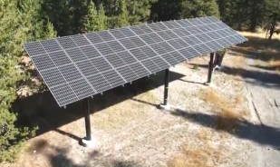
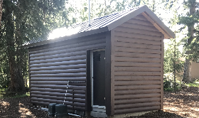
West Thumb Microgrid (YNP)
West Thumb (2020)
Purpose:
Power remote convenience store at West Thumb.
Overview (Off-grid):
18KW inverter/6 KW per phase - 208 3 phase output
200 kWh Storage
- SuperCap Battery Modules
14.08 KW DC Solar
- 3 separate strings to allow bottom string to be covered in snow.
- Adjustable racking to minimize snow load and maximize production and animal protection
Note: No Backup Generation. No HVAC. Operated throughout winter
DNP3 Communications

Slide 9
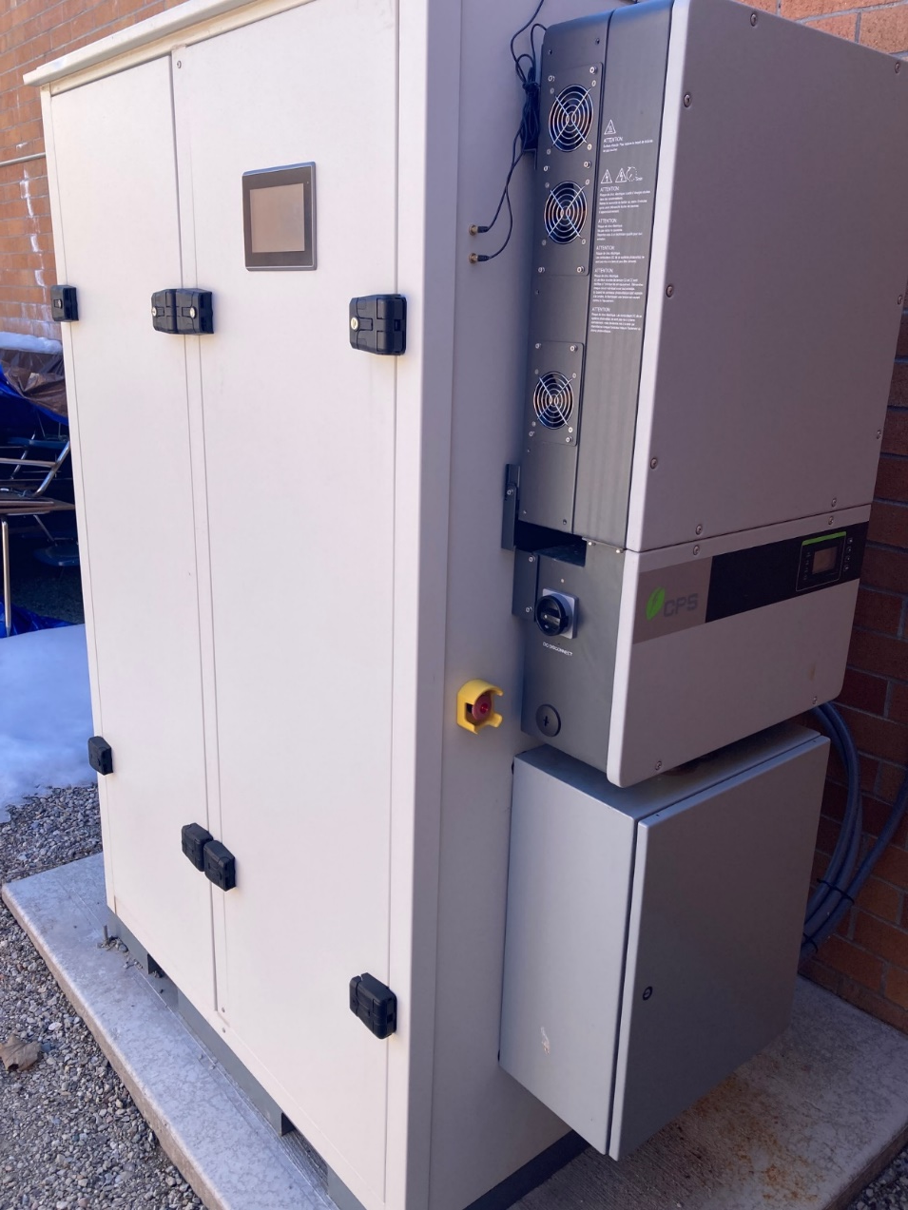
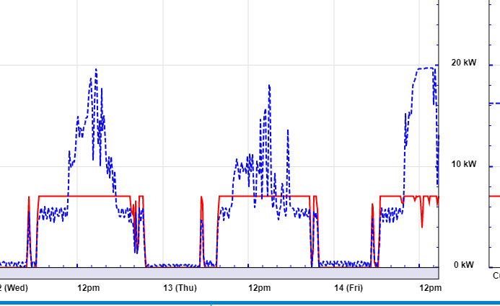
Big Sky High School
Big Sky High School (2021,2022)
Purpose:
Test the ability to virtually charge and discharge battery based on PV production and load. Battery should use PV first to charge and manage load, with the grid as a last resort.
Grid-tied storage:
2 – 30 KW inverters
130 kWh Storage
NMC
AC Coupled Solar PV

Slide 10
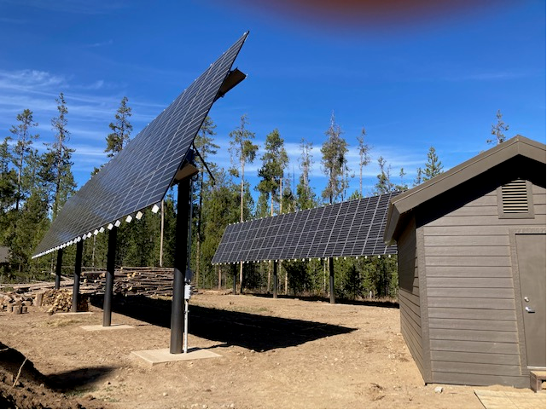
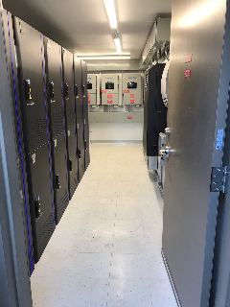
Bechler Ranger Station Microgrid (YNP)
Bechler Ranger Station (2021)
Purpose:
Bechler provides power to 3 homes, historic district, visitor center and 4 RV Sites. Very remote access (12 mi of gravel road).
Overview (Off-grid):
5 - 9KW inverters (45kW)
120/240 phase output
192 kWh Storage
Lithium Iron Phosphate (LiFePO4)
39.6 KW DC Solar
Adjustable racking to minimize snow load and maximize production
45 KW Propane Generator
DNP3 communications
RTAC Site Controller
Winter shut down

Slide 11
Energy Storage Concepts

Slide 12
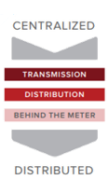
Revenue streams for storage
Energy storage has many uses cases and can be installed in the following locations:
Transmission
Distribution
Behind the meter or in-front
Transformer/customer level
Revenue streams can be realized from different connection points.
Use Cases
RMI-TheEconomicsOfBatteryEnergyStorage-FullReport-FINAL.pdf

Slide 13
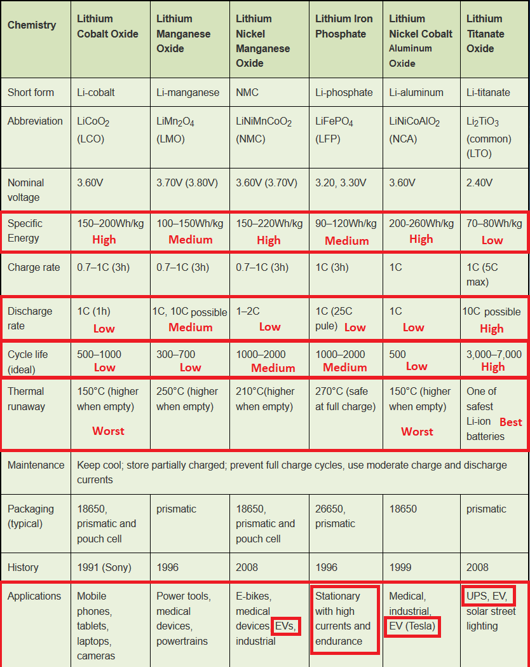
Type of Lithium Storage

Slide 14
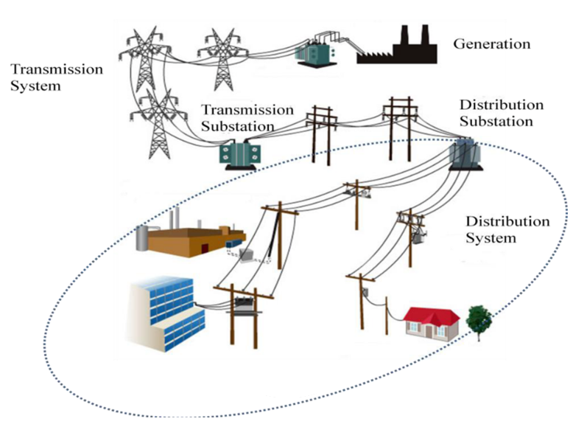
Market Overview
1
RRR Program &
Capacity Program
2
DCFC EV Load Management
1
3
Single Phase Microgrid &
3
Sectionalized Microgrids (Fire Safety)
2
4
In-Front of meter storage
5
Behind the meter storage
4
5

Slide 15
Critical Energy Storage Components
Cell/module protection (thermal, overvoltage, & short circuit/high current protection)
Reliability (loosing a cell/module doesn’t take down the entire system)
Operational temperature ranges of modules.
BMS to monitor SOC and safety parameters with inverter integration to limit energy flows during certain conditions (thermal, overvoltage, failed cells, etc.)
Cell balancing through BMS
Rapid shutdown of equipment of battery bank with external control(s).
Fire Safety/Codes
All units must have Fire Response Documentation with emergency shutoff procedures, disposal procedures for both non-damaged and damaged modules, discharge of modules, and accurate SDF of materials. (NFPA 855.)
Requirements for fire detection and suppression, explosion control, exhaust ventilation, gas detection, thermal runaway, etc.
Behind the meter storage and storage located near structures should adhere to:
UL9540, NEC Section 14 – Storage Batteries, & NEC Articles 700,701,705 (part IV),706

Slide 16
Beyond Storage Costs – Design Consideration for distribution level storage
General Engineering and Full Plan Set
Arc-Flash Analysis (IEEE 1584-2018)
Protective Device Coordination Analysis
Short-Circuit Analysis
Grounding System Analysis
Microgrid Site Control Engineering and Enclosure Design
Phase Imbalance
*Islanding from the utility at scale requires specialized grounding bank, verification of operation during unbalanced 3 phase loads, and protection setting changes.

