Slide 1

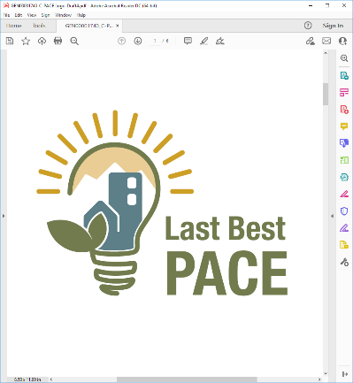
Montana Facility Finance Authority
Adam Gill
Executive Director
Seth Lutter
Associate Director
Carolyn Jones
C-PACE Program Manager

Slide 2
What is C-PACE? (Commercial Property-Assessed Capital Enhancement)
A financing structure that allows building owners to borrow private sector funds to pay for:
energy efficiency improvements
water conservation improvements
renewable energy systems
Savings cover the cost of improvements
Repayments made via an assessment on property tax bill

Slide 3
C-PACE Eligibility
Eligible Projects
Eligible Properties
Eligible Improvements
New Construction
Retrofit
Retroactive (up to 3 years)
Commercial
Industrial
Mixed-Use
Agricultural
Multi-family (4 or more dwelling units)
HVAC
Lighting
Solar
Water Fixtures
Water Reuse
Roofing/Insulation
Elevators
Envelope
Irrigation
Cogeneration

Slide 4
Benefits
Provides economic growth
Saves local businesses money
Creates / retains jobs
Increases property values
Increases revenues
C-PACE participation is 100% voluntary
Neither local government nor citizens are on the hook for the loan

Slide 5
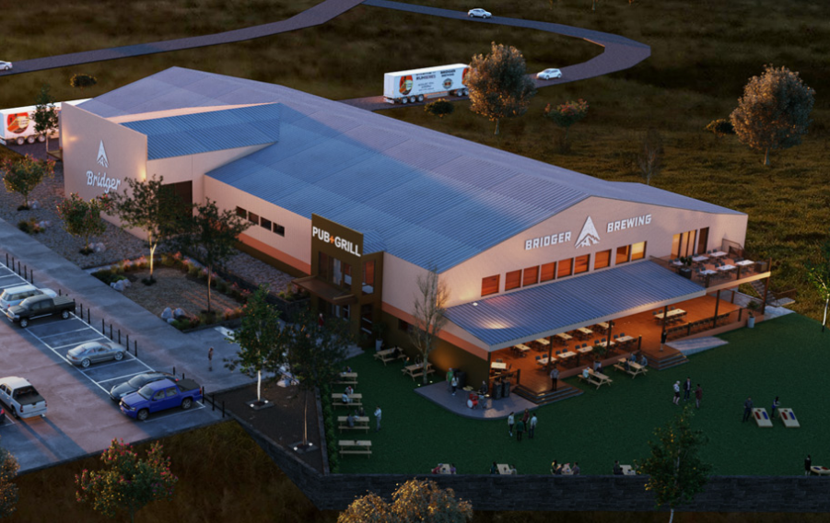
Headwaters Utility District – Broadwater County
200-acre development park at Montana’s busiest intersection
Property being developed by Bridger Brewing and will include a 60,000 bb/yr brewery and pub
Prior development hampered by need for a wastewater system
Membrane bioreactor system will clean sewage and sell it back as grey water.
Estimated County tax revenue of over $75,000 in first year
Worked with Dividend Finance
Up to $5.5M in two tranches
Expected project savings of $10 million
Financing enables growth of the entire development
Notes:
C-PACE facilitated 100 percent financing for the project,
projected to improve the building’s energy efficiency by a whopping 85 percent.
to boost the building’s value by $619,910.

Slide 6
McCandless Building – Florence, CO
Amount Financed: $616,844
Total Savings: $779,814
Measures
Insulation
Lighting
Window glazing
Rooftop solar
Heating & cooling
Building value improved by $619,910
“ I recommend C-PACE because it can replace equity and because it doesn’t affect you as a borrower. If you don’t look at C-PACE, you’re leaving money on the table.”
— Melissa Baldridge, vice president of Sustainability, real estate broker, GreenSpot Global

Slide 7
Where Are We Now?
Program launched January 1, 2022…
Ten counties and one city have approved C-PACE Districts:
Broadwater , Butte-Silver Bow, Cascade, Gallatin, Lincoln, Mineral, Missoula, Park, Pondera, and Yellowstone Counties and City of Kalispell
54% of commercial buildings covered
Outreach to six other Local Governments
Once established, over 73% of commercial buildings will be covered
Current discussions with 30 potential C-PACE projects in 10 counties
Ready to assist with additional C-PACE projects

Slide 8
More information available at: www.LastBestPACE.com
Adam Gill Carolyn Jones
adamgill@mt.gov cjones@mt.gov 406-444-0259 406-444-3367
Seth Lutter
seth.lutter@mt.gov 406-444-5435

