Slide 1
Flathead Electric Microgrid Projects
Essex
Cooke City
Whitefish

Slide 2
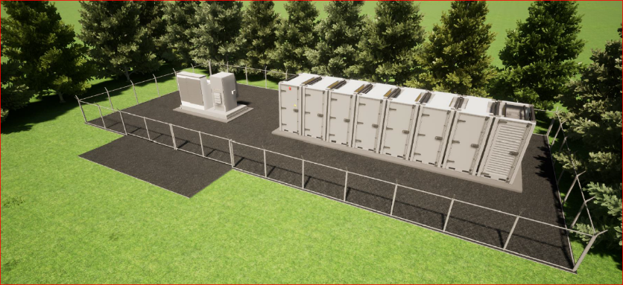
Project Drivers
New Technology
New Solution to Existing Problems
Value Stacking
Outage Mitigation

Slide 3
Feeder Details
Essex Feeder
30 Mile Radial Feeder
387 Total Meters
Average Load = 475 kW
176 Meters in Community of Essex at end of feeder
Average Load = 218 kW

Slide 4
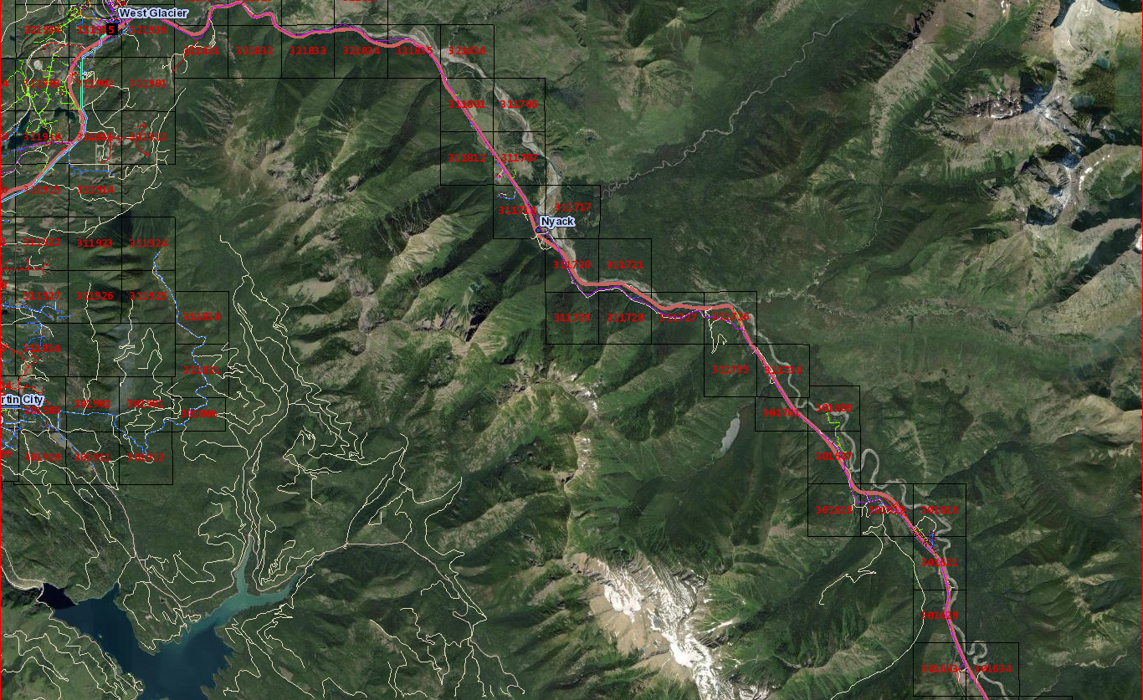
Essex Feeder

Slide 5
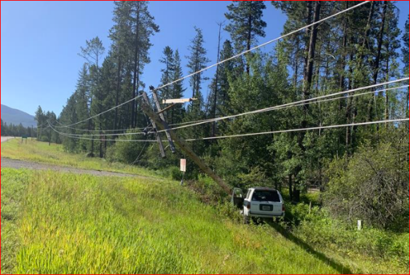
Outage Details
Looked at 10 Year Outage History
310 Total Outages on Feeder
Most of any feeder
160 Outages with fault upstream of the last recloser
Determined how much battery was needed

Slide 6
Battery Size
Size Battery to ride through MOST outages

Slide 7
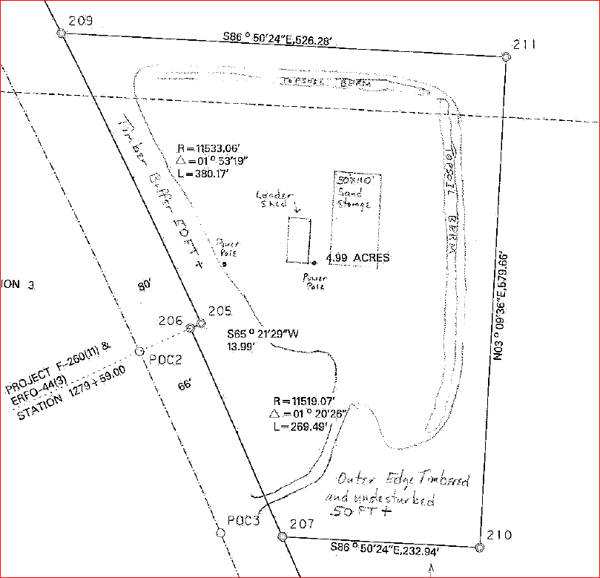
FEC Perspective
Location – Not In My Backyard
Thank you to MDT
Size Matters
Vendors focus on larger scale projects
Approach
Turnkey from vendor

Slide 8
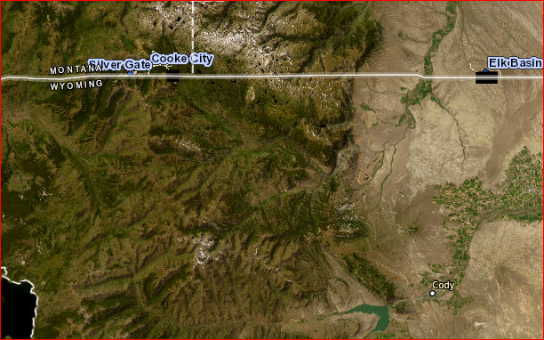
Cooke City Feeder

Slide 9
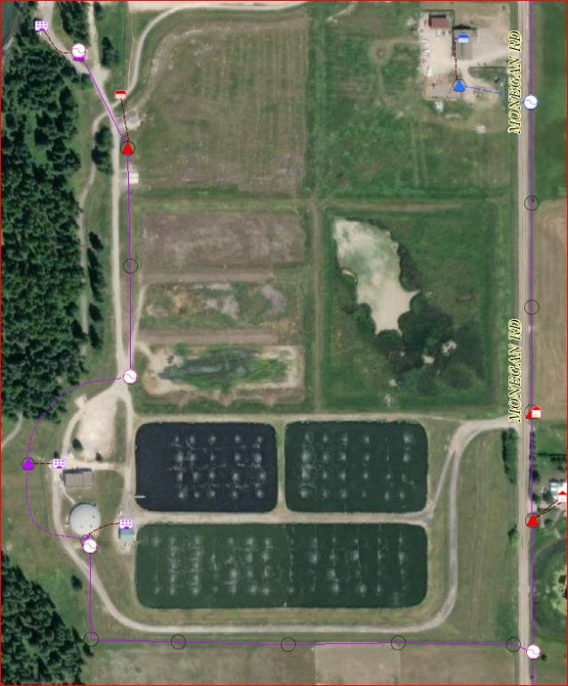
Whitefish Community Solar
Community Solar Project
BESS & Solar

Slide 10
Project Funding Options
Essex
Grid Resilience - 40101(C)
NRECA Consortium (application submitted)
Cooke City
Energy Improvements in Rural and Remote Areas
NRECA Consortium
Whitefish
Undecided- 40101(D)?

Slide 11
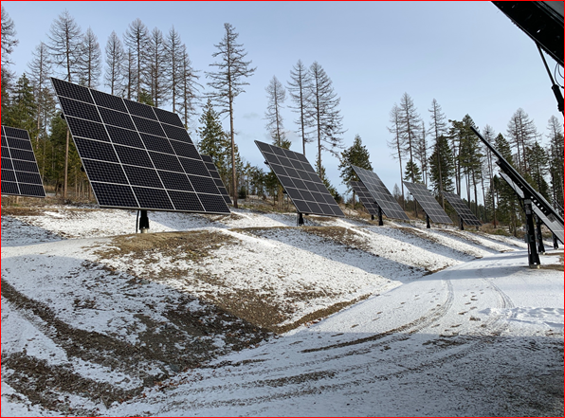
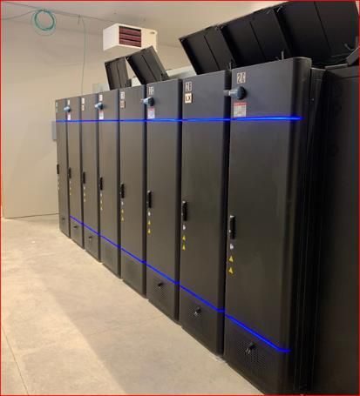
Lookout Ridge
Solar – 150 kW
Battery – 375 kW
Natural Gas Gen – 150 kW
Independent Power Systems

Slide 12
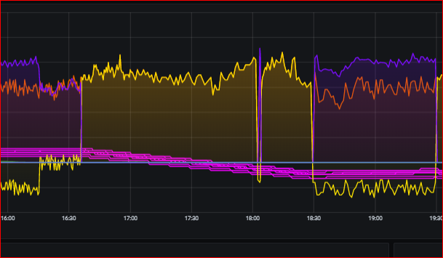
Lookout Ridge
LOR Outage Example
Utility (FEC)
Load
Inverter

Slide 13
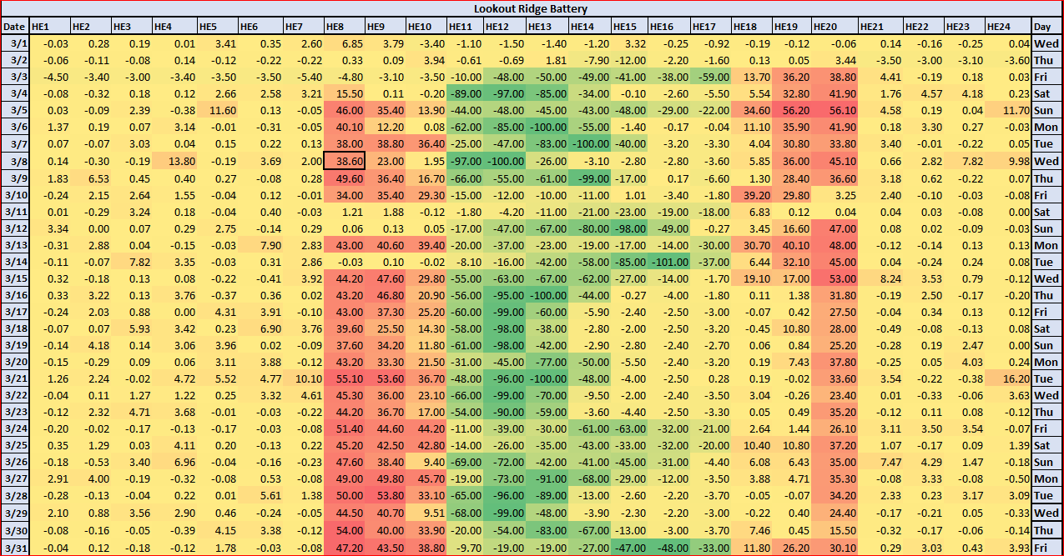
Lookout Ridge
Hourly Inverter Statistics

