Slide 1
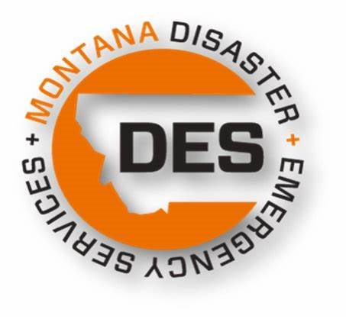
FEMA Mitigation Funding
Sara Hartley
Andrew long
Shari pool
Amanda Avard

Slide 2
FEMA Hazard Mitigation Assistance Funding
BRIC – Building Resilient Infrastructure in Communities
HMGP/PF – Hazard Mitigation Grant Program/Post Fire

Slide 3
BRIC
Timing
Annual nationally competitive application process
Funding
Funded through the 6% set aside in the Disaster Relief Fund
Where
Funding is not limited to damaged facilities or geographic areas
What
Multi-hazard mitigation projects
Match
Typically 25%
***
Need a current local/regional HMP at time of application and award
Notes:
The BRIC Program began in FY2020, following the Disaster Recovery Reform Act of 2018, which authorized the President to set aside from the Disaster Relief Fund (DRF), for every major disaster declaration, an amount equal to 6% of the total funding awarded under seven sections of the Stafford Act.
Based on historical disaster expenditures, FEMA’s expectation was that this set-aside would be $300-500 million per year; however, the COVID-19 major disaster declarations resulted in additional funding. As of October 31, 2021, $1.629 billion was set aside in the DRF for pre-disaster mitigation.
$500 million was available for BRIC in FY2020. The program was oversubscribed, with 53 states and territories requesting over $3.6 billion. The Notice of Funding Opportunity (NOFO) for BRIC FY2021 was posted on August 9, 2021, with a total of $1 billion available:
- state/territory allocation: $56 million;
- tribal set-aside: $25 million;
- national competition: $919 million.
The priorities for FY2021 incentivize
- natural hazard risk reduction activities that mitigate risk to public infrastructure and disadvantaged communities;
- projects that mitigate risk to one or more community lifelines;
- projects that incorporate nature-based solutions;
- projects that enhance climate resilience; and
- projects proposed by applicants who adopt and enforce mandatory building codes based on the latest published editions of building codes.
A goal of BRIC FY2021 is to promote equity by prioritizing 40% of the funding for disadvantaged communities, in accordance with E.O. 14008 and the Justice40 Initiative

Slide 5
HMGP
Timing
Post-disaster
Funding
Capped funding based on other Stafford Act costs
Where
Funding not limited to damaged facilities or geographic areas
What
Multi-hazard projects
Match
Typically 25%
***
Need a current local/regional HMP at time of award
Notes:
HMGP assistance is triggered by a major disaster declaration under the Stafford Act, awarded on a sliding scale as a percentage of the estimated amount of total federal assistance for the disaster: - up to 15% of the first $2 billion,
- up to 10% for amounts between $2 billion and $10 billion,
- up to 7.5% for amounts between $10 billion and $35.333 billion
Funding priority will be given to jurisdictions impacted by the disaster and listed in the declaration

Slide 6
HMGP-PF
Timing
Post-disaster
Funding
Funding is based on national aggregate calculation based on an average of historical FMAG declarations from the past 10 years.
Where
Funding not limited to damaged facilities or geographic areas
What
Multi-hazard projects
Match
Typically 25%
***
Need a current local/regional HMP at time of award
Notes:
HMGP – Post Fire assistance is triggered by a Fire Management Assistance Grant (FMAG) under the Stafford Act. The amount awarded per event will be recalculated at the beginning of every fiscal year.
Funding from multiple events will be aggregated into one grant under the first declaration. This will support larger projects, streamline grants management, and expedite closeout. Aggregation will reset at the beginning of each fiscal year and will remain in effect for that year.
Funding priority will be given to jurisdictions impacted by the disaster and listed in the declaration

Slide 7
HMA Grant Expectations
Award Timeline
Dependent on type of project (EHP process for physical construction/infrastructure projects)
Construction: 9-15 months from time of application submission
Non-Construction: 6-12 months
Dependent on grant program (BRIC & FMA vs. HMGP & HMGP-PF)
Period of Performance (POP)
HMGP & HMGP-PF
36 months beginning with the opening of the application period
BRIC and FMA
36 months from the date of sub application selection
SOW and Budget Amendments
HMGP & HMGP-PF
Possible
Budget amendment only if funds remaining in the program
BRIC and FMA
SOW change possible but difficult as you cannot alter the intent of the project since it was reviewed and ranked at the national level
Budget amendments not possible under these programs

Slide 8
What can be Done With Funding?
Project Scoping/AA
Plans
Physical Projects

Slide 9
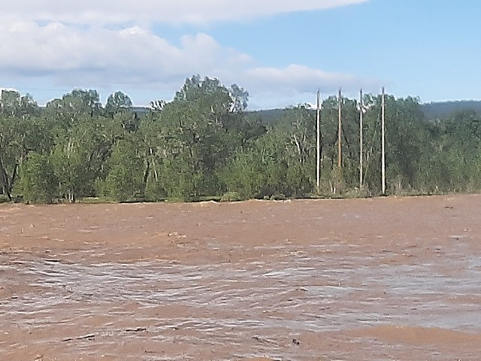
DR-5324
Columbus Substation
Notes:
This is a picture of a 4-pole structure on the South side of the Yellowstone River, East of Columbus. The structure was swept away by the flood 2 days later. A temporary mobile substation was located on the North side of the crossing and is currently being replaced with a permanent substation.
BEC submitted a project application in September 2021 where they proposed to mitigate the risk of imminent damage to this electric distribution system and loss of service to members north of the Yellowstone River. The application proposed to permanently relocate the power supply to the north side of the Yellowstone River and outside of the floodplain. This line serves 153 residential homes, two irrigation services, and two commercial agricultural feed lots on the north side of the river.
BEC had been monitoring this river crossing for many years as the Yellowstone River increasingly eroded and braided with spring runoff. As recently as May 2021, the channel was measured within twenty-five feet of the powerline support structure. Beartooth Electric Cooperative has spent thousands of dollars in the past three years mitigating the river threat by moving, reinforcing, and installing a temporary line to bypass a hazardous area. In 2020, the power support structure was relocated further from the river and the temporary line rerouted to avoid the migrating channel.
Not only was the river crossing structure at risk, but other support poles throughout the floodplain have been inundated by braiding channels during spring runoff. To protect the feeder circuit and maintain reliable electric service to their members, BEC proposed to remove the river crossing and terminate the overhead power that was in the floodplain at the last service and structure along the south side of the river. A new, permanent substation will be constructed on the north side of the Yellowstone River on land that lies out of the floodplain and is currently secured by Beartooth Electric Cooperative. This substation will be interconnected at an existing Northwestern Energy 50 kV transmission line. A new substation feeder will connect to the remaining portion of the feeder to serve the north side members. All power line facilities and associated support structures within the floodplain will be removed and any easements and right-of-way will be retired.

Slide 10
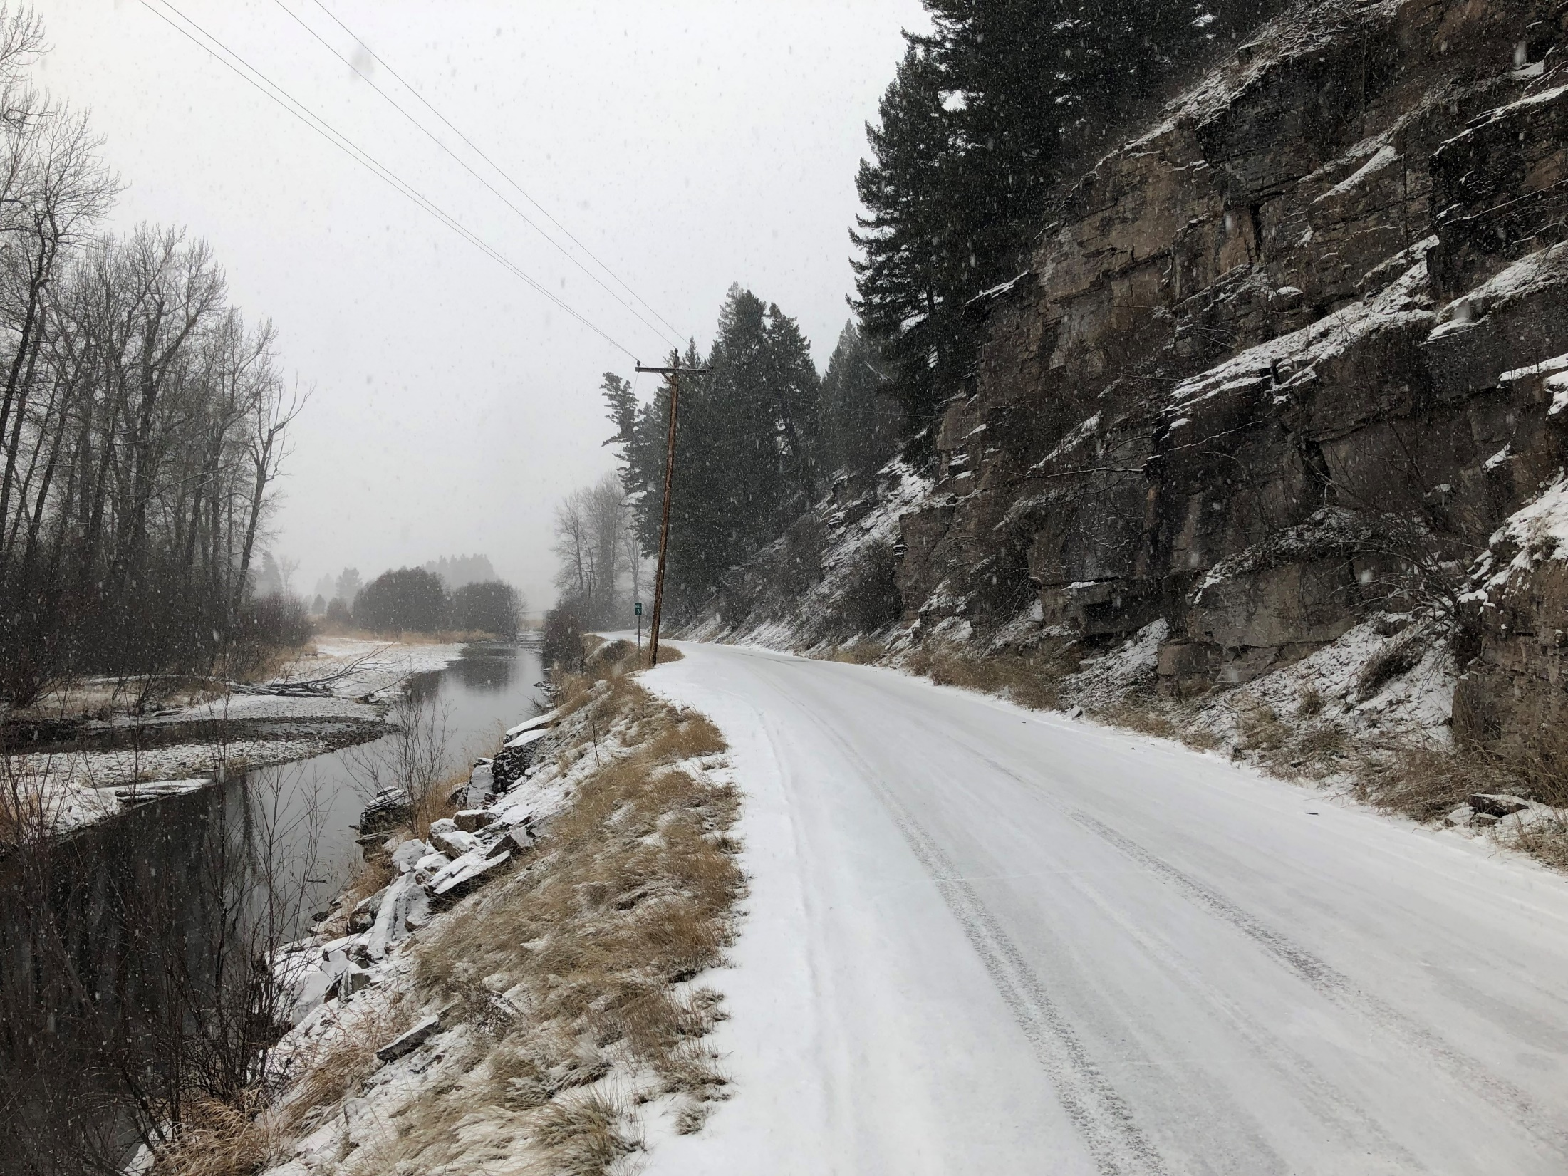
BRIC 2021
Rock Creek Fire Mitigation Project
Notes:
The Rock Creek Fire Mitigation Project involves the relocating of overhead power lines for the purpose of mitigating risk of fire and long-term outages to homes and businesses located in Missoula and Granite County.
Access to the transmission lines is difficult under normal conditions and challenging terrain. An outage in this rugged terrain could be impossible to repair/address during winter conditions due to densely forested land on steep terrain creating a huge risk of long-term power outages to the 194 homes and businesses depending on these lines for electricity. The proposed project involves relocating and converting three segments of overhead lines from the steep hillside to underground along Rock Creek Road near Rock Creek.
This project will mitigate fire risk caused by falling trees on the overhead power lines as well as reduce the risk associated with impacts to the overhead lines by wildland fire. This will also make the power lines much more accessible for power restoration year-round. This project improves the energy power grid by protecting it from fire and severe weather hazards. Buried power is known to be more resilient and have significantly less maintenance and outage times. The proposed project will create a more dependable power source for the residents and businesses in the Rock Creek area.

Slide 11
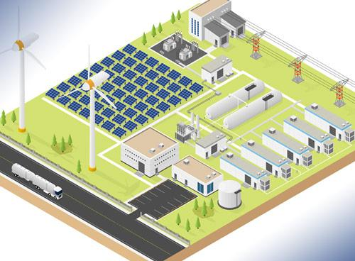
FEMA & Microgrids

Slide 12
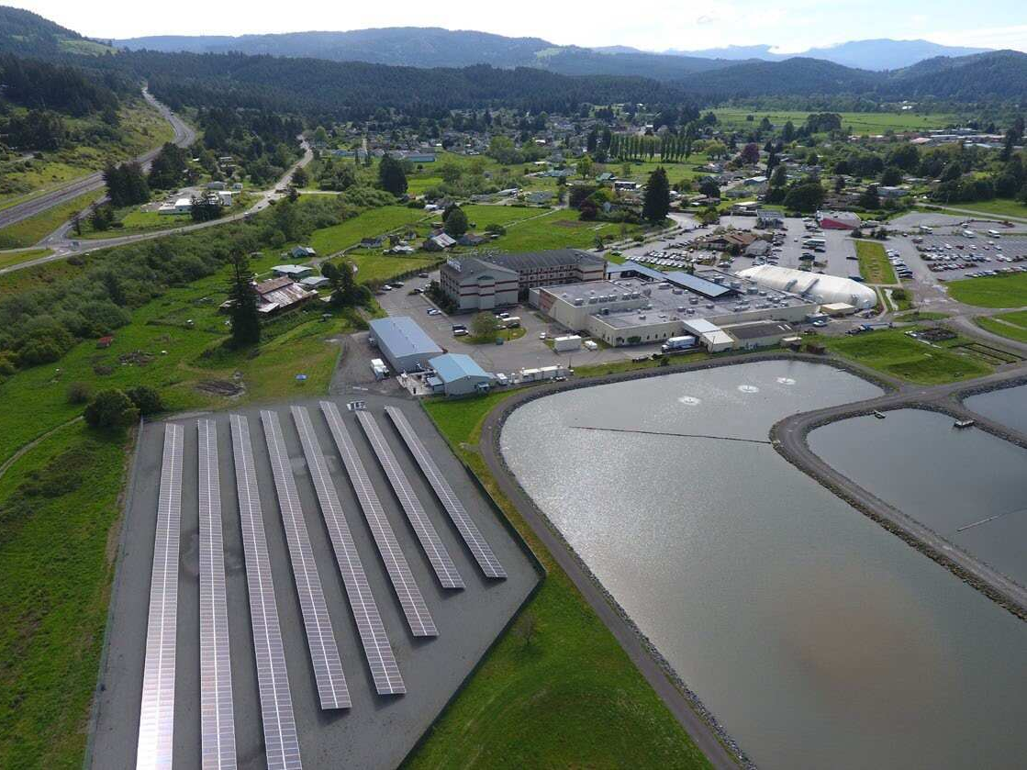
Blue Lake Rancheria Tribe Microgrid Project
Notes:
The Blue Lake Rancheria (BLR) is a Native American reservation located in an area subject to heavy rainstorms, Innovative Energy Solution Tested and Proven in 2019 forest fires, and frequent power outages. The reservation constructed a low-carbon community microgrid in 2017 to bolster its resilience to these outages. It helps power Humboldt Bay, CA FEMA Region IX Community Lifelines government offices, economic enterprises, and several Red Cross safety shelter-in-place facilities. The BLR microgrid integrates a solar array, battery storage, and control systems to allow the Rancheria campus to operate in tandem with, or islanded from, the main utility grid. This provides resiliency to the community because if the main grid experiences a power outage, the microgrid will automatically disconnect and go into island mode. The system prioritizes clean generation, but if needed it will bring a 1-megawatt isochronous backup generator online to support the photovoltaic (PV) array and battery. The solar array also generates renewable energy regardless of whether or not it is in island mode, providing both carbon emission and electricity cost savings. The microgrid is projected to save $150,000 a year and reduce 150 tons of carbon dioxide emissions annually.
Hazards:
Inland flooding
Wildfire
Lifelines
Safety/Security
Food/Water/Shelter
Project Cost
$6.3 Million
Funding
California Energy Commission R&D grant through Electric Program Investment Charge (EPIC) Program: $5 million
The Blue Lake Rancheria: $1.3 million
Partnerships:
The California Energy Commission (major funder)
The Blue Lake Rancheria (site host and major funder)
Humboldt State University’s Schatz Energy Research Center
Pacific Gas & Electric (local utility)
Siemens (Microgrid Management System [MGMS])
Tesla (battery energy storage system)
Idaho National Laboratory (testing and simulation)
Robert Colburn Electric (electrical contractor)
REC Solar (turnkey PV system)
McKeever Energy & Electric (PV installation)

Slide 13
Microgrid Eligibility Requirements
Eligibility requirements under the BRIC and HMGP programs:
Must have a FEMA approved and adopted Hazard Mitigation Plan in Place
Project just be considered technically feasible and effective
Project must be cost effective
Project will need to be reviewed compliance with environmental and historic preservation laws and executive orders.
FEMA’s Mitigation Action Portfolio
https://www.fema.gov/sites/default/files/2020-08/fema_mitigation-action-portfolio-support-document_08-01-2020_0.pdf

Slide 14
Contact Information
Sara Hartley
State Hazard Mitigation Officer
406-324-4794 (Office)
406-417-9238 (Mobile)
Sara.Hartley@mt.gov
Andrew Long
Mitigation Coordinator
406-202-4532
Andrew.Long@mt.gov
Shari Pool
Mitigation Coordinator
406-202-2584
Spool@mt.gov
Amanda Avard
Mitigation Coordinator
406-202-4195
Amanda.Avard@mt.gov
Vacant Position
Mitigation Coordinator

