Slide 1
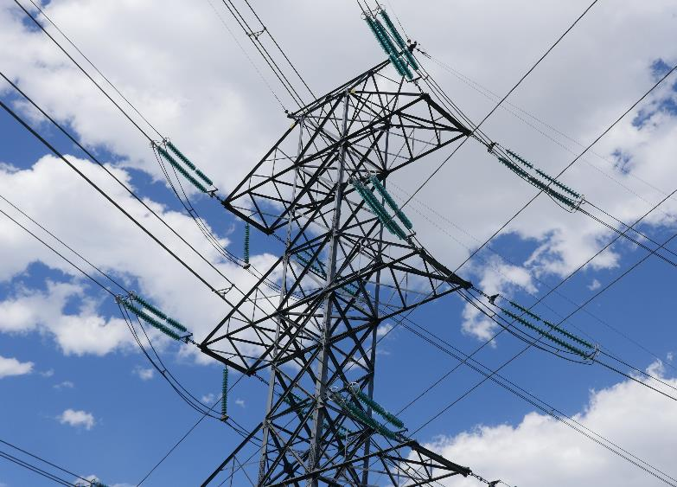
Grid
Resilience
& Reliability
State & Federal Funding
April 18, 2023

Slide 2
Infrastructure Investment and Jobs Act
Over $60 Billion for DOE to Support:
Domestic Manufacturing & Workers
Energy Efficiency
Transportation
Technology Innovation
Transmission
Montana Energy Office
State Energy Program
Energy Efficiency Revolving Loan/Grant
Energy Efficiency Block Grant
National Electronic Vehicle Infrastructure
Grid Resilience & Reliability
Notes:
Thanks Emily for your great presentation. Emily has been a resource to us as we think through our approach to the State and Tribal Grid resilience program we are setting up for Montana.
We have also been working with the National Association of State Energy Officials (NASEO) and other states to better understand the opportunity for states to set up their own programs within the parameters of the federal legislation and DOE’s “Administrative and Legal Requirements Document.” I will run through these next slides pretty quickly as Emily covered much of this.
Point of this slide is to illustrate there are a number of programs contained in IIJA that are relevant to folks on this call.
My office will be managing expanded State Energy Program funding, funding to establish new grant and loan programs for EE, EECBG, NEVI, and obviously this program

Slide 3
IIJA Grid Funding Provisions
Grid Resilience State and Tribal Formula Grants Program—40101(d), $2.3B
Year 1 and Year 2 Allocation to Montana: $14,067,392
Grid Resilience and Innovation Partnership (GRIP) Program
Grid Resilience Utility and Industry Grants—40101(c), $2.5B
The Grid Resilience Utility and Industry Grants support the modernization of the electric grid to reduce impacts due to extreme weather and natural disasters.
Smart Grid Grants—40107, $3B
Smart Grid Grants is designed to increase the flexibility, efficiency, and reliability of the electric power system
Grid Innovation Program—40103(b), $5B
$5 billion for FY 22-26 to support projects that use innovative approaches to transmission, storage, and distribution infrastructure to enhance grid resilience and reliability.
Notes:
Some of these other transmission programs—that are not managed by states—recently had concept papers due and there is another due under 40103(b) that has a concept paper due later this month.

Slide 4
40101(d) Eligible Entities
Eligible Entities
an electric grid operator;
an electricity storage operator;
an electricity generator;
a transmission owner or operator;
a distribution provider;
a fuel supplier; and
any other relevant entity, as determined by the Secretary (of DOE).

Slide 5
40101(d) Eligible Resilience Measures include:
weatherization technologies and equipment;
fire-resistant technologies and fire prevention systems;
monitoring and control technologies;
the undergrounding of electrical equipment;
utility pole management;
the relocation of power lines or the reconductoring of power lines with low-sag, advanced conductors;
vegetation and fuel-load management;
the use or construction of distributed energy resources for enhancing system
adaptive capacity during disruptive events, including:
microgrids; and
battery-storage subcomponents;
adaptive protection technologies;
advanced modeling technologies;
hardening of power lines, facilities, substations, of other systems; and
the replacement of old overhead conductors and underground cables.

Slide 6
40101(d) Federal Requirements & Limitations
Regular Reports on Financials, Project Progression, and Metrics
National Environmental Policy Act
Build America Buy America Act
Davis-Bacon Act (Prevailing Wage)
Cannot be used for: Cybersecurity, New Generation Facilities, Large-Scale Battery Storage not used for Adaptive Capacity
No Cost Recovery for Portion of Project that is Grant Funded
Others

Slide 7
40101(d) Cost Matching
State required to provide 15% match
15% state match may be secured from eligible entities receiving subawards
Eligible entity >4,000,000 MWh sales: match 100% of subaward
Eligible entity <4,000,000 MWh sales: match 1/3 of subaward
Small Utility Set-Aside
A minimum amount of funds must be made available to small utilities, based on the percentage of customers served by small utilities

Slide 8
40101(d) MT Program Objectives
1 | Improve the reliability and resilience of Montana’s electric transmission and distribution system by reducing vulnerability to disruptive events and natural hazards, including wildfire, wind events, flooding, and winter storms.
2 | Reduce the likelihood and consequence of outages affecting community facilities and critical infrastructure.
3 | Limit the potential for wildfire ignition from transmission and distribution equipment and reduce the scope and consequence of precautionary wildfire-related public safety power shutoffs.
4 | Increase skilled workforce within Montana by assuring that installed reliability and resilience measures can be operated and maintained by Montana-based businesses and laborers, where possible.

Slide 9
40101(d) Anticipated Timeline
September 19, 2022: First Public Hearing DONE
January 4, 2023: Second Public Hearing DONE
April : MEO to Submit Program Narrative DONE
Summer/Fall 2023: MT Energy Office to Release 1st Competitive Solicitation

Slide 10
State Energy Program—MT Objectives
IIJA State Energy Program, 5-year formula award
$3.5M allocated to Montana
Energy Security Planning, Energy Efficiency Deployment, Workforce Development and Training, Support Innovative Energy Projects
Solar + Storage Resiliency Projects, approx. $500,000
Microgrid Demonstration Projects, approx. $1,000,000

Slide 11
Information and Resources
US Department of Energy:
energy.gov/gdo/conductor
Montana Energy Office:
deq.mt.gov/energy/incentive (40101(d), tax credits, rebates, EV charging equipment)

Slide 12
Contact Information
Ben Brouwer
Energy Planning Section Supervisor
(406) 444-6459
bbrouwer@mt.gov

