Slide 1
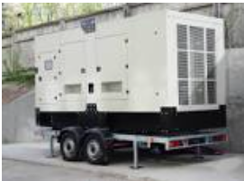
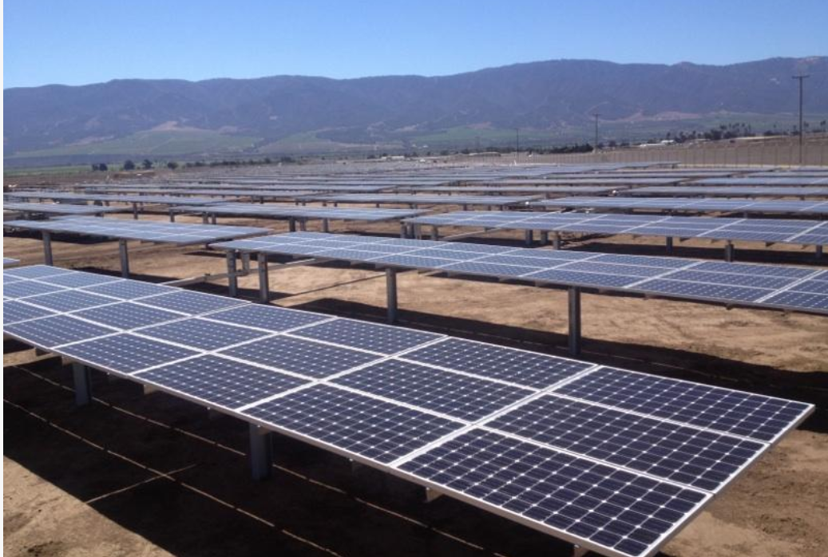
Energy Performance Contracting
in Montana

Slide 2
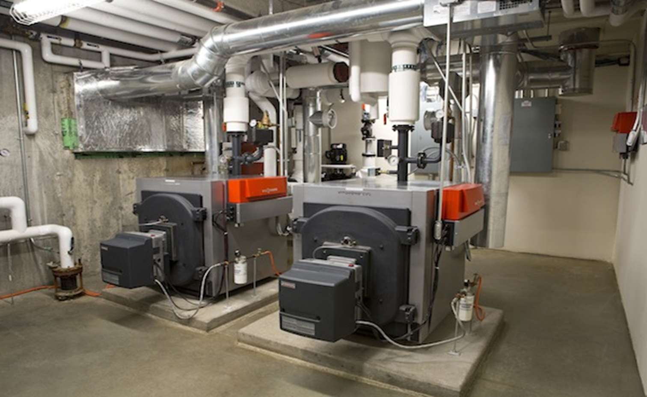
Energy Performance Contracting (EPC)
What is Energy Performance Contracting (EPC)?
An alternative form of project delivery and financing that uses cost savings from reduced utility produced energy and water consumption to repay the cost of installing energy conservation or production measures.
Also known as an Energy Savings Performance Contract (ESPC) or a Guaranteed Energy Savings Contract, it is a valuable tool for achieving infrastructure modernization, budget reduction, resource efficiency, and sustainability goals.

Slide 3
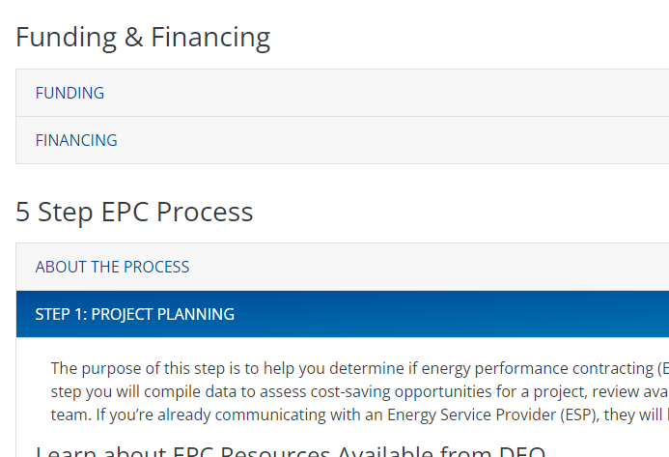
Considerations for Utilizing EPC for an Energy Project
1st – do your research
The Energy Office’s EPC website has excellent tools for determining if EPC is a good option for your project: https://deq.mt.gov/energy/Programs/epc
2nd – Talk to a few of Montana’s prequalified Energy Service Providers (ESPs) who meet statutory criteria for using EPC in Montana.
List is available on the Energy Office’s website: https://deq.mt.gov/files/Energy/Energy%20Performance%20Contracting/Documents/EPC_List_2022.pdf
Includes: Ameresco, Apollo Solutions, McKinstry, Honeywell, Iconergy, and Johnson Controls

Slide 4
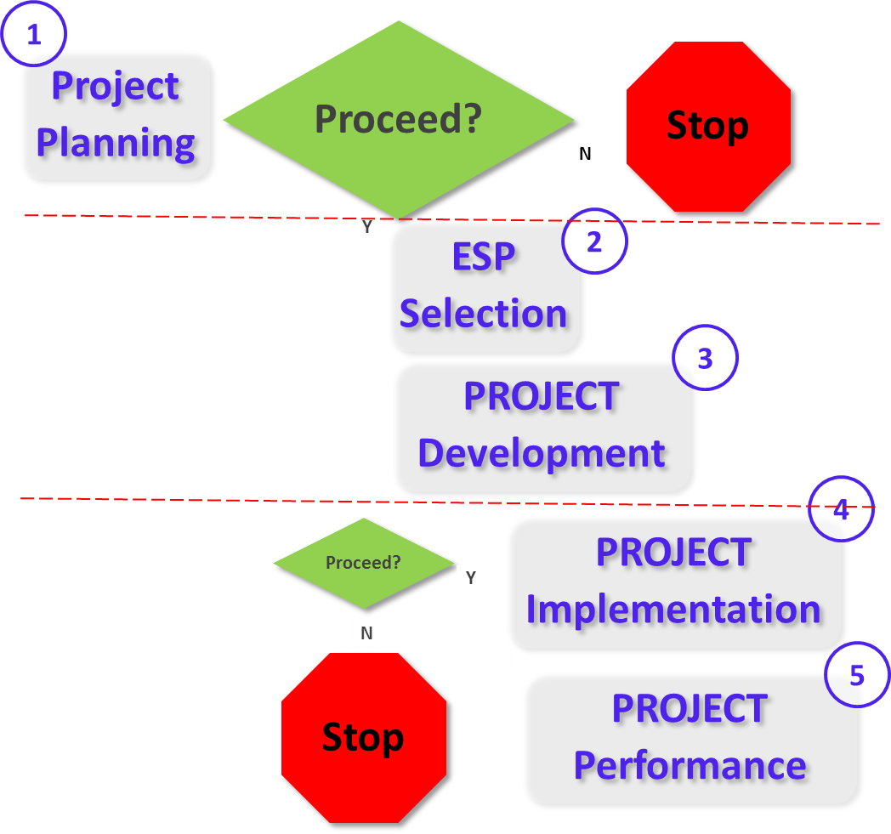
The 5 Step EPC Process
Step 1- Project Planning
Step 2 - Energy Service Provider
(ESP) Selection Process Step 3 - Project Development
Step 4 - Project Implementation
Step 5 - Project Performance

Slide 5
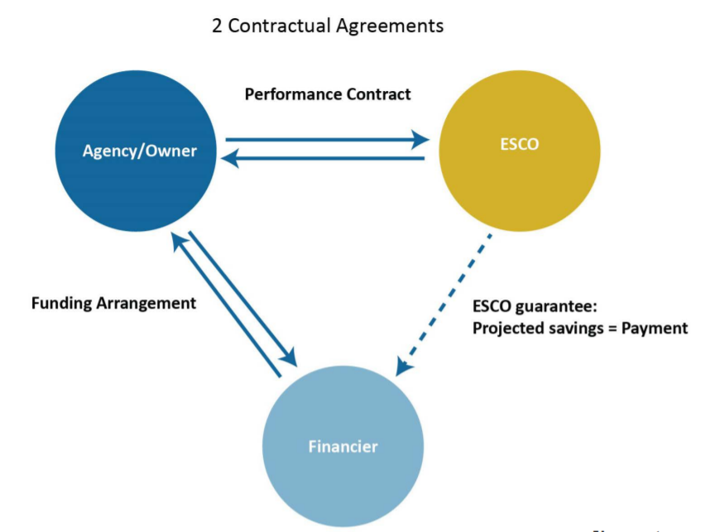
Contractual Arrangement

Slide 6
Other Potential Financing Opportunities
State Building Energy Conservation Program available for State-owned facilities
SB 483 – better defines use of public/private partnerships for projects involving state-owned assets. Excludes toll roads, toll bridges, and broadband infrastructure.

Slide 7
Questions and Discussion
Bonnie Rouse, Supervisor
Energy Efficiency & Compliance Assistance
1.406.444.6439
brouse@mt.gov
https://deq.mt.gov/energy/index

