Slide 1
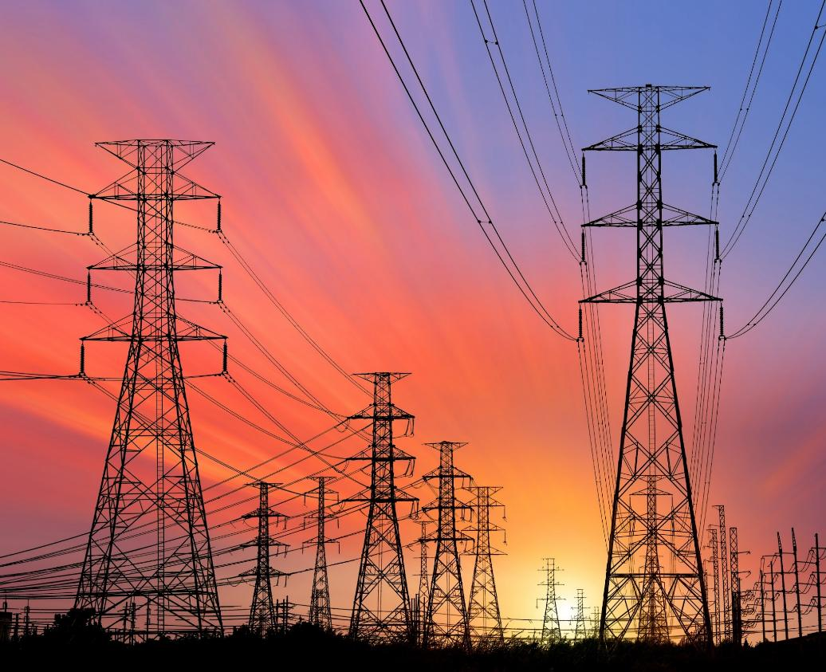


Measuring Progress and Valuing Resilience Investments in Montana
Pete Larsen
Berkeley Lab
June 23, Billings
June 24, Helena

Slide 2
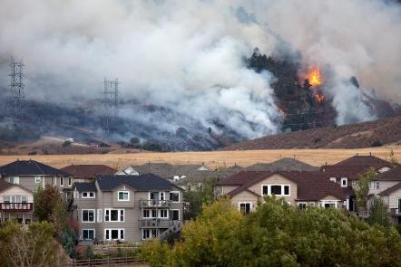
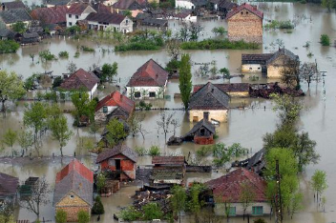
Goals for today
Information Sharing
Metrics for valuing resilience projects
Valuation frameworks
Example of valuing a resilience strategy
Links to references

Slide 3
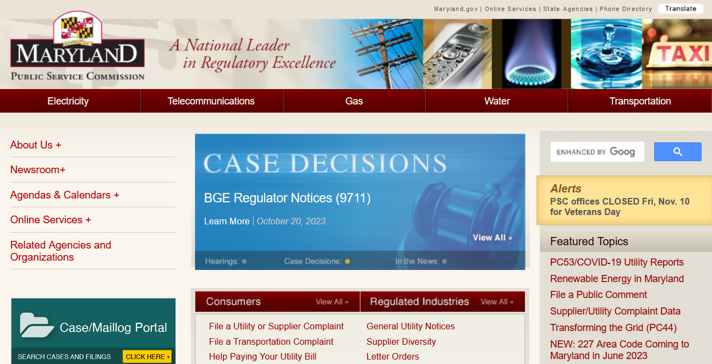
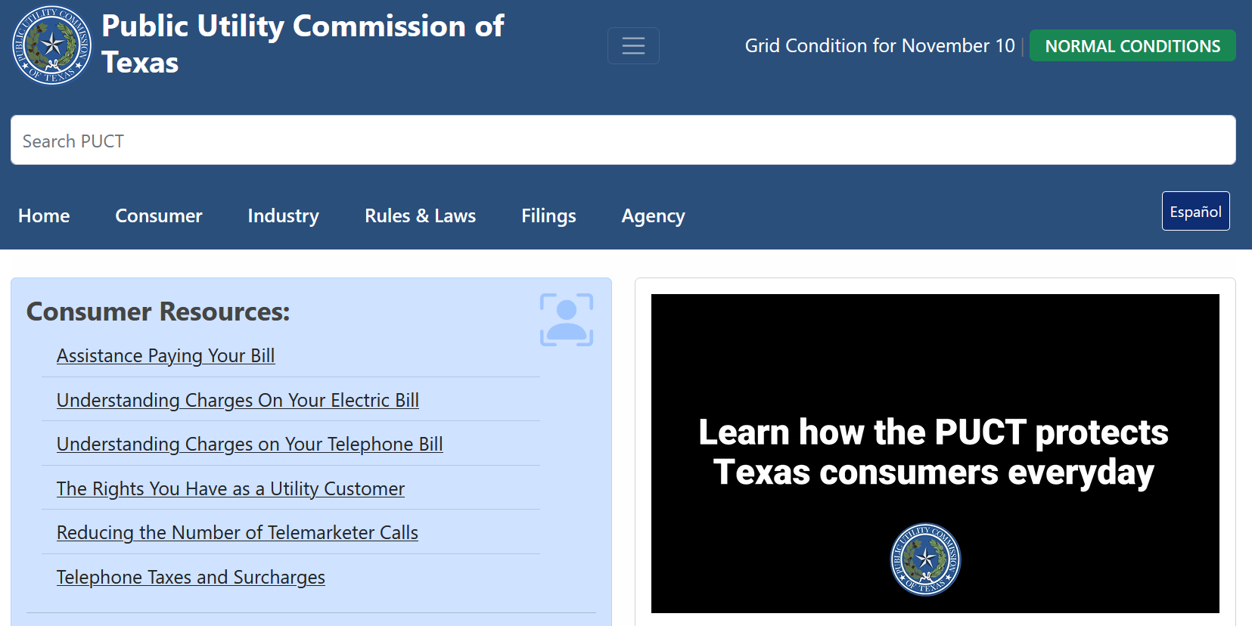
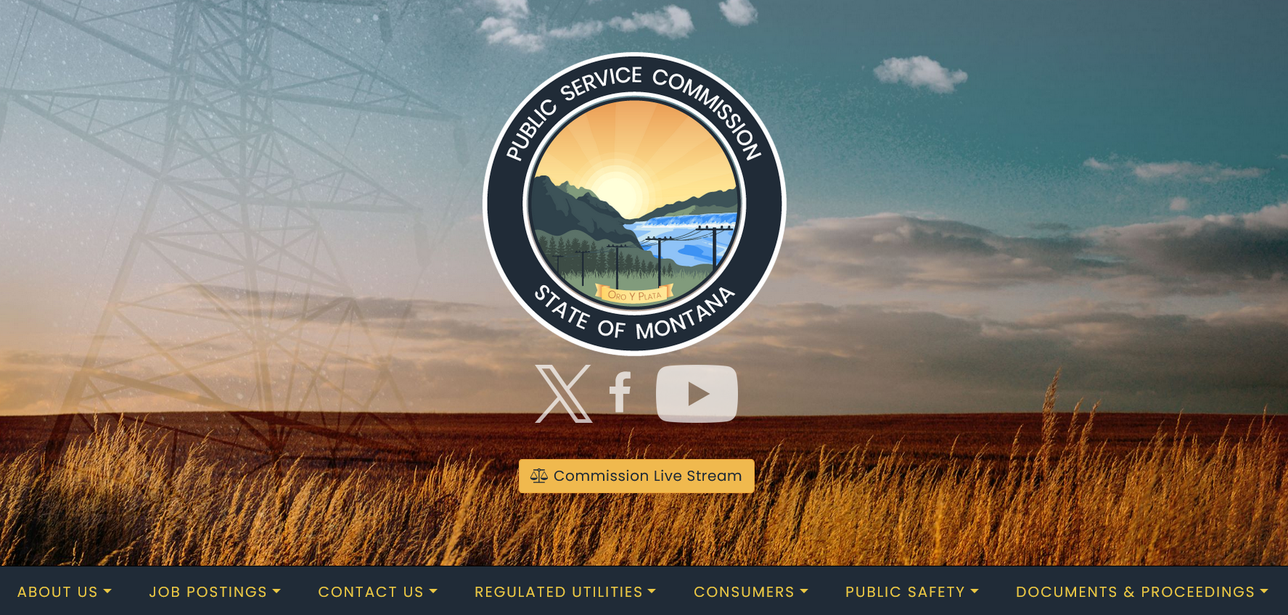

Availability of information
Regulatory processes lead to publicly-available information that can be useful for (1) evaluating projects that have societal benefits and (2) measuring performance after the project has been installed
For this reason, there tends to be more information in the public domain for regulated utilities and less so for other utilities (e.g., cooperatives)

Slide 4


Metrics for Valuing Resilience Projects

Slide 5
Metrics within context of project valuation
Berkeley Lab’s Portfolio of Resilience Activities
Metrics are important because they allow key stakeholders to assess the performance of systems before or after an investment
Some metrics (e.g., costs of power interruptions) are critical inputs into the value proposition for new projects

Slide 6
Resilience planning utilizes two types of metrics
Attribute Metrics
Performance Metrics
System characteristics that contribute to or describe aspects of the resilience of a system or community
Examples include:
  Presence of environmental monitoring systems
  Line miles undergrounded
  Reclosers automated or remotely controlled
Describe effectiveness of resilience investments by quantifying extent to which they have (or have not) reduced the negative impacts of hazard events
Measure progress toward achieving resilience objectives
Examples include reductions in:
  Customer interruptions
  Restoration costs
By tracking both types of metrics, utilities can connect infrastructure performance to tangible asset characteristics.

Slide 7
Widely-used reliability indices
Defined by IEEE 1366-2022
Typically calculated and reported on an annual basis, aggregating performance over an entire year
Exclude Major Event Days (MEDs), which are statistically-determined days when utility system performance is significantly impacted by events outside of normal operating conditions
Metric | Definition | Interpretation
SAIFI | System Average Interruption Frequency Index | Total number of interruptions that an average customer experiences over some time period
SAIDI | System Average Interruption Duration Index | Total number of minutes that an average customer is without power over some time period
CAIDI | Customer Average Interruption Duration Index | Time required to restore service for an average customer over some time period
MAIFI | Momentary Average Interruption Frequency Index | Total number of momentary interruptions (< 5 minutes) that an average customer experiences over some time period

Slide 8
Customer-focused reliability metrics
Additional metrics defined by IEEE 1366-2022
Reflect percentage of customers experiencing multiple or longer-duration interruptions
Metric | Definition | Interpretation
CEMI_{n} | Customers Experiencing Multiple Interruptions | Ratio of customers experiencing n sustained interruptions to the total number of customers served
CEMM_{n} | Customers Experiencing Multiple Momentaries | Ratio of customers experiencing n momentary interruptions to the total customers served
CEMSMI_{n} | Customers Experiencing Multiple Sustained Interruptions and Momentary Interruptions | Ratio of individual customers experiencing n or more of both sustained interruptions and momentary interruption events to the total customers served
CELID-s; CELID-t | Customers Experiencing Long Interruption Durations | Ratio of individual customers that experience interruptions with durations longer than or equal to a given time: (s), where the time is a single interruption (t), defined as the total time a customer has been interrupted

Slide 9
Categories of performance metrics
Category | Description
Electric Service | Metrics describe power interruptions in terms of frequency, duration, location, cause, customers affected, and other variables.
Asset Damage or Failure | Metrics describe infrastructure impacts in non-monetary terms, such as counts of damaged utility structures.
Response and Restoration | Metrics describe response and recovery from a hazard event, such as the time to restore power to some or all of a utility service territory.
Monetary Impact | Metrics describe the cost of impacts and include capital costs of damaged assets, operations and maintenance (O&M) costs for restoration and recovery, costs incurred by customers as a result of power interruptions, and economy-wide impacts from power interruptions.
Customer Communications and Engagement | Metrics describe the effectiveness of utility outreach regarding a storm or interruption event.

Slide 10
Electric service - Examples
Key Dimensions of Granularity
Start and end of event or interruption
Interruption cause
  IEEE Standard 1782-2022 provides a structured approach to identify and categorize causes of interruptions to enable consistent reporting and analysis.
Interruption location
  Circuit, substation, or other location
Conditions
  Major storm, high wind warning, etc.
Metric | Description
Customer Interruptions | Sum of all customers interrupted over a given time period
Customer Minutes Interrupted | Sum of all customer minutes interrupted over a given time period
Targeted reliability indices (specifically for major storms) | SAIDI, SAIFI, CEMI, etc. specific to time, circuit, weather conditions, outage cause, etc.

Slide 11
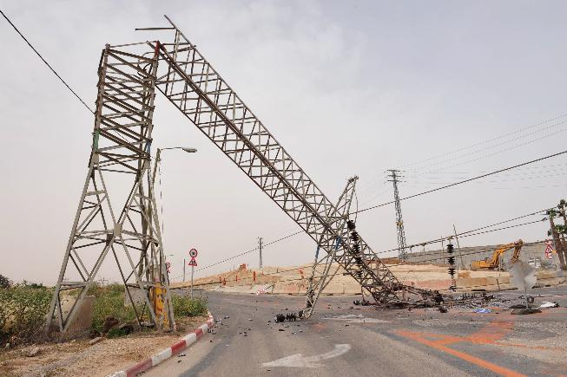
Asset damage or failure - Examples
Examples of Metrics
Critical facility asset damage from resilience events
Number of pole failures
Hours line loading exceeded normal rating
Conductor performance during major events
Number of overloaded pieces of equipment resulting from an event
Total overhead equipment failures in wildfire risk tiers
Ignition events (wildfire)
Pole replacements after major events

Slide 12
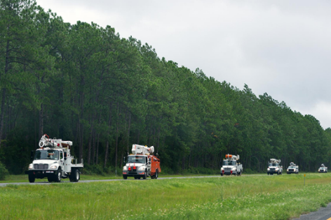
Response and restoration - Examples
Metric | Description
Time to restore X% of customers (CR-X) | Hours from onset time to restore X% of customers impacted (usually 50%, 90%, or 100%)
Time to restore from peak customers interrupted to 95% restoration (National Grid) | For a major storm, the time it takes to restore from peak customers interrupted to 95% restoration
Percent of customers restored within X hours of a major storm | Among customers impacted by a major storm (or other major event designation), the percent restored within X hours of interruption onset time
Average time to respond to safety and critical infrastructure needs | Minutes elapsed from the time the issue is reported to when the utility resolves it
Number of critical assets without power for more than N hours | Number of critical assets without power for longer than a chosen time threshold (from one to 24 hours)
IEEE Storm Resilience Metric (IEEE, 2020) | Quantifies speed of recovery during first 12 hours of a storm from customers losing power

Slide 13


Monetary impact metrics - Examples
Examples of Metrics
Utility Costs | Value of assets damaged and destroyed by resilience events
 | Post-event O&M restoration costs
Customer Interruption Costs | Cost per event
 | Cost per average kW
 | Cost per unserved kWh
Economy-wide Impacts | Gross output
 | Gross (regional) Domestic Product
 | Change in household consumption
Interruption Cost Estimate (ICE) Calculator Online tool for estimating interruption costs and/or the benefits associated with reliability improvements
Power Outage Economics Tool (POET) Prototype tool for estimating the economic impact of widespread, long-duration power interruptions and the value of investments in resilience

Slide 14
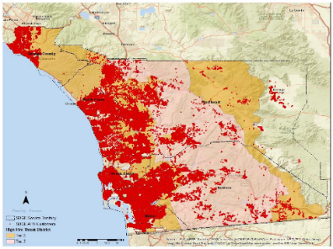
Performance metrics – Additional dimensions
Critical Facilities
  Facilities and infrastructure that are critical to the health and welfare of the population and that are especially important following hazard events (FEMA)
  Critical facilities include, but are not limited to, hospitals, water and waste treatment facilities, telecommunications, shelters, police and fire stations
Essential Facilities
  A secondary category of buildings and other structures intended to remain operational in the event of a multi-day outage, such as gas stations, grocery stores, and pharmacies
Vulnerable Populations
  The elderly, people with life support systems, disabilities, or other medical needs, and low-income and rural populations that require specific attention in electric resilience planning due to their unique challenges during and after power outages
Access and Functional Needs (AFN) Customers in San Diego Gas & Electric (SDG&E) Service Territory
Source: SDG&E Wildfire Mitigation Plan (2023)
14

Slide 15
Other potentially useful metrics
Examples of Metrics
Number of residential customers benefitted by project
Number of commercial customers benefitted by project
Number of industrial customers benefitted by project
Number of customers that provide community services/emergency centers benefitted by project
Number of customers that provide communication services benefitted by project
Number of customers that provide energy supply benefitted by project
Number of customers that provide transportation services benefitted by project
Number of customers that provide water services benefitted by project
Number of customers that provide food services benefitted by project
When applicants have resource or data constraints, even basic information on the magnitude and distribution of benefits can be helpful.
How many customers will benefit?
What are the customer classes of the benefitting customers?
How many of the benefitting customers provide critical or essential services to the community?
Source: California Energy Commission - Community Energy Reliability and Resilience Investment (CERRI) Program

Slide 16
Valuation Frameworks and Measuring Progress

Slide 17
Selected economic and social valuation methods
Method | Units | Examples | Comments
Least-cost, best-fit | $ divided by a non-monetary value | X dollars invested in grid to avoid Y number of fatalities X dollars invested in grid to reduce SAIDI by Y minutes | Presumes that an investment is needed and helps prioritize options to achieve objectives Does not require monetization of any or all benefits of project
Cost-benefit analysis | $ divided by $ | X dollars invested in grid leads to Y dollars in societal benefits | Does not presume that an investment is needed Allows for an apples-to-apples comparison of options Can be extremely challenging to put a dollar value on some benefits
Source: Woolf et al. (2021)

Slide 18

Example of information needed for valuation
Cost | Benefits: Non-monetized | Benefits: Monetized | Other
Capital/installation Annual operations and maintenance | Avoided pollution Avoided health/safety risk Avoided damage to utility infrastructure Reduction in frequency and/or duration of power interruptions Avoided impacts to national security | Avoided morbidity and mortality costs Avoided capital and O&M costs to utility Avoided interruption costs to customers Avoided “spillover” effects to regional economy Avoided aesthetic costs (if applicable) | Real discount rate (or weighted average cost of capital) Lifespan of strategy Local, state, and federal incentives and rebates Frequency and duration of power interruptions before and after investment Detailed information about customers impacted

Slide 19
Forward- and backward-looking analyses
  Valuation activities can be conducted “ex ante” or “ex post”
Ex ante: “Based on forecasts rather than actual results”
Ex post: “Based on actual results rather than forecasts”
Ex ante analysis is often used to identify a proposed investment and, in some cases, rank it among alternatives
Undergrounding circuit 1234 has expected net benefits of $1M over its lifespan
Ex post analysis is often used to measure progress or performance of an investment that has already been made
Undergrounding circuit 1234 improved SAIDI and SAIFI by 21.2% and 19.4%, respectively.
Source: Oxford Dictionary (2023)

Slide 20
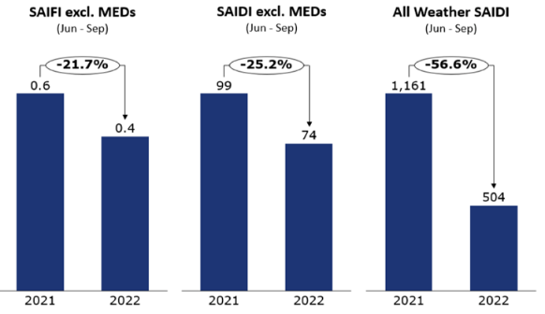
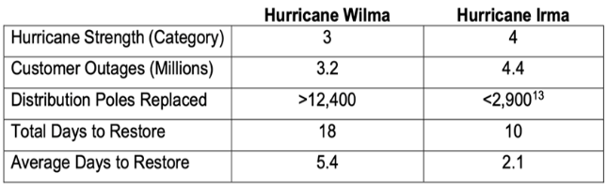
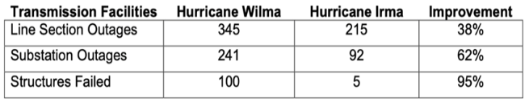
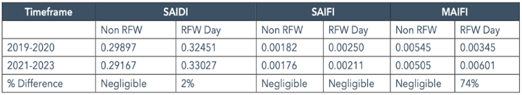
Ex post analyses from utility resilience plans
DTE Electric: Performance Improvements from Short Cycle Preventative Maintenance Programs
FPL: Ex Post Analysis of Distribution Pole and Transmission Facility Performance during Hurricanes
PGE: Ex Post Analysis of Systemwide Reliability Performance
(June 1-October 31) on RFW and Non-RFW Days (Excluding MEDs)

Slide 21
Example of Valuing a Resilience Strategy

Slide 22
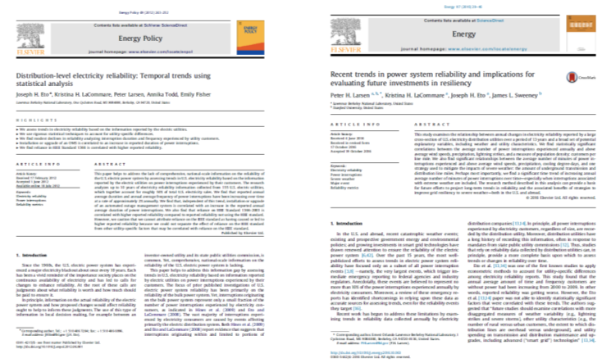
Example of valuing a utility resilience strategy
  Berkeley Lab research into factors that impact long-term reliability of the U.S. power system led to research on the value of undergrounding power lines
  Increase in % share of transmission and distribution lines that are underground has a statistically significant correlation with improved reliability/resilience (Larsen et al. 2020)

Slide 23
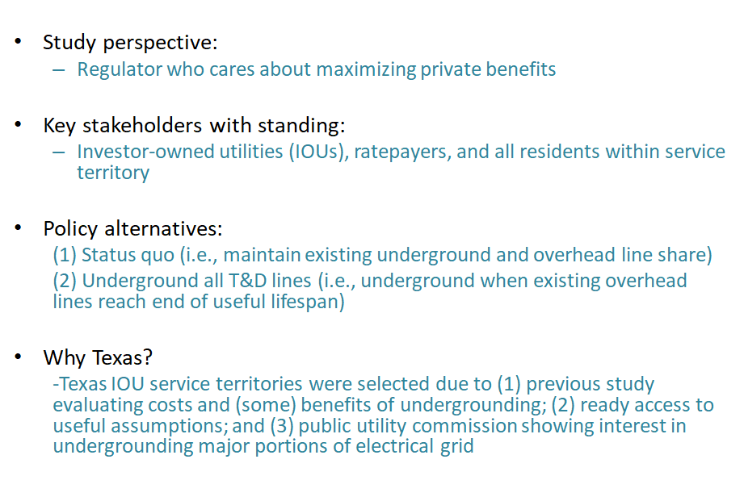
Components of valuation framework (1)
Despite the high costs attributed to power outages, there had been little or no research to quantify both the benefits and costs of improving electric utility reliability/resilience—especially within the context of decisions to underground T&D lines
Source: Larsen (2016)

Slide 24
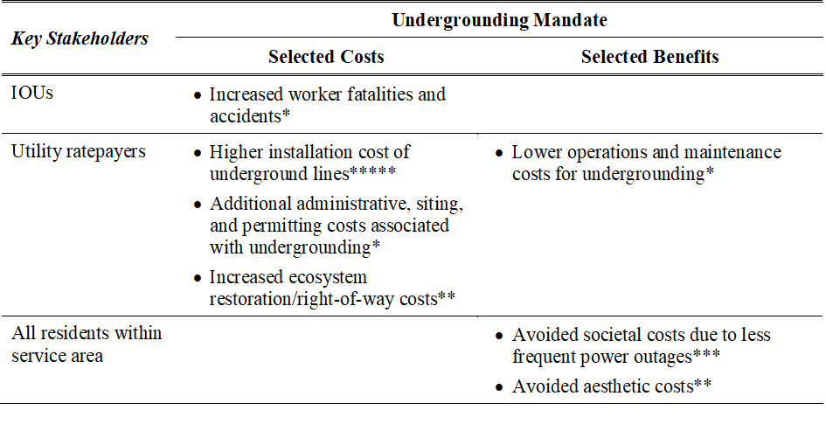
Components of valuation framework (2)
Can you spot the metrics included in this valuation framework?
* Denotes degree of impact on overall results

Slide 25
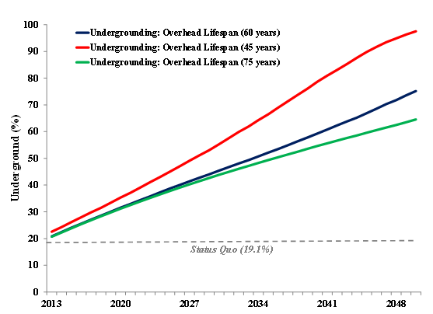
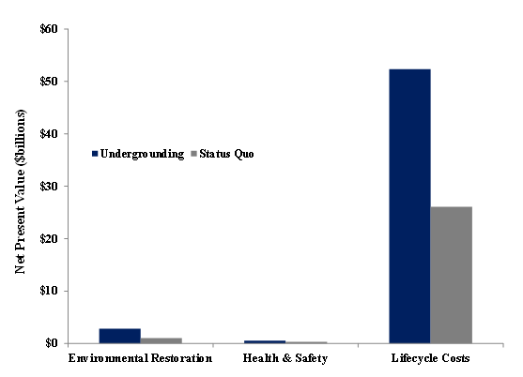
Estimated costs

Slide 26
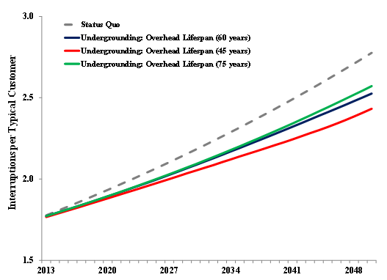
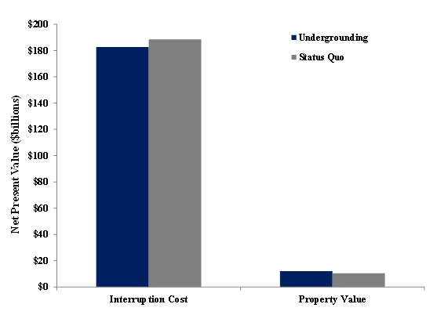
Estimated benefits

Slide 27
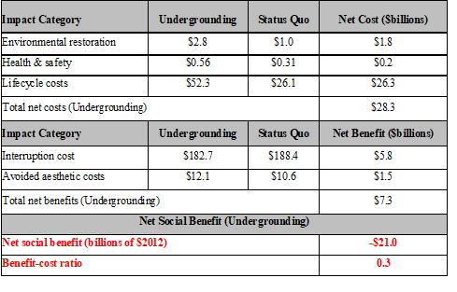
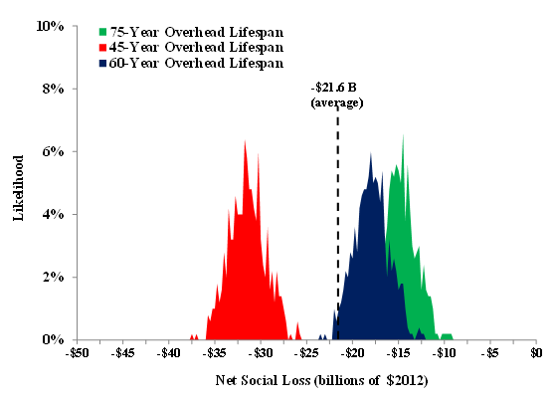
Valuation results

Slide 28
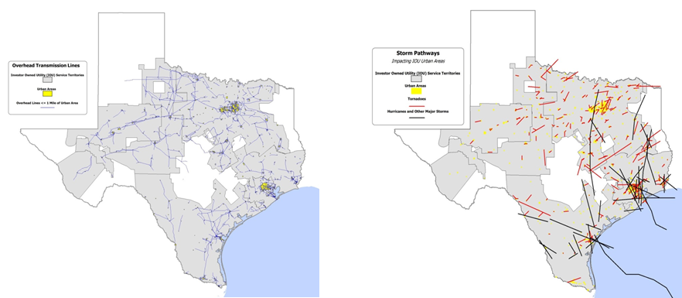
Undergrounding all of Texas not cost-effective
The initial valuation indicated that broadly mandating undergrounding when overhead T&D lines have reached the end of their useful life is not cost-effective for Texas IOUs.
What are the minimum conditions necessary for a targeted undergrounding initiative to have positive net benefits…?

Slide 29
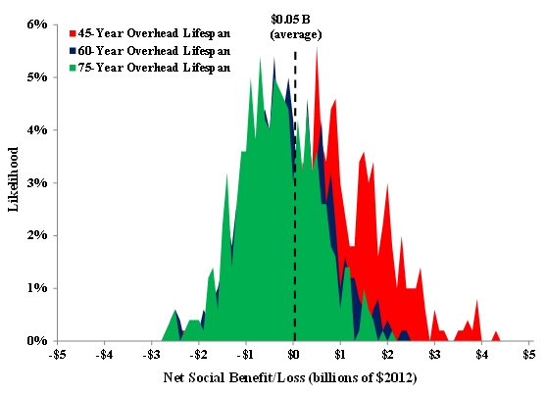
Possibility of net benefits
Texas policymakers should consider requiring that specific T&D lines be undergrounded in places where:
  there are a large number of customers per line mile (e.g., greater than 40 customers per T&D line mile)
  there is an expected vulnerability to frequent and intense storms
  there is the potential for economies of scale for installing underground T&D lines (e.g., installation costs decrease each year)
  overhead line rights-of-way are larger than underground line rights-of-way (i.e., less environmental footprint)
“Electric utility providers should evaluate strategic, targeted undergrounding of distribution lines in limited, appropriate circumstances based on the exposure to the threat of severe winter events.” Source: ORC (2021)

Slide 30
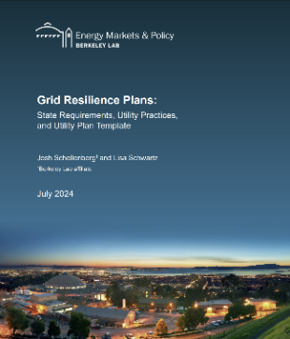
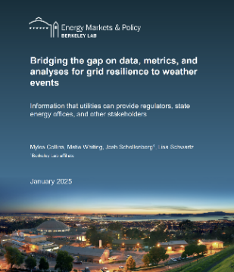
Additional Berkeley Lab resources
Grid Resilience Plans: State Requirements, Utility Practices, and Utility Plan Template
Bridging the Gap on Data, Metrics, and Analyses for Grid Resilience to Weather Events

Slide 31


Discussion Questions and Contact Information
  Do you track the performance of past investments? Can you describe how this performance is tracked?
  What resilience valuation methods have you observed?
  What new metrics might be needed in Montana to evaluate proposed or past investments in resilience?
  What is the biggest challenge that you have faced when attempting to identify, prioritize, and justify a resilience project?
Peter Larsen
Leader | Energy Markets and Policy Department
Research Deputy | Energy Analysis and Environmental Impacts Division
Berkeley Lab
Em: PHLarsen@lbl.gov
Ph: (510) 486-5015
https://emp.lbl.gov/

Slide 32
Useful references (1)
Baik, S., G. Barbose, J.P. Carvallo, C. Miller, W. Gorman, and M. Spears. 2023. Backup Power Performance of Solar-plus-Storage Systems during Routine Power Interruptions: A Case Study Application of Berkeley Lab’s PRESTO Model. Link
Consolidated Edison Company of New York Inc (ConEd). 2013. Substation Hardening. Presentation; Appendix G in Consolidated Edison Company of New York Inc Storm Hardening and Resiliency Collaborative Report, December 4. Link
California Public Utilities Commission (CPUC). 2021. Electric System Reliability. Prepared by Julian Enis from the CPUC Energy Division, February 17. Link
Eto, J., K. Hamachi-LaCommare, H. Caswell, and D. Till. “Distribution System vs. Bulk Power System: Identifying the Source of Electric Service Interruptions in the U.S.” IET Generation, Transmission, and Distribution, Volume 13, Issue 5, 12 March 2019, p. 717 – 723. Link
Florida Public Service Commission (PSC). 2013. Grid Reliability and Integrating Intermittent Energy Sources in Florida. Prepared by Commissioner Eduardo Balbis, May 21. Link
Florida Power and Light (FPL). 2004. Distribution Engineering Reference Manual, December. Link
Florida Public Service Commission (FPSC). 2021. Petition for Rate Increase by Florida Power and Light Company, September 21. Link
Georgia Power. 2019. Georgia Power’s Strategic Overhead-to-Underground Conversions. Prepared by Robert Reepe for IEEE Insulated Conductors Committee Education Program, October 23. Link
Georgia Public Service Commission. 2022. Direct Testimony of Peter Hubbard of the Georgia Center for Energy Solutions, May 5. Link

Slide 33
Useful references (2)
Jeffers, R., Hotchkiss, E., Hart, O., Jones, K., Shepherd, R. (2023) GDO Technical Assistance: Resilience Objectives and Metrics. Presentation to the US DOE Grid Deployment Office, National Renewable Energy Laboratory. February 2023. Future Link
LaCommare, K., P. Larsen, and J. Eto. 2017. Evaluating Evaluating Proposed Investments in Power System Reliability and Resilience: Preliminary Results from Interviews with Public Utility Commission Staff. LBNL Report 1006971. Link
Larsen, P., M. Lawson, K. LaCommare, and J. Eto. 2020. Severe weather, utility spending, and the long-term reliability of the U.S. power system. Energy: The International Journal 198 (2020). Link
Larsen, P. 2016. A method to estimate the costs and benefits of undergrounding power systems. Energy Economics 60 (2016): 47-61. Link
North Carolina Utilities Commission (NCUC). 2018. Direct Testimony of Caroline Golin on Behalf of the North Carolina Sustainable Energy Association, January 23. Link
North Carolina Utilities Commission (NCUC). 2020. Docket No. E-7, Sub 1213 and Docket No. E-7 Sub 1214 within Application for General Rate Case, February 18. Link
Office of Regulatory Staff (ORS). 2021. Report on the Resiliency of South Carolina’s Electric and Natural Gas Infrastructure Against Extreme Winter Storm Events. Prepared by Guidehouse for the South Carolina Office of Regulatory Staff, December. Link
Presidential Policy Directive 21 (PPD-21). 2013. Critical Infrastructure Security and Resilience, February 12. Link
Rocky Mountain Institute/Regulatory Assistance Project (RMI/RAP). 2020. North Carolina Energy Regulatory Process, December 22. Link

Slide 34
Useful references (3)
U.S. Department of Energy Office of Cybersecurity, Energy Security, and Emergency Response (U.S. DOE-CESER). 2023. Electric Disturbance Events (DOE 417). Link
U.S. Department of Energy Energy Information Administration (U.S. DOE-EIA). 2023. Annual Electric Power Industry Report (EIA 861). Link
Rocky Mountain Institute/Regulatory Assistance Project (RMI/RAP). 2020. North Carolina Energy Regulatory Process, December 22. Link
U.S. Department of Energy Office of Cybersecurity, Energy Security, and Emergency Response (U.S. DOE-CESER). 2023. Electric Disturbance Events (DOE 417). Link
U.S. Department of Energy Energy Information Administration (U.S. DOE-EIA). 2023. Annual Electric Power Industry Report (EIA 861). Link
Woolf, T., B. Havumaki, D. Bhandari, M. Whited, and L. Schwartz. 2021. Benefit-Cost Analysis for Utility Facing Grid Modernization Investments: Trends, Challenges, and Considerations. Link

