Slide 1
FACTS: Montana DEQ’s
Water Discharge Permitting System
Compliance, Training and Technical Assistance Section
Water Quality Division
Water Protection Bureau

Slide 2
What is FACTS?
FACTS
Fees, Applications and
Compliance Tracking System
Online submission of permit application/NOIs and renewals,
including secure payments and electronic signatures

Slide 3
How do I use the system?
Getting Started
Create a User Account
Find or add Organizations
Request Organization access
Approve/grant access
FACTS user dashboards
Signatory Authority Role
Organization Administrator
Transfer or Terminate

Slide 4
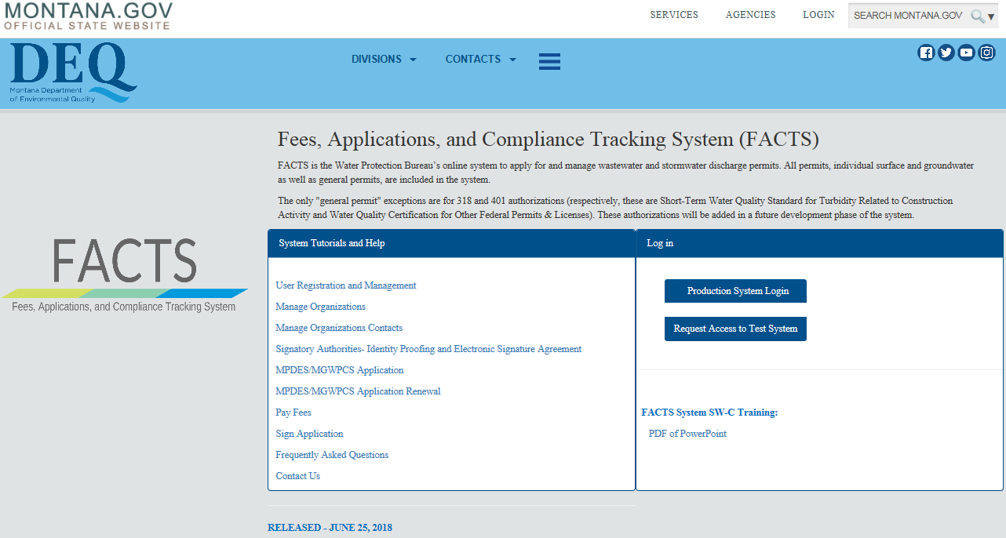
How do I use the system?
www.deq.mt.gov/FACTS

Slide 5
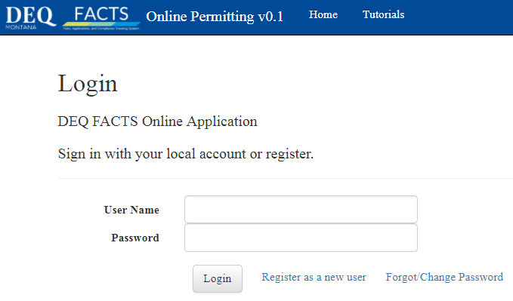
How do I use the system?
Create a User Account

Slide 6
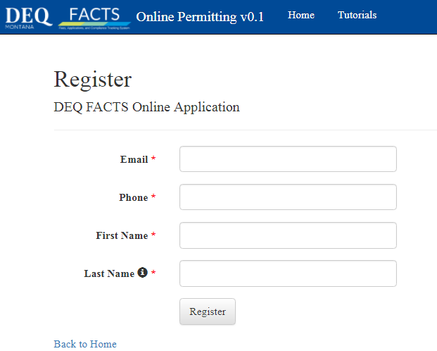
How do I use the system?
Create a User Account
Note: Email addresses can only be used once for registration.
Each person must have a unique email.

Slide 7
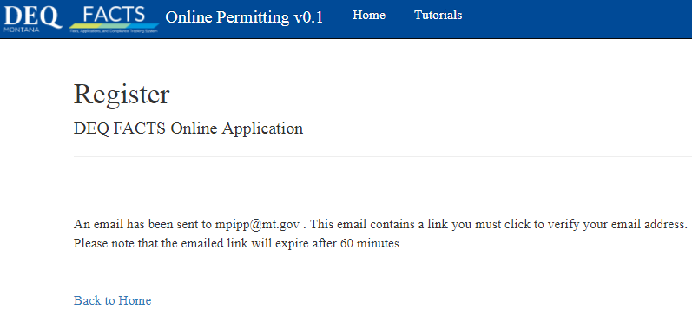
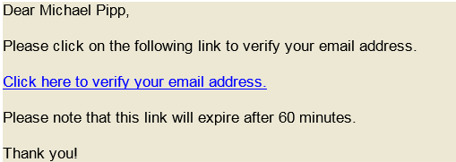
How do I use the system?
Create a User Account

Slide 8
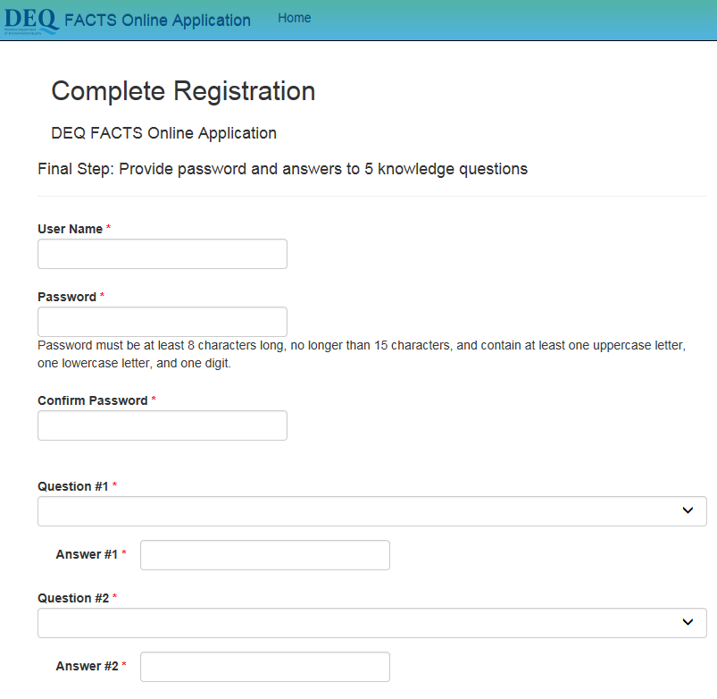
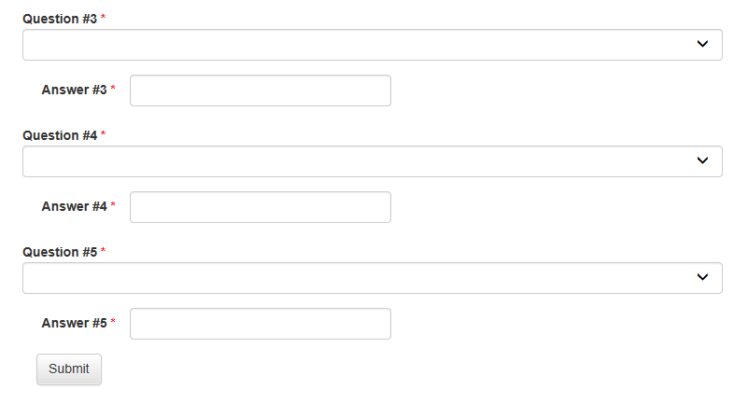
How do I use the system?
Create a User Account

Slide 9
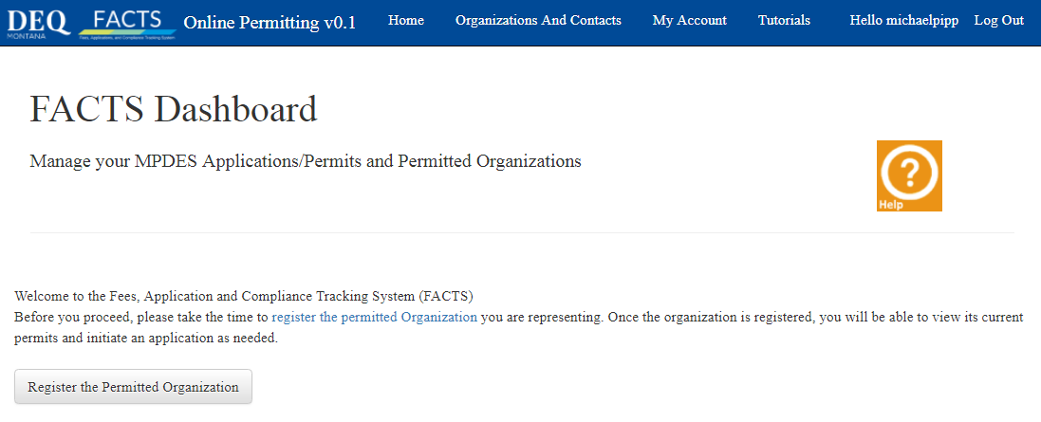
How do I use the system?
Find or Add an Organization
Initial login & dashboard view with no Organization associated
NOTE: ONLY Organizations that require permit coverage are created in FACTS.
i.e., Permitted Entities
If you currently have a permit…You WILL have an Existing Organization in FACTS!

Slide 10
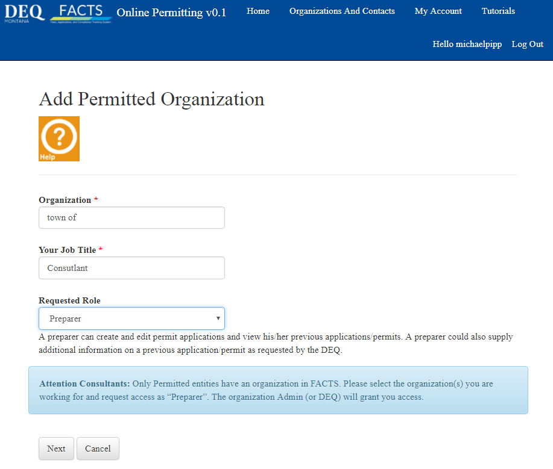
How do I use the system?
Find or Add an Organization
Add or Find an Organization
This is also a search feature – enter one or more full words of the existing organization to search for it.
Check your spelling ☺
Role description

Slide 11
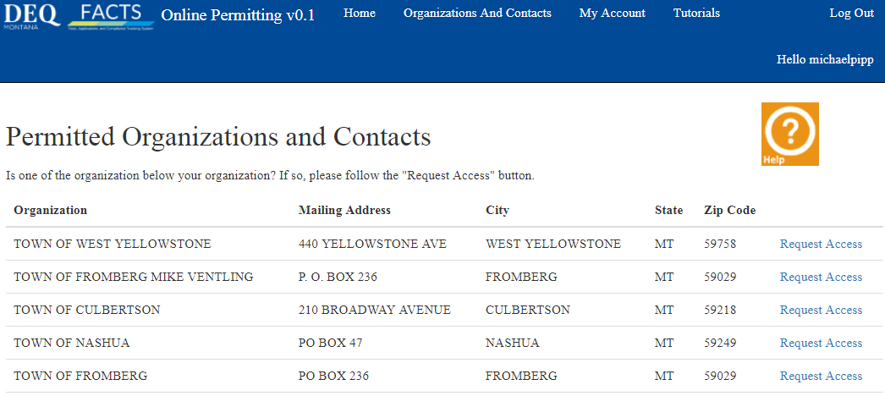
How do I use the system?
Find or Add an Organization
IF you have a permit…You WILL have an Existing Organization in FACTS!
TIP: Create the Organization Administrator account first. The OA can approve access for all the other roles (Preparer, SWPPP Admin, etc.)

Slide 12
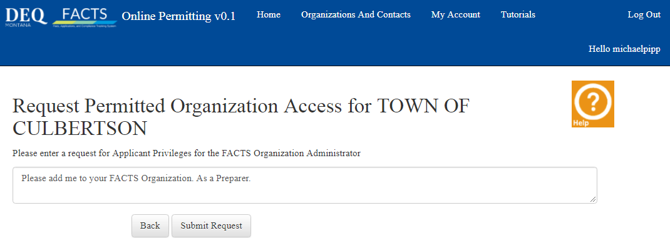
How do I use the system?
Request Access
Request Access to the Permitted Organization
TIP: You can request multiple roles at this time (e.g., Signatory Authority and Preparer)
The initial request for access to an organization will be approved by DEQ. Other roles can be approved by the Organization Administrator. The OA will receive email requests.

Slide 13
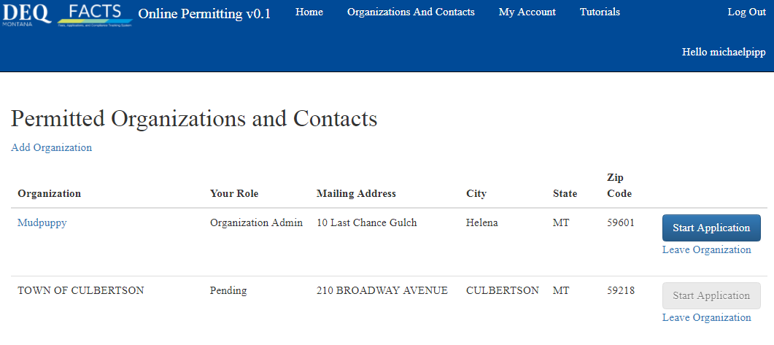
How do I use the system?
Request Access
After requesting access, your pending status is shown on your Organizations And Contacts page. Note that you cannot start an application until access is granted.

Slide 14
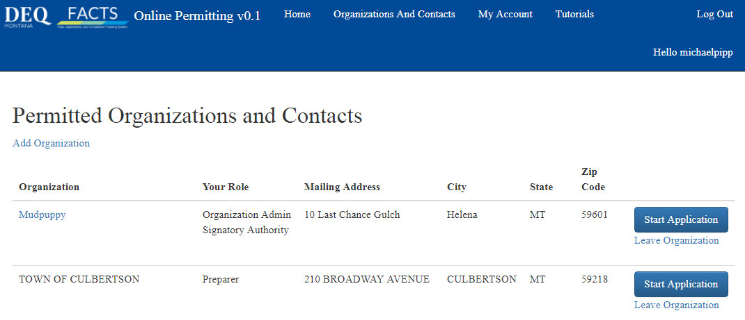
How do I use the system?
FACTS User Dashboard
The requestor will now see access is granted on their Organization And Contacts page.

Slide 15
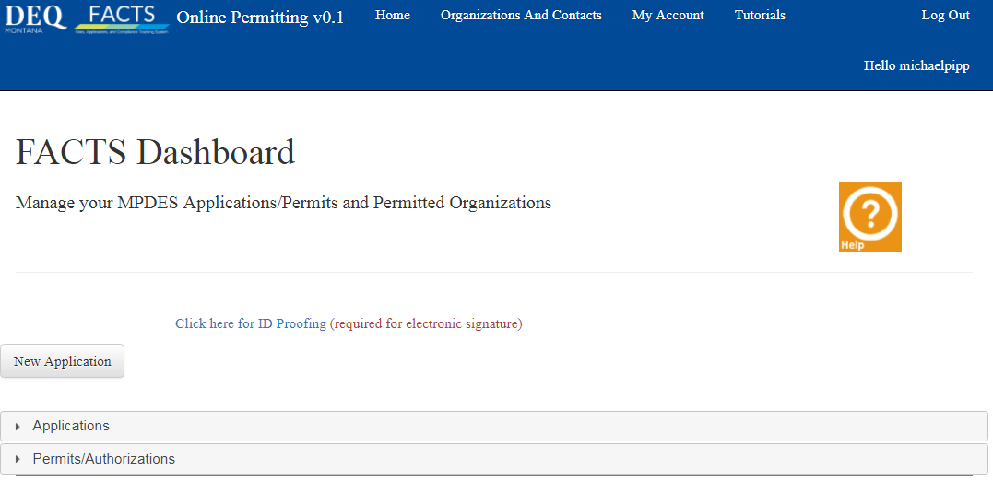
How do I use the system?
FACTS User Dashboard
The requestor’s FACTS Dashboard Home view after approval
Click here to start a new application
Click here to see in-progress or pending applications/NOIs
Click here to see current permit authorizations

Slide 16
How do I use the system?
Permit Application
Create a new Application/NOI

Slide 17
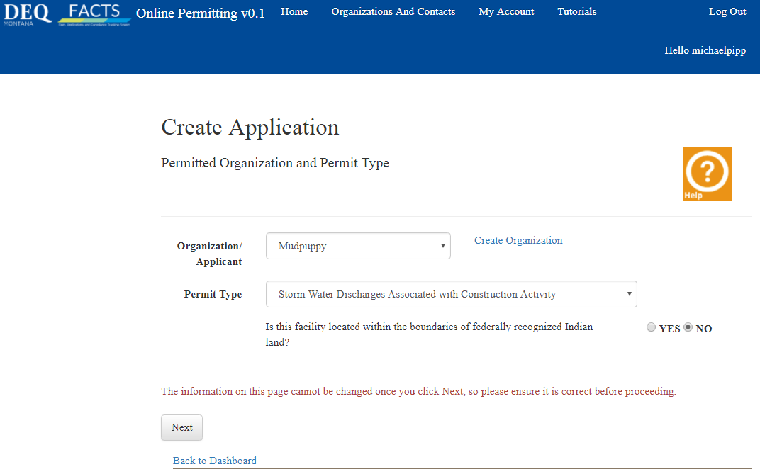
How do I use the system?
Permit Application
Create a new Application/NOI

Slide 18
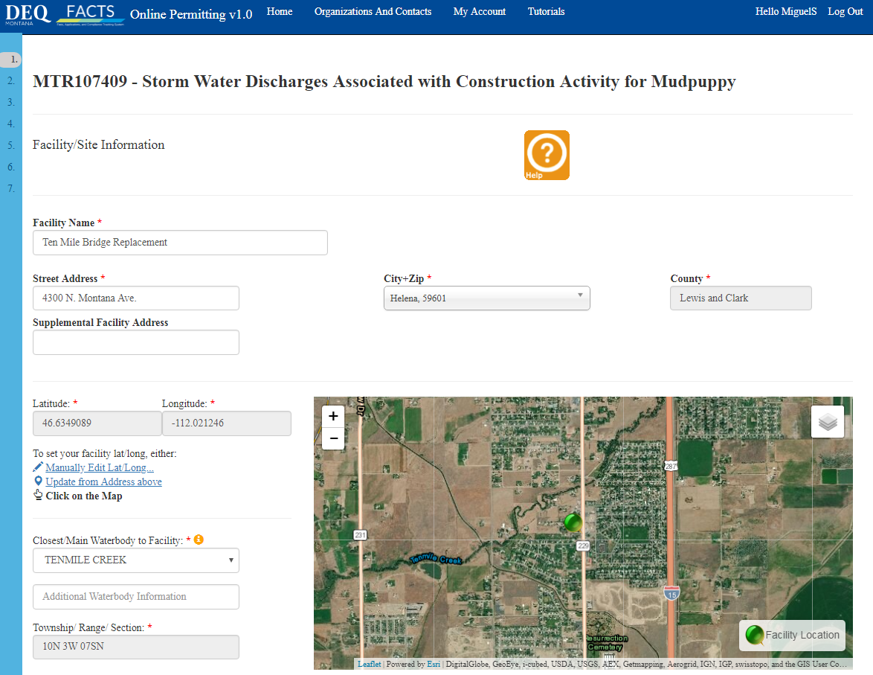
How do I use the system?
Permit Application
Facility / Site
Information & Location
Screen
* Street address or site description
2 address lines, 50 character fields
* If Waterbody is grayed out, enter nearest water or “drainage name”

Slide 19
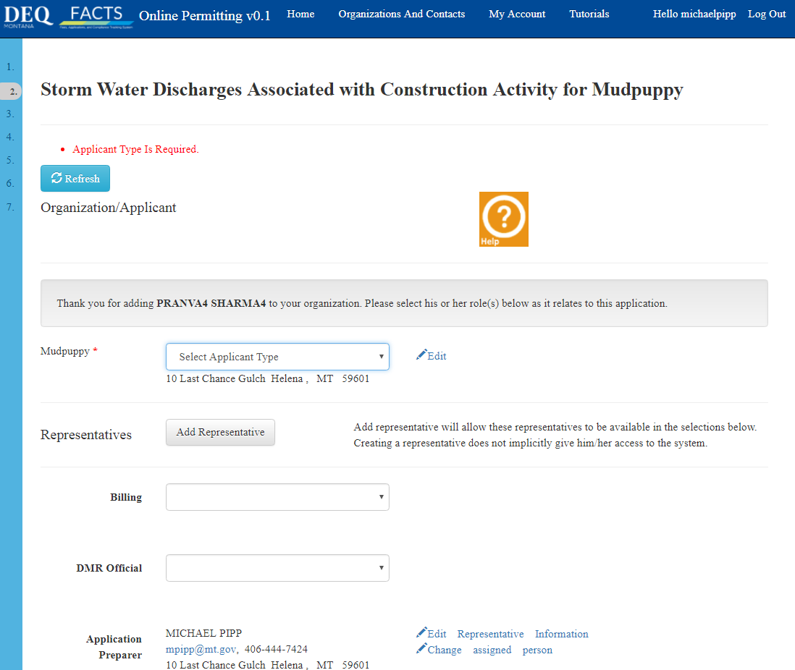
How do I use the system?
Permit Application
Representative
Screen – 1
Note:
Anyone can be added
User account is not required
User role is not required
Email is not required
Phone number is required

Slide 20
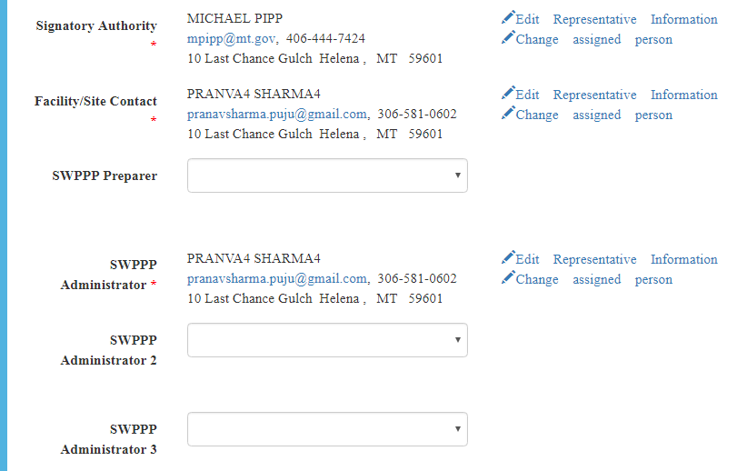
How do I use the system?
Permit Application
Representative
Screen – 2
Note:
Multiple SWPPP Administrators
* Prepares: add new facility contact by editing an existing contact.

Slide 21
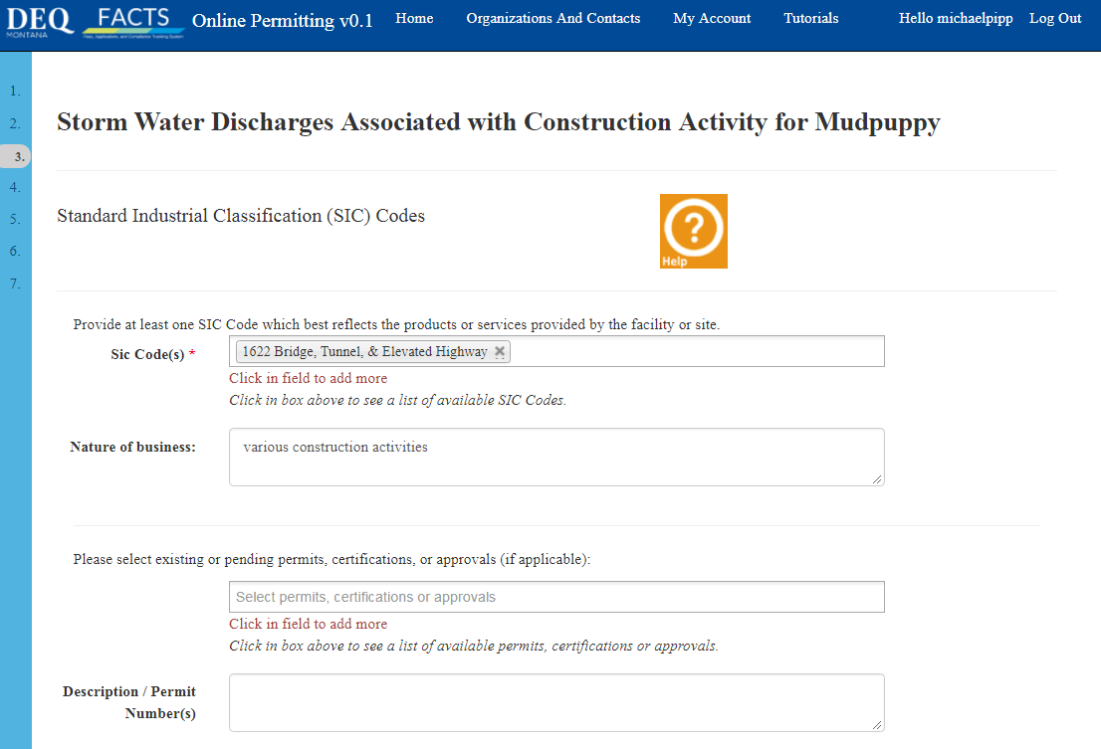
How do I use the system?
Permit Application
SIC Codes
Screen

Slide 22
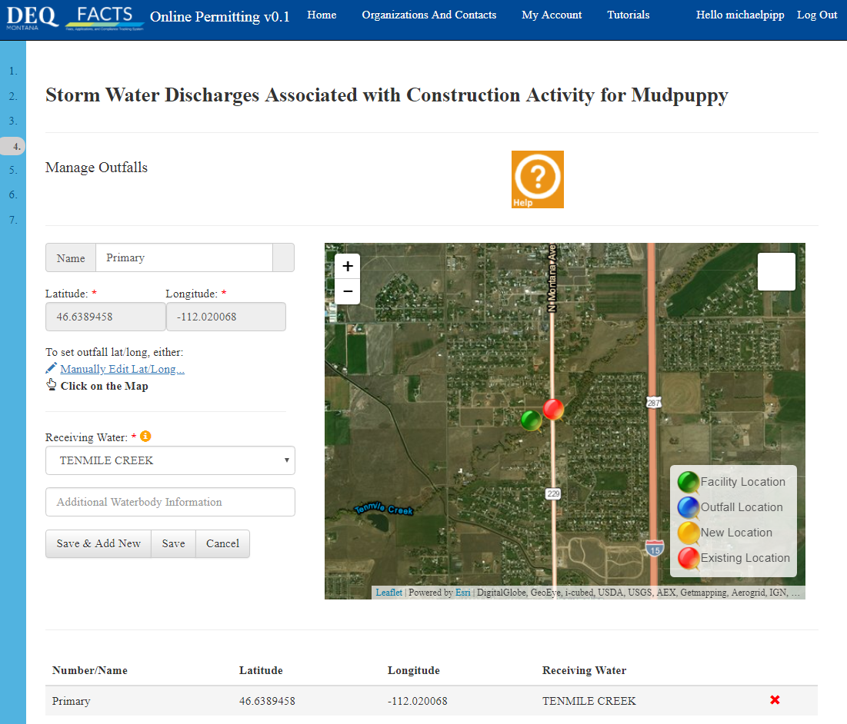
How do I use the system?
Permit Application
Outfall Screen
Mapping
Base Layers:
Imagery
Topo
Themes:
Waters
County
Sage Grouse
** If Receiving Water is grayed out, enter nearest waterbody

Slide 23
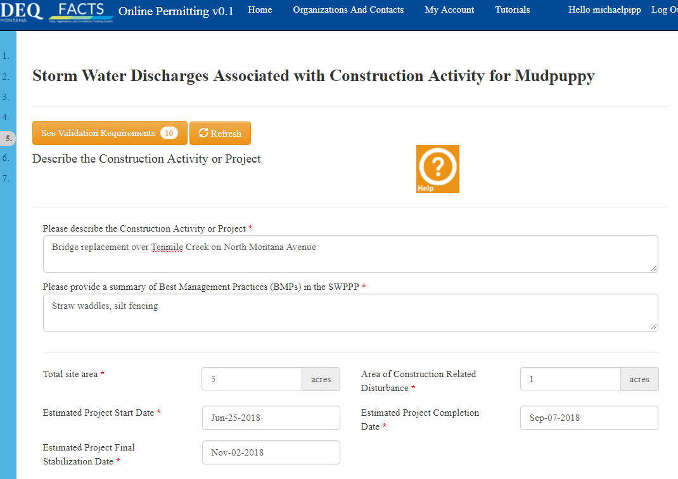
How do I use the system?
Permit Application
Construction Project
Screen – 1
Note:
10 required elements in validation for this page

Slide 24
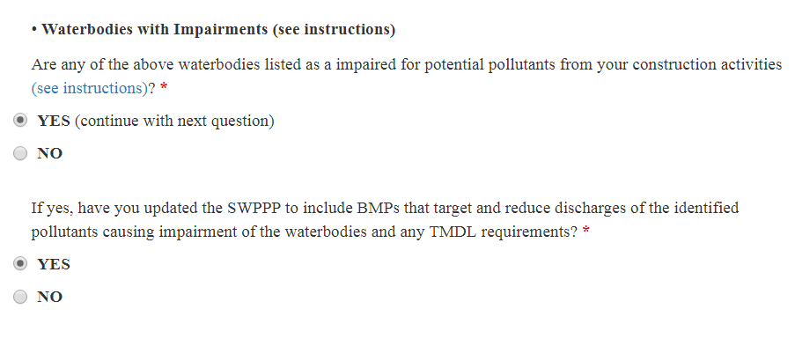
How do I use the system?
Permit Application
Construction Project
Screen – 2
Note:
Impaired Waters List

Slide 25
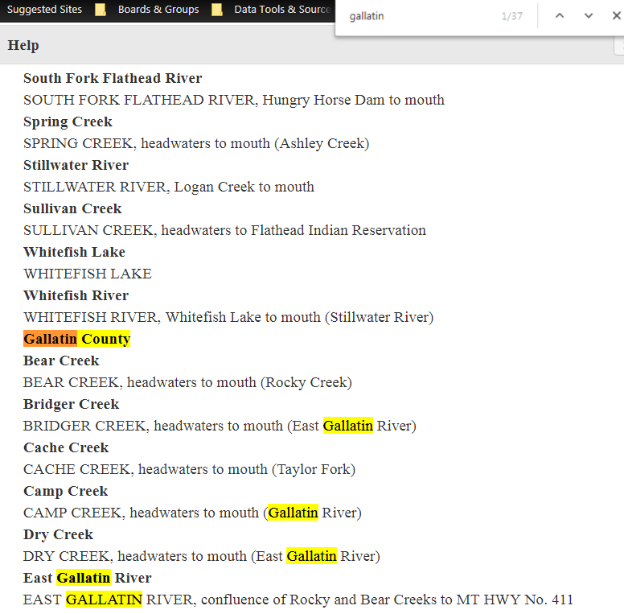
How do I use the system?
Permit Application
Construction Project
Screen – 3
Note:
Search
Impaired Waters List with “Ctrl F”

Slide 26
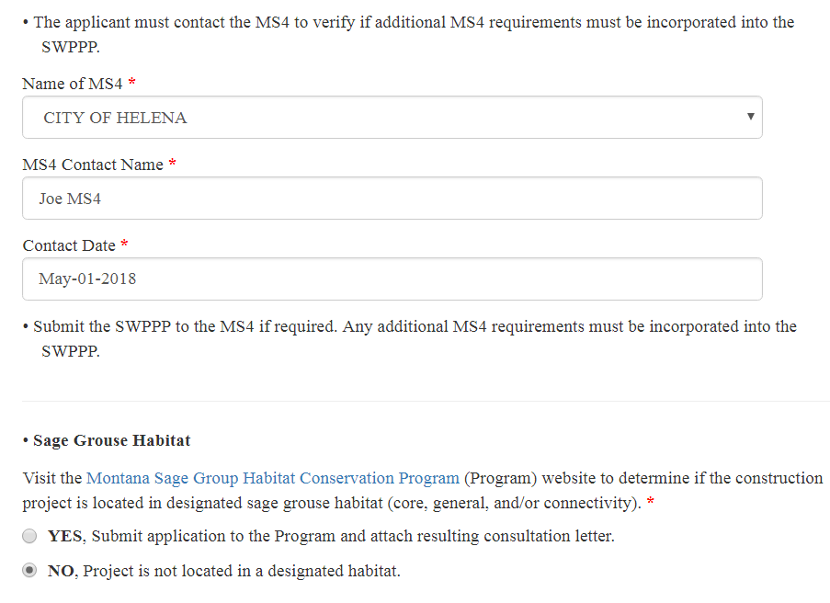
How do I use the system?
Permit Application
Construction Project
Screen – 4
Note:
MS4 Coordination
and
Sage Grouse consultation (link to DNRC Sage Grouse Program
web site)

Slide 27
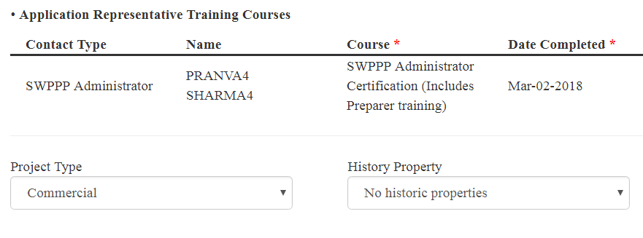
How do I use the system?
Permit Application
Construction Project
Screen – 5
Note:
SWPPP Training
and
project type

Slide 28
How do I use the system?
Permit Application
Documents Screen – 1
Note: required documents for submission based on information entered

Slide 29
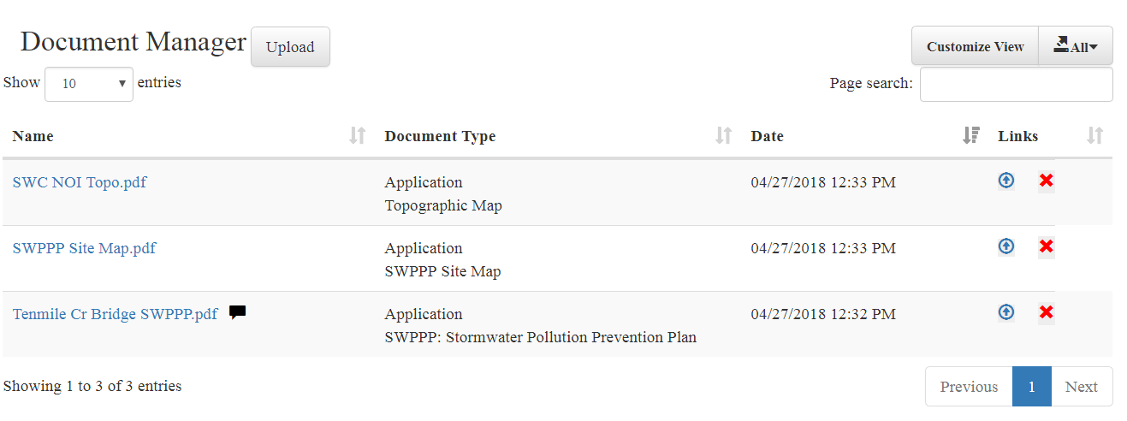
How do I use the system?
Permit Application
Documents Screen – 2
Document Manager

Slide 30
How do I use the system?
Permit Application
Create & Submit the Application / NOI
Note: “Generate Application Document”
creates NOI (.pdf), saves to Document Manager, and submits to DEQ

Slide 31
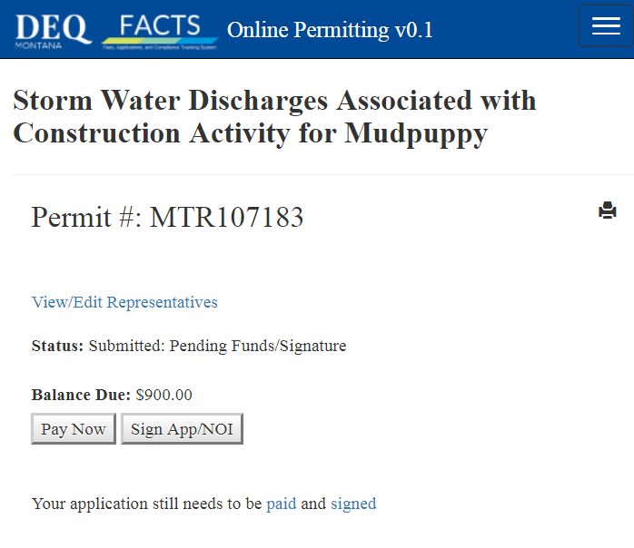
How do I use the system?
Permit Application
Completed Application / NOI ready for:
- Payment
- Signing

Slide 32
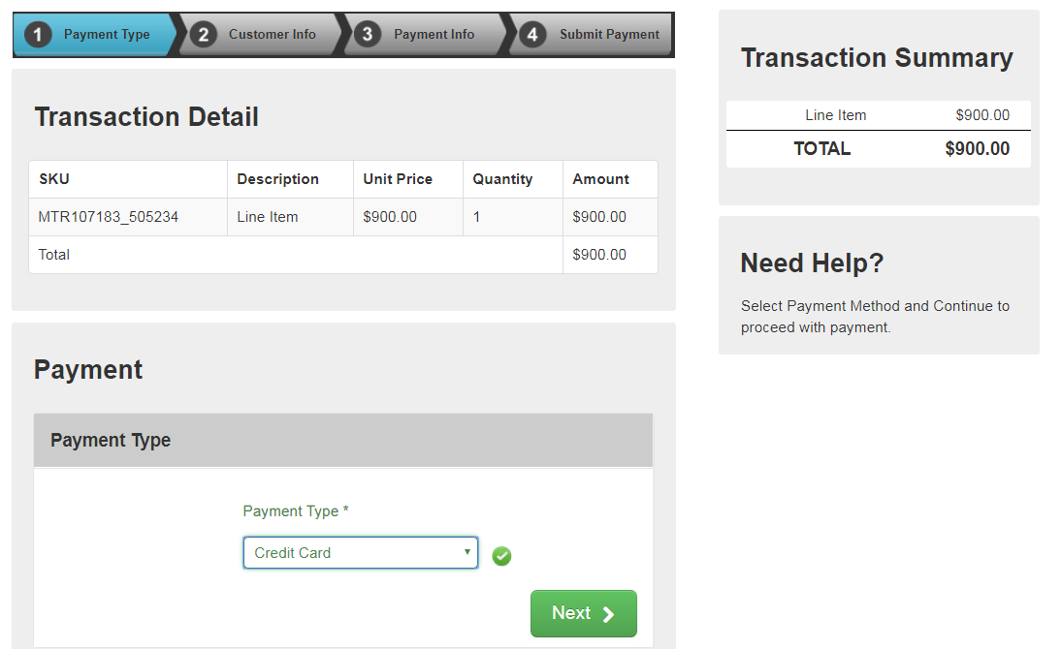
How do I use the system?
Payments
To make a payment:
Select
payment type:
- Credit card
- eCheck

Slide 33
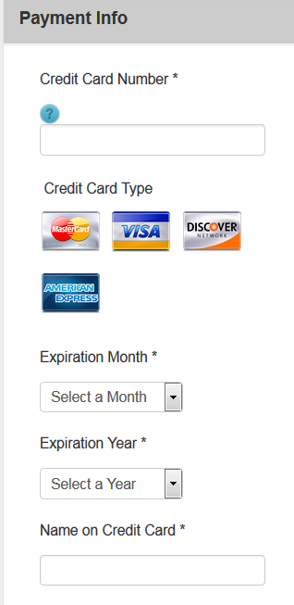
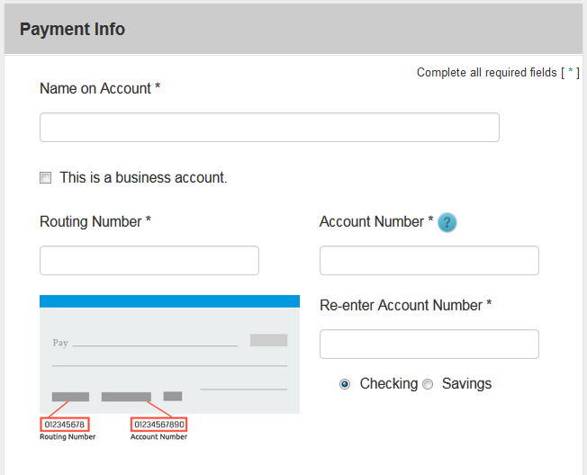
How do I use the system?
Payments
Credit card screen
eCheck screen
To make a payment:
Select
Payment
type:
- Credit card
- eCheck
* 9-digit
routing #

Slide 34
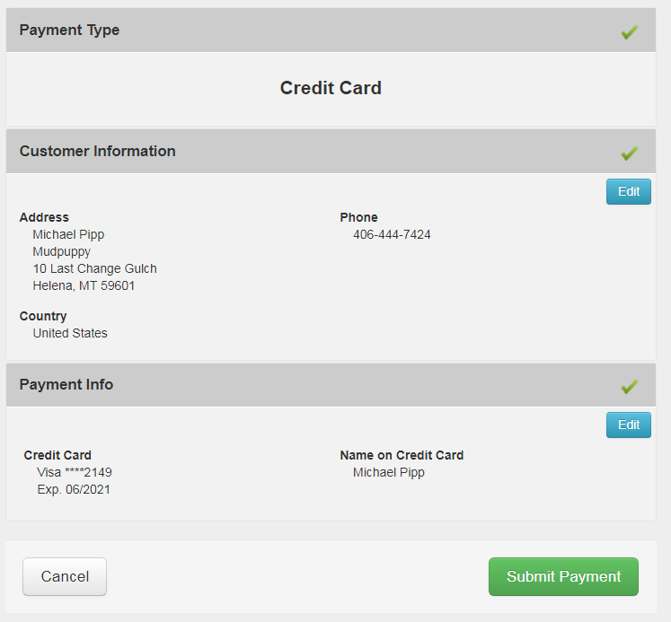
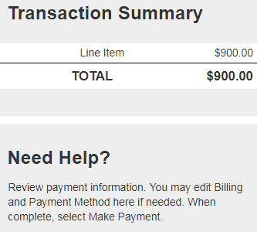
How do I use the system?
Payments
To make a payment:
Review information and submit payment

Slide 35
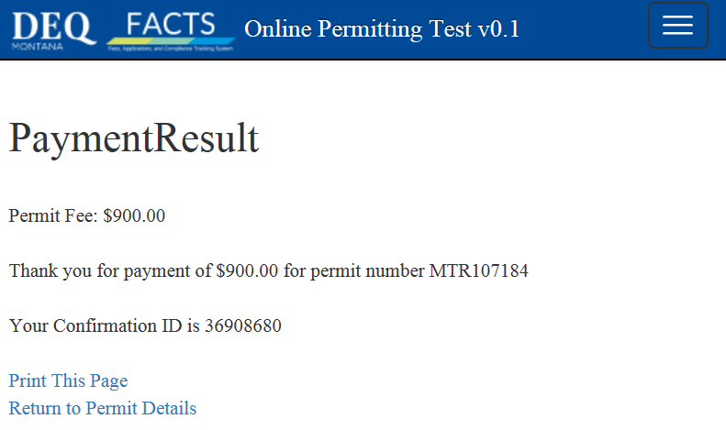
How do I use the system?
Payments
To make a payment:
Payment Receipt & Confirmation

Slide 36
How do I use the system?
Signatory Authority Process
Signatory Authority Role:
* Person defined by rule who can sign application/NOI/SWPPP
* Only role required to ID Proof
- one time only per user with SA role
* Requires Electronic Signature Agreements
- one per Organization for user with SA role
* Also has same ability in system as Organization Admin.

Slide 37
How do I use the system?
Signatory Authority Process
The Signatory Authority’s FACTS Dashboard view after approval

Slide 38
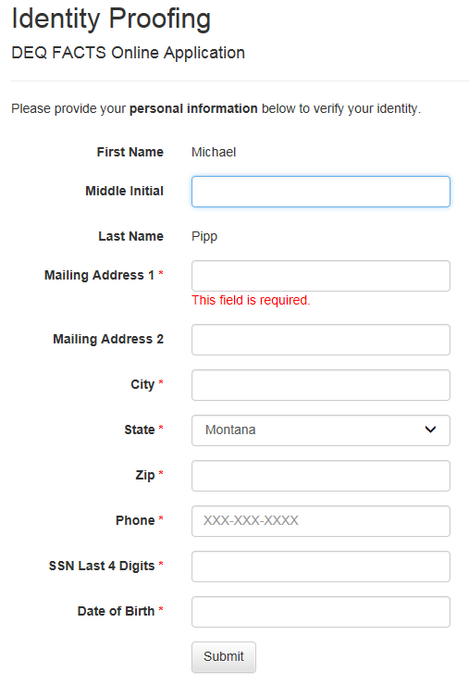
How do I use the system?
Signatory Authority Process
ID Proofing Form
NOTE:
This is only required once.
ID Proofing is done by Lexis-Nexis. DEQ does not save any personal data.

Slide 39
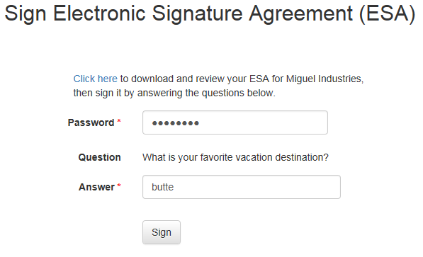
How do I use the system?
Signatory Authority Process
To Sign an Application:
Sign the Electronic Signature Agreement
(ESA) for the Organization

Slide 40
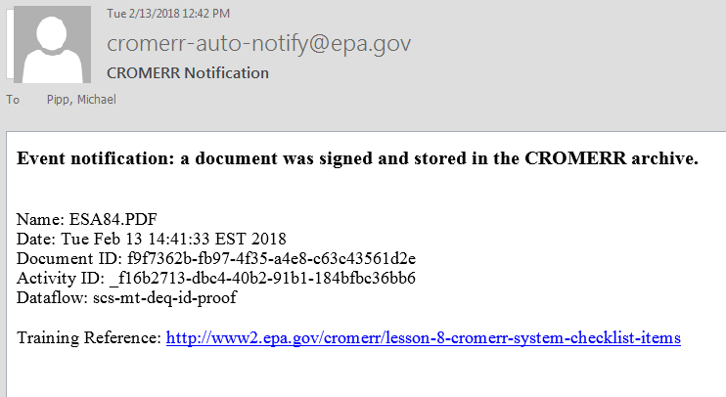
How do I use the system?
Signatory Authority Process
To Sign an Application:
EPA’s CROMERR
Email notice for a signed ESA
ESA document was created by DEQ

Slide 41
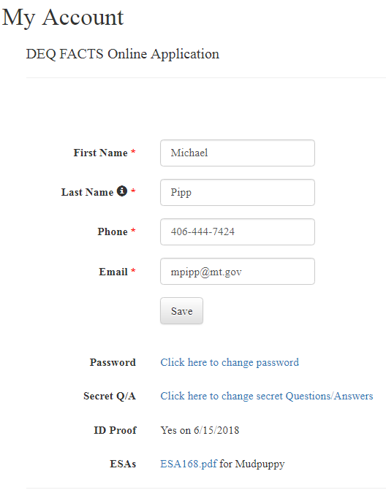
How do I use the system?
Signatory Authority Process
My Account page with ID Proof status and completed ESAs

Slide 42
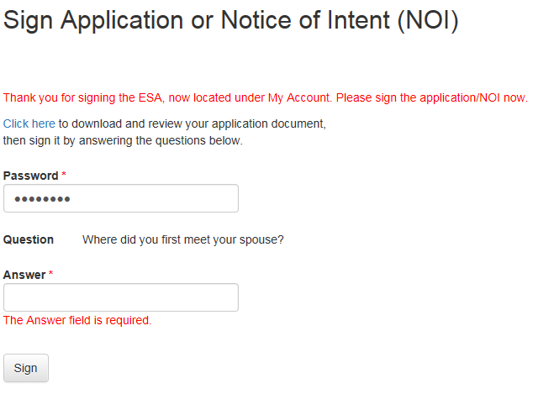
How do I use the system?
Sign & Submit
To Sign an Application:
Now -
sign the Application or NOI

Slide 43
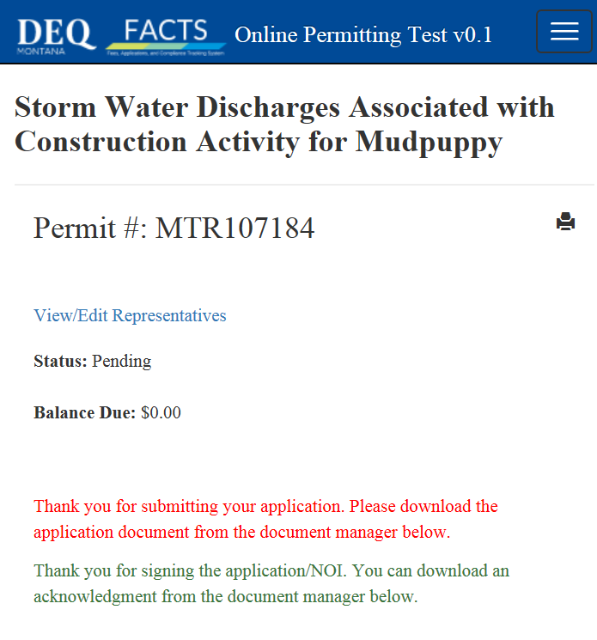
How do I use the system?
Application Complete
Permit Application Process
Completed.
- Status
- Balance

Slide 44
How do I use the system?
Org admin process
Organization Admin Role:
Designated by the Organization to manage FACTS representatives
Has authority to take any action on permit or application/NOI - except signing
Approves user access requests and can assign roles - including Signatory Authority
Can add new reps so the NOI Preparer can add to an application. NOTE: Preparers cannot add representatives to the org.
NOTE: Only representatives that require access to a facility’s permit (authorization) need an account in FACTS

Slide 45
How do I use the system?
Org admin process
The Org Admin will be able to click on a company name to confirm role requests.

Slide 46
How do I use the system?
Org admin process
The Organization Admin will receive an email requesting access. The OA clicks on the pending requestor’s name.
Organization Admin:
if you want or need to remove a Contact, click on the X after their name.

Slide 47
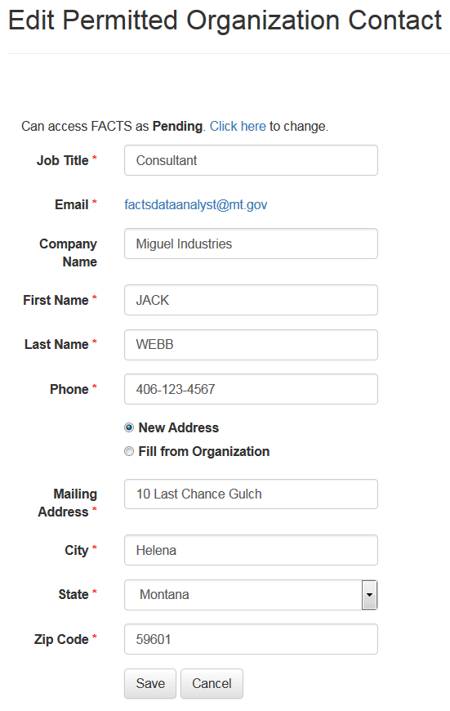
How do I use the system?
Org admin process
Organization Contact Request Screen
IF access to the system (permit) is needed by a person or representative:
“Click Here” …

Slide 48
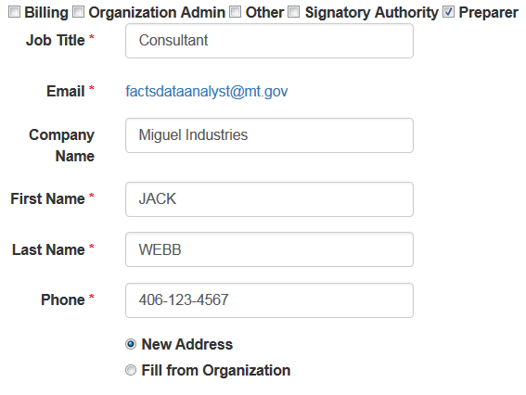
How do I use the system?
Org admin process
… Select one or more roles and save

Slide 49
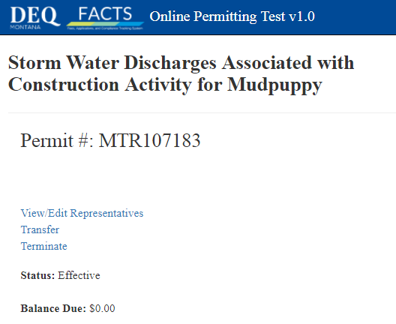
How do I use the system?
Transfer or Terminate
Select permit # from home page, then select option on permit page.
- Form PTN or NOT will open as fillable pdf.
- Complete form and mail to DEQ WPB.

Slide 50
Questions?
Contacts
Gina Self
Database Analyst
Water Protection Bureau
444.5388
gself@mt.gov
Lisa Tucker
Computer System Analyst
FACTS
444.9897
ltucker@mt.gov
www.deq.mt.gov/FACTS

