Slide 1
WALKTHROUGH INSPECTIONS
Wally Jemmings
UST Licensee Training
February 7, 2019

Slide 2
EPA Final Rule 40 CFR Parts 280 and 281
Revising Underground Storage Tank Regulations
Revisions to Existing Requirements and
New Regulations for Secondary Containment and Operator Training

Slide 3
EPA Final Rule 40 CFR Parts 280 and 281
“Today’s final UST regulation allows owners and operators to conduct operation and maintenance walkthrough inspections according to a code of practice developed by a nationally recognized association or independent testing laboratory or according to requirements developed by the implementing agency.”

Slide 4
EPA Final Rule 40 CFR Parts 280 and 281
“EPA is including Petroleum Equipment Institute’s Recommended Practice 900 as a code of practice that may be used to meet the walkthrough inspections requirement in today’s final UST regulation. This recommended practice includes daily, monthly, and annual inspections for properly maintaining underground storage tank systems. Owners and operators who use the code of practice option for meeting UST requirements must use the ENTIRE code of practice.”

Slide 5
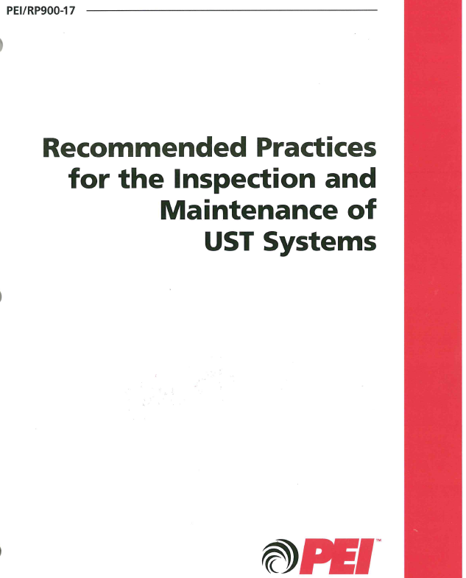

Slide 6
PEI/RP900-17
“In many respects, the federal walkthrough inspection and testing requirements are less comprehensive than the inspection and testing requirements contained in this document. After reviewing the walkthrough inspection requirements of the federal regulation, the PEI UST System Inspection and Maintenance Committee has decided that more frequent and comprehensive inspections of vehicle fueling UST systems than those specified in the federal rule are warranted. The recommended practices in this document include inspection and maintenance procedures the Committee believes to be important whether or not these procedures are included in the federal rule.”
Notes:
PEI RP 900 page 3

Slide 7
EPA Final Rule 40 CFR Parts 280 and 281
“Owners and operators who use the code of practice option for meeting UST requirements must use the ENTIRE code of practice. “
Notes:
PEI RP 900 page 3

Slide 8
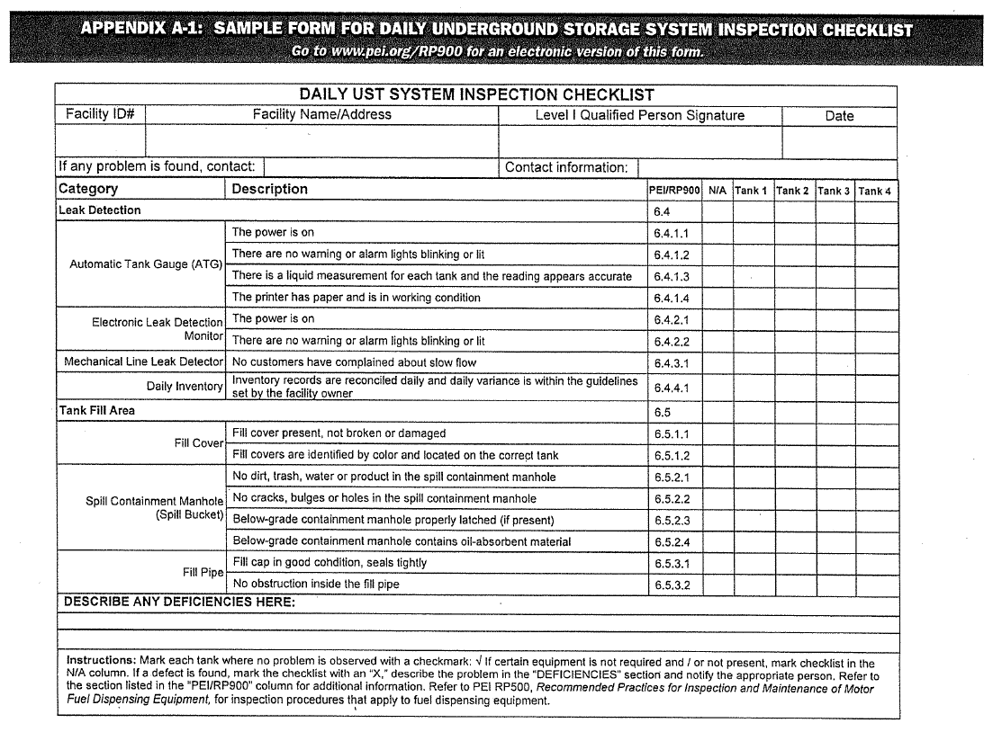
Notes:
Daily

Slide 9
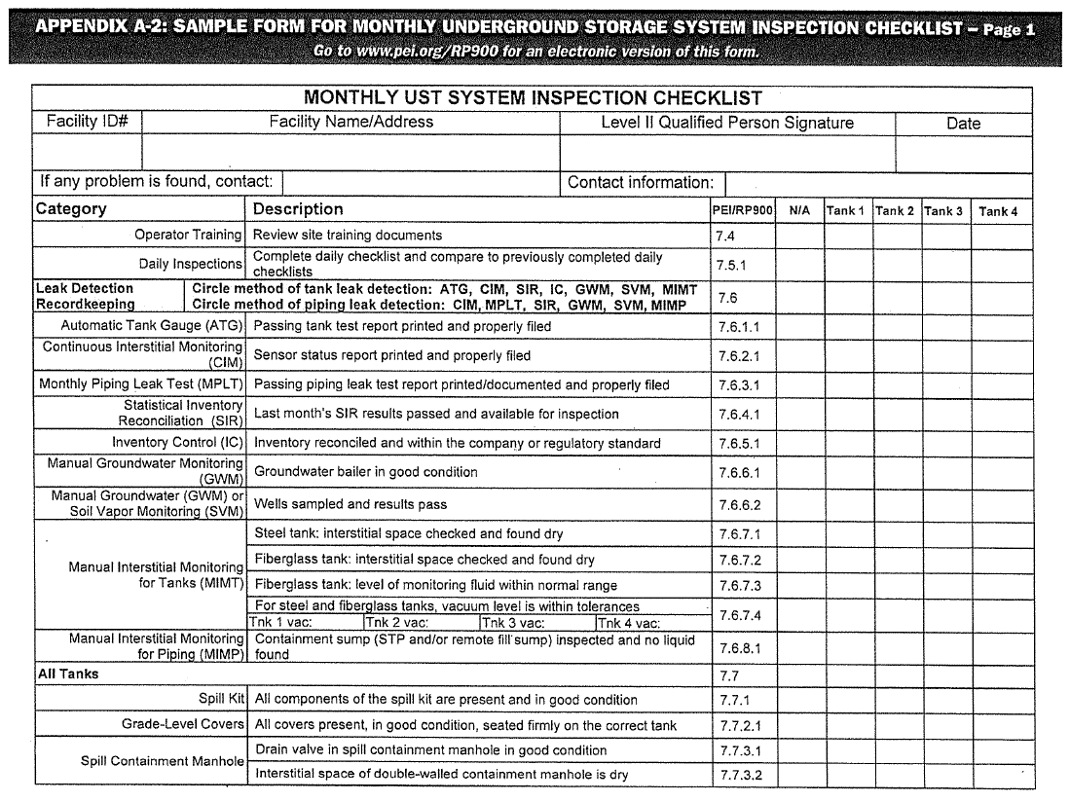
Notes:
Monthly

Slide 10
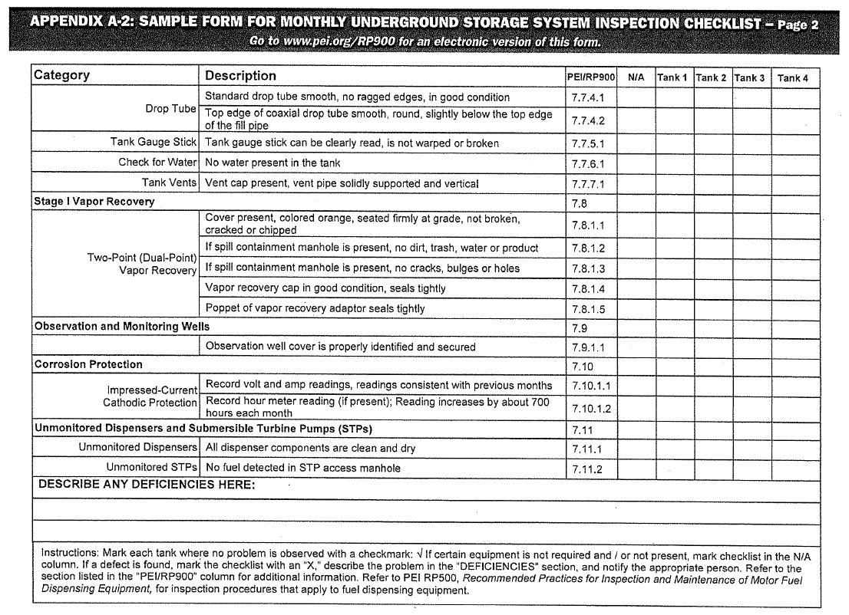
Notes:
Monthly

Slide 11
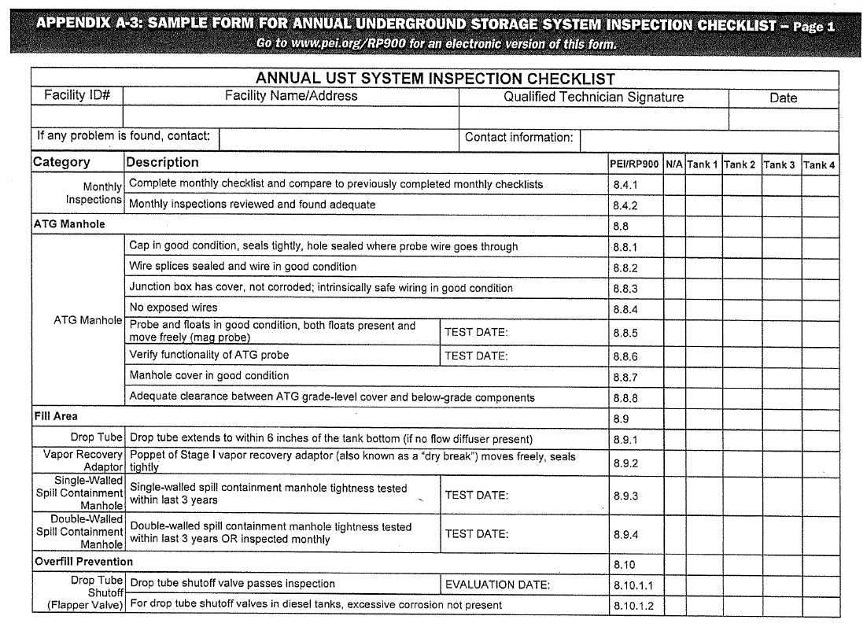
Notes:
Annual

Slide 12
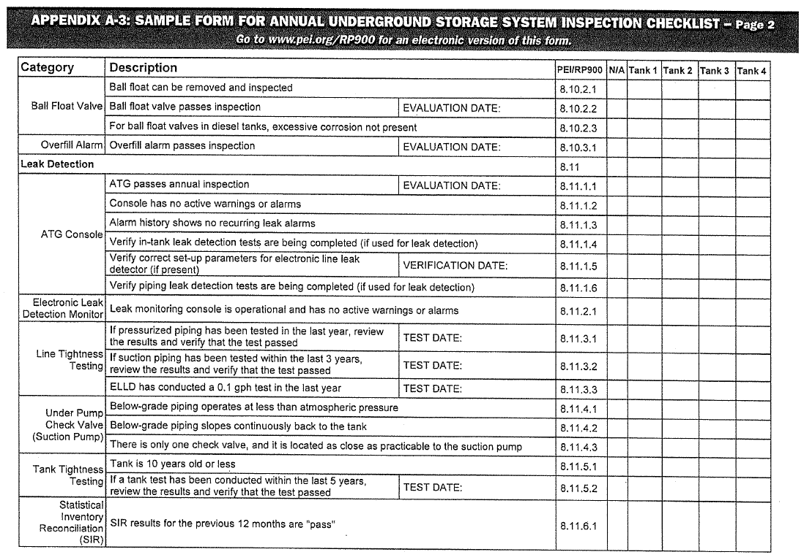
Notes:
Annual

Slide 13
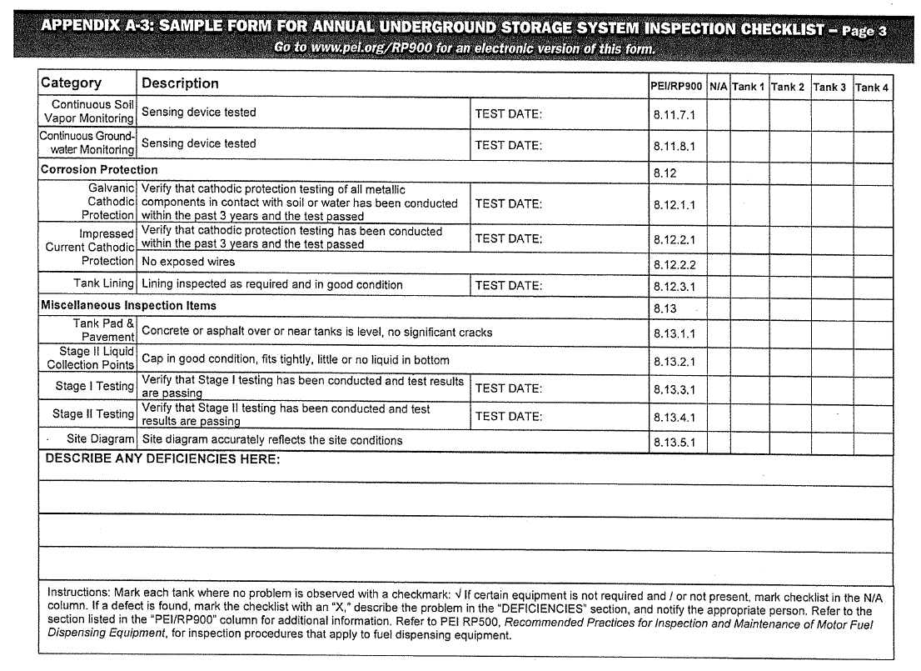
Notes:
Annual

Slide 14
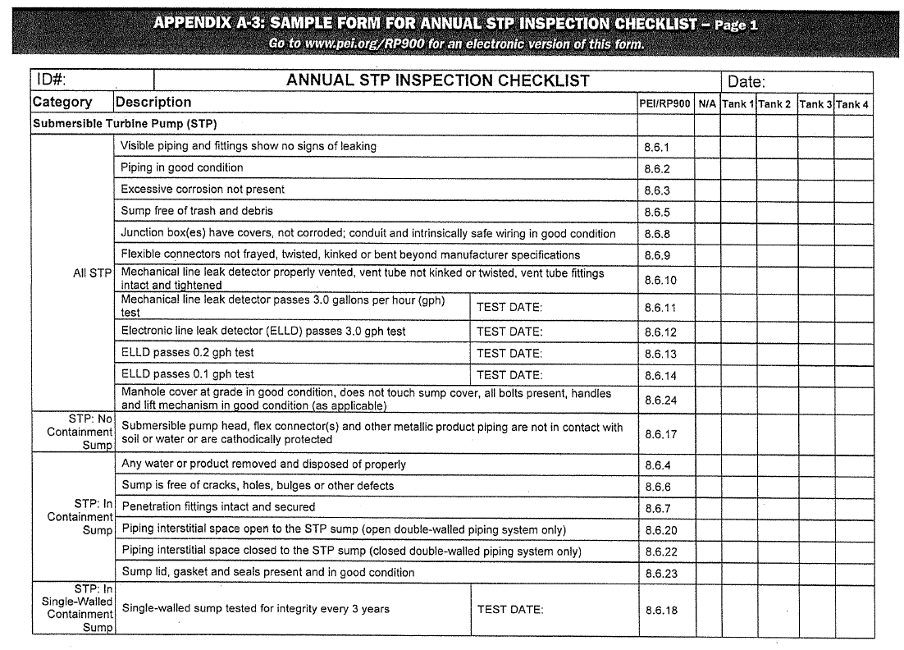
Notes:
Annual

Slide 15
Notes:
Annual

Slide 16
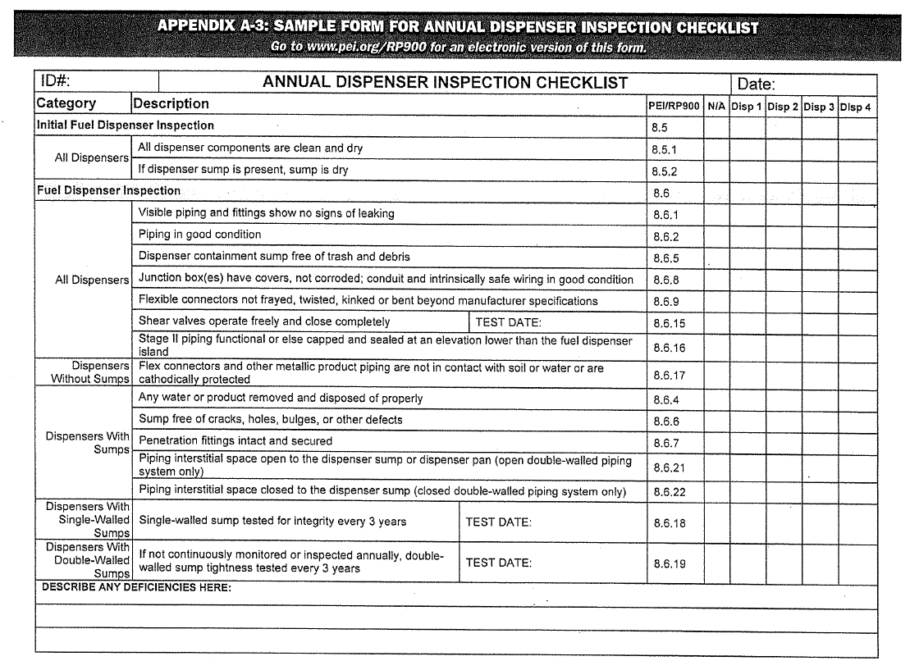
Notes:
Annual

Slide 17
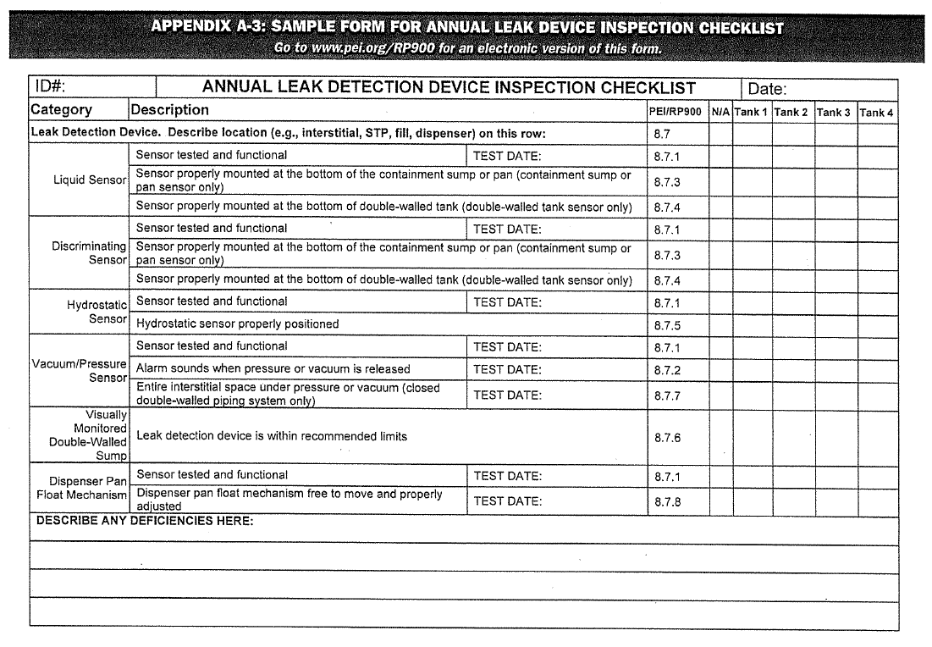
Notes:
Annual

Slide 18
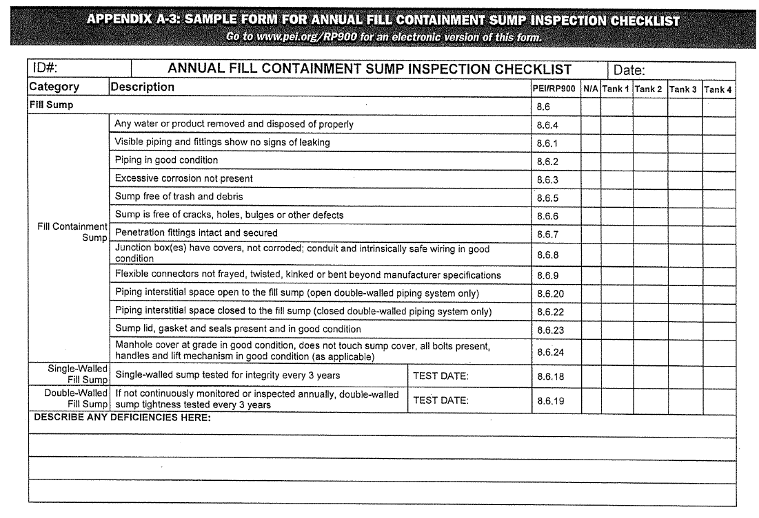
Notes:
Annual

Slide 19
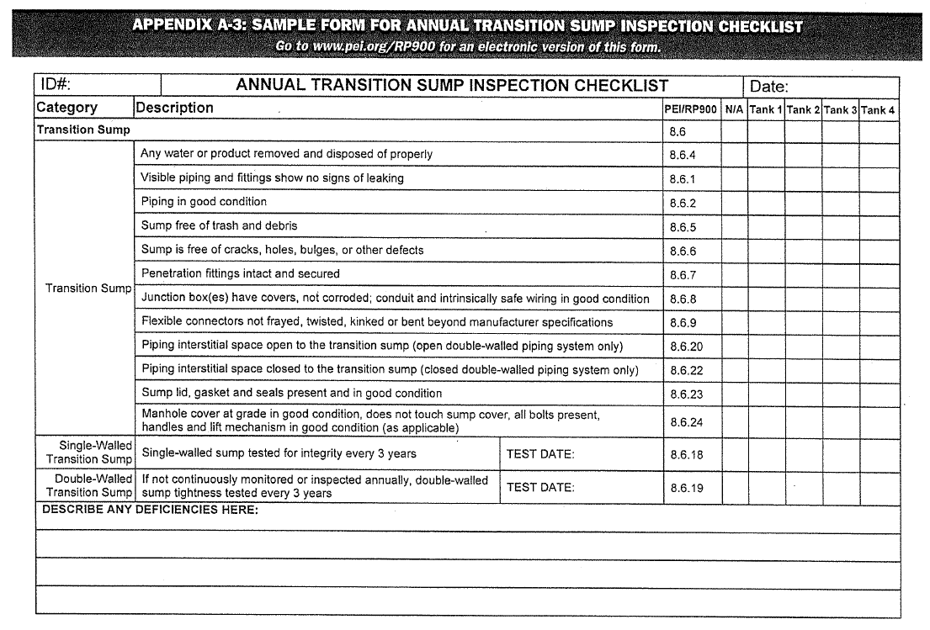
Notes:
Annual

Slide 20
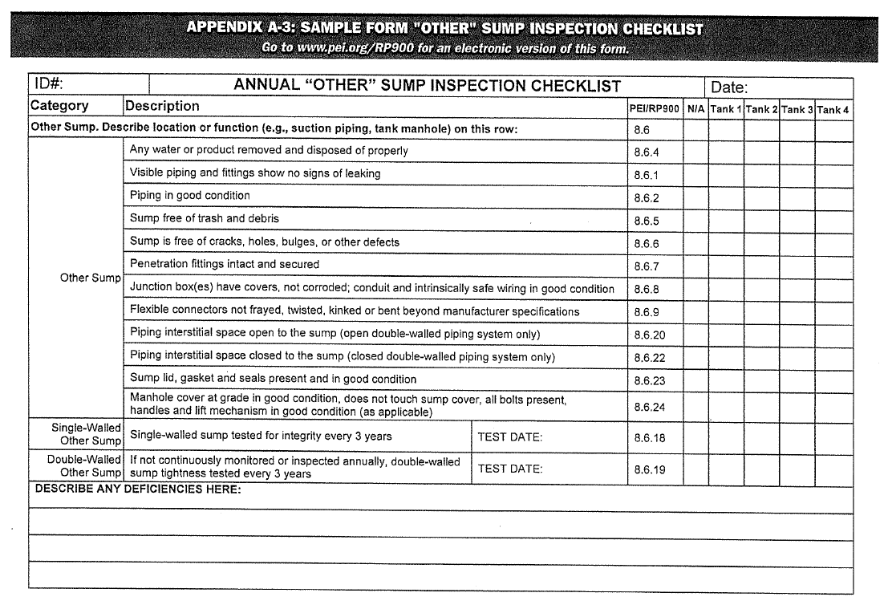
Notes:
Other

Slide 21
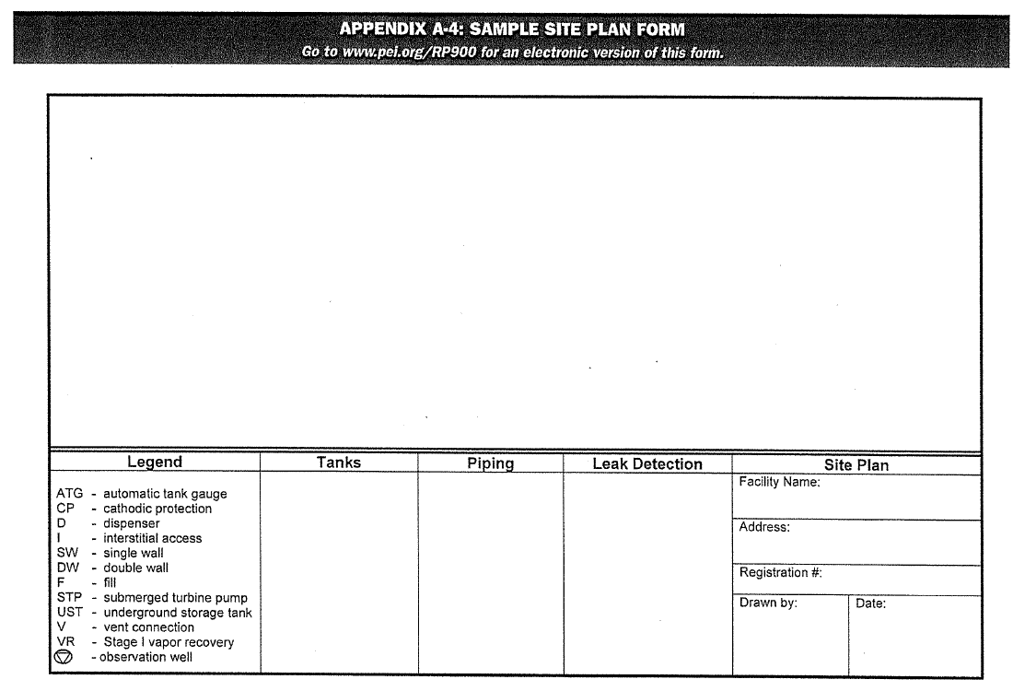
Notes:
Site Map

Slide 22
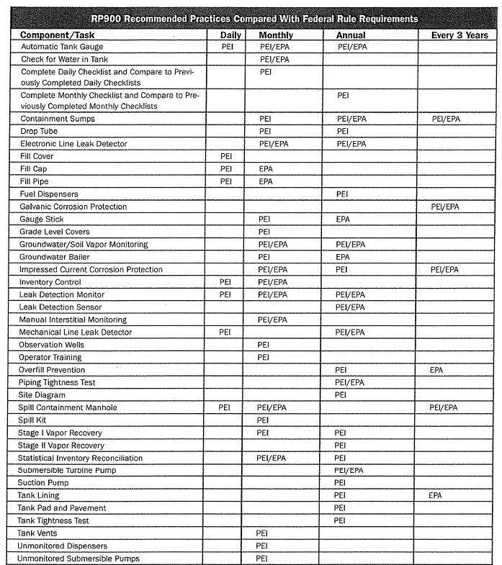
Notes:
EPA/PEI Comparison

Slide 23
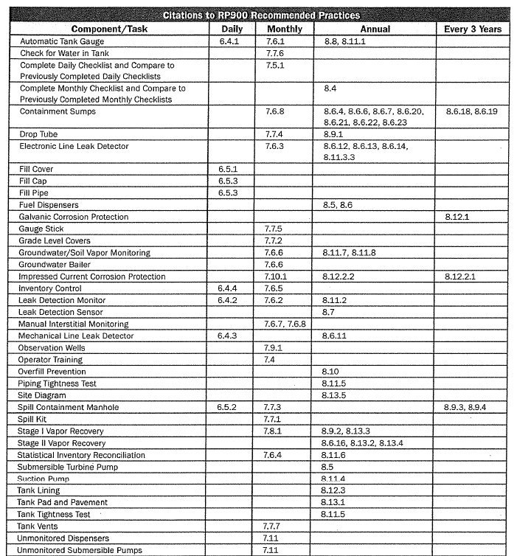
Notes:
Where in book

Slide 24
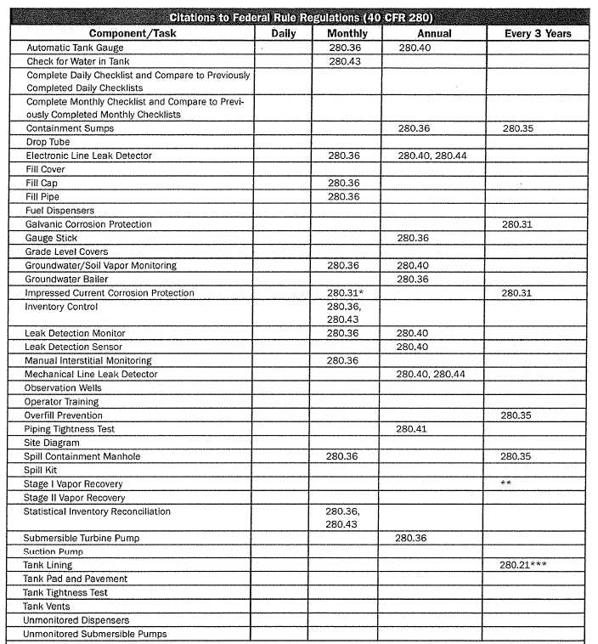
Notes:
EPA rule reference

Slide 26
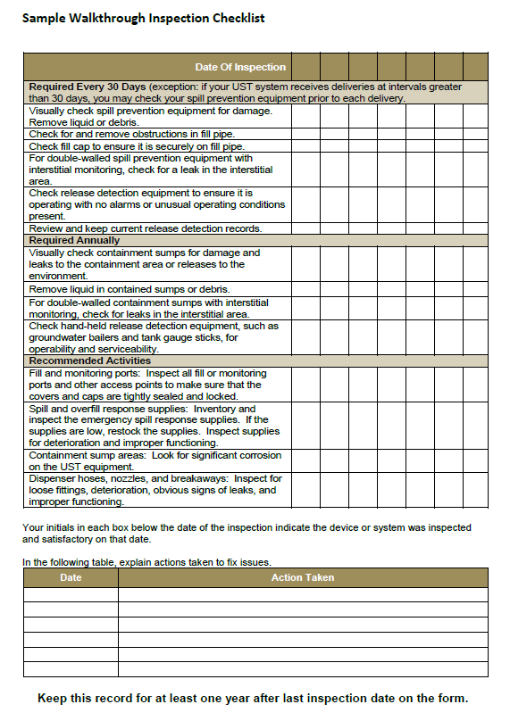

Slide 27
ARM 17.56.307 Periodic Operation and Maintenance Walkthrough Inspections
October 13, 2021.
Keep the records for one year.

Slide 28
