Slide 1
A summary of the New 2018 Rule Changes Rule Changes
Leanne Hackney
Montana DEQ Underground Storage Tank Program
October 15, 2019

Slide 2
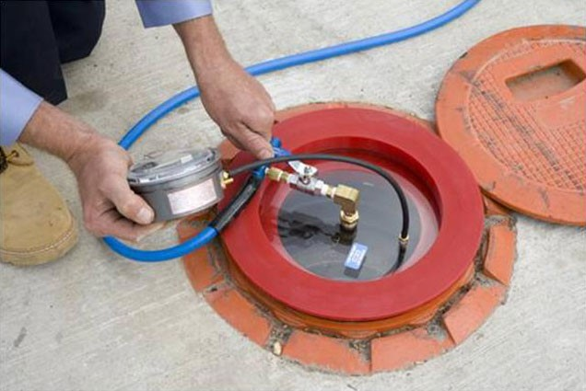
The new 2018 Montana UST rules – October 9, 2018
October 6, 2018

Slide 3

What’s New?
Operation and Maintenance:
  Walk-through inspections:
    Every 30 days:
      Visually check spill prevention equipment (spill bucket, fill cap, fill pipe) – exception: facilities with deliveries > 30 days, check prior to each delivery
      Check release detection equipment
        Operating with no alarms
        No unusual operating conditions present
        Ensure release detection records are reviewed and current
          Facilities that utilize remote monitoring may utilize this method for checking release detection records and alarms

Slide 4
What’s New Continued…
Walkthrough Inspections continued
  Annually:
    Visually check containment sumps
    Check hand held release detection equipment (tank gauge sticks)
  Use standard code of practice: PEI RP 900, Recommended Practices for the Inspection and Maintenance of UST Systems as a code of practice, but must be followed in its entirety, or
  Conduct walkthrough inspections developed by the department
  O/O must begin walkthrough inspections no later than October 13, 2021.

Slide 5
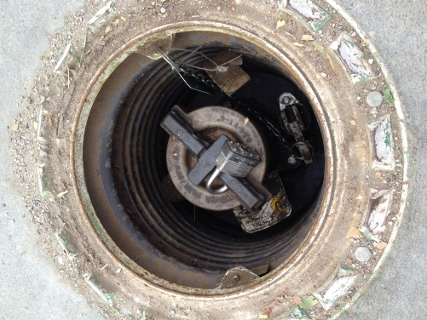
What’s New Continued…
Spill Prevention Equipment Tests
  Every three years tightness test
    Liquid, pressure or vacuum
    “Periodic” monitoring of double-walled spill bucket may be used in lieu of the three year test if O/O conducts periodic monitoring of the equipment at a frequency consistent with, or more frequent than the walkthrough inspection frequency
      Example: O/O checks vacuum, pressure, or liquid interstitial integrity indicators of double-walled spill bucket as part of walkthrough inspection
Notes:
Remote facilities where tank fills are >30 days, inspect before filling and keep receipts. Once a year fills will need 3 year tightness test

Slide 6
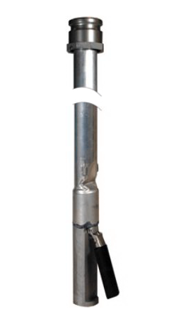
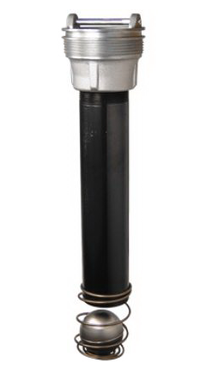
What’s New Continued…
Overfill Prevention Equipment Inspections
  Owners and operators must conduct
  overfill prevention equipment
  inspections at lease once every
  three years, including BFVVs that have
  been paved-over

Slide 7
What’s New Continued…
Secondary Containment Tests
  Follows Montana’s three year tightness testing requirement of sumps and UDCs for Energy Act Tanks installed November 26, 2009 and later and systems where primary method of LD is interstitial monitoring.
  Double-walled sumps and UDCs, if monitored “periodically” and included in the walkthrough inspection (i.e. O/O checks vacuum, pressure, or liquid interstitial integrity indicators of sump, UDC) can be used in lieu of 3 year tightness test.

Slide 8
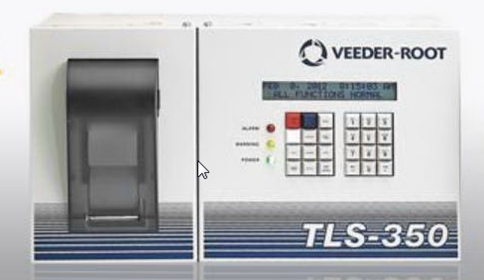
Additional Requirements for Operation and Maintenance
Release detection equipment tests
  Annual operation and maintenance tests on electronic and mechanical components of their release detection equipment:
    Automatic Tank Gauge (ATG) systems and other controllers
      Test Alarm
      Verify system configuration
      Test battery back-up
Notes:
17.56.401(1)(d)

Slide 9
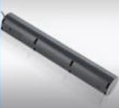
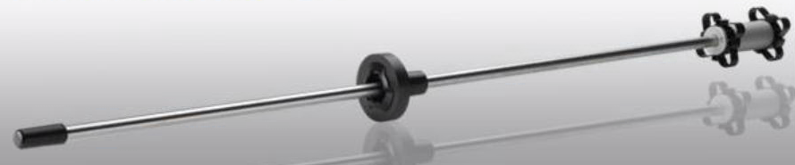
Release Detection Equipment Tests Continued
Probes and Sensors
  Inspect for residual build-up
  Ensure floats move freely
  Ensure probe or sensor is not damaged
  Ensure cables are free of kinks and breaks
  Test alarm operability and communication with controller

Slide 10
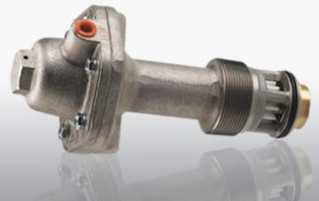
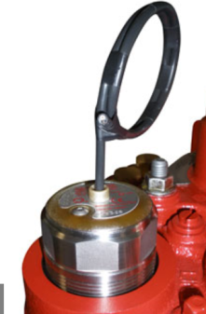
Release Detection Equipment Tests Continued…
Automatic Line Leak Detector
  Simulate a leak which determines
    capability to detect a leak
    Vacuum pumps and pressure gauges
      Ensure proper communication with sensors and controller

Slide 11
Additional Requirements for Operation and Maintenance
  Beginning October 13, 2021, these tests and inspections must be conducted following:
    Manufacturer’s instructions,
    Code of practice, or
    Requirements determined by the department no less protective of the environment
  Currently, there is one code of practice: PEI RP 1200, Recommended Practices for the Testing and Verification of Spill, Overfill, Leak Detection and Secondary Equipment at UST Facilities
  These tests and inspections must be performed by a MTDEQ licensee.
Notes:
Recommend performing these as soon as possible!

Slide 12
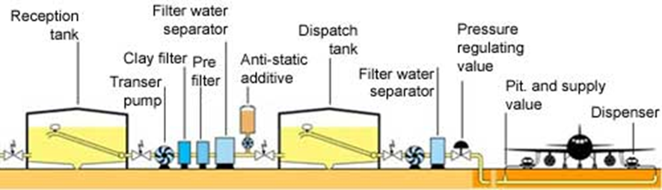
Addressing Deferrals
Airport hydrant fuel distribution systems
  “An UST system which fuels aircraft and operates under high pressure with large diameter piping that typically terminates into one or more hydrants (fill stands)”.

Slide 13
Airport Hydrant Systems Continued
Airport hydrant systems are no longer deferred from regulations.
Because of the large diameter piping and differences in maintenance requirements for airport hydrant systems, Subpart K of 40 CFR 280 was created to specifically address airport hydrant systems, as well as field-constructed tanks.
Currently, no systems in Montana meet this EPA definition.

Slide 14
Deferrals Continued…
Field-constructed tanks
  Also addressed in 40 CFR 280, Subpart K
  A tank constructed of concrete that is poured in the field, or a steel or fiberglass tank primarily fabricated in the field.
    Tanks that are primarily factory built, but assembled in the field, are considered factory built tanks.
    Tanks with components primarily manufactured in a factory with minimal assembly in the field, are considered factory built tanks.
  Montana does not currently have any field-constructed tanks.

Slide 15
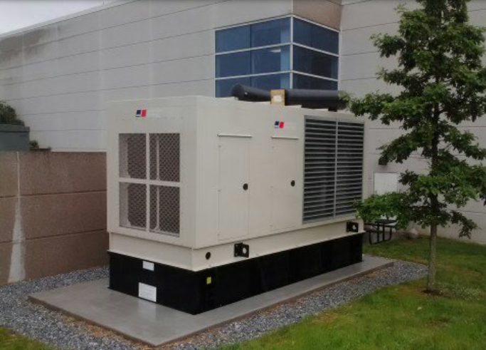
Deferrals Continued…
USTs storing fuel solely for use by Emergency Power Generators
  Deferral for release detection has been removed
  Federal regulatory requirements align with Montana’s current UST Program regulations on EPGs

Slide 16
Other Changes
Vent line flow restrictors (ball float vent valves) - are no longer an option for overfill protection in new UST systems and when these devices need to be replaced.
Replacement of piping – updated from “over” 50 % to 50% or more.
Under-dispenser containment– UDC must be installed when dispensers and equipment necessary to connect to the dispenser is replaced – includes check valves, shear valves, unburied risers or flex connectors, or other transitional components that are underneath the dispenser and used to connect the dispenser to the UG piping.

Slide 17
Other Changes Continued…
ALLDs and ISM – 3.0 gph requirement 10 PSI line pressure within one hour. Effective now.
Removal of 5.0 gph ALLD re-test - Failure of annual 3.0 gph test is a failure and must be replaced. Effective now.
Vapor and GW monitoring - allowed as a leak detection method until October 13, 2023.

Slide 18
Other Changes Continued…
Compatibility
  Definition of Motor fuel now clarifies the regulated substance to include hydrocarbons derived from non-petroleum sources, such as biomass, plant material, organic waste and shale oil.
  Owners and operators must demonstrate compatibility of regulated substances containing greater than 10% ethanol and substances greater than 20% biodiesel.
  Owners and operators still must use UST systems that are compatible with the substance stored.
Notes:
Page 41602 and 41603 in FR; https://www.epa.gov/ust/emerging-fuels-and-underground-storage-tanks-usts

Slide 19
Compatibility Continued…
Owners and operators must demonstrate compatibility with the UST system:
  Tank, piping, containment sumps, pumping equipment, release detection equipment, spill equipment, and overfill equipment.

Slide 20
Compatibility Continued…
Owners and operators may demonstrate compatibility of the UST system by using one of the following options:
  Certification of listing of UST system equipment or components by a nationally recognized, independent testing laboratory for use with the substance stored; or
  Equipment or component manufacturer approval. The manufacturer’s approval must be in writing, indicate an affirmative state of compatibility, specify the range of biofuel blends the equipment or component is compatible with, and be from the equipment or component manufacturer; or

Slide 21
Compatibility Continued…
  Use another option determined by the implementing agency to be no less protective of human health and the environment.
Owners and operators must maintain records documenting compliance as long as the UST system is used to store the regulated substance.

Slide 22
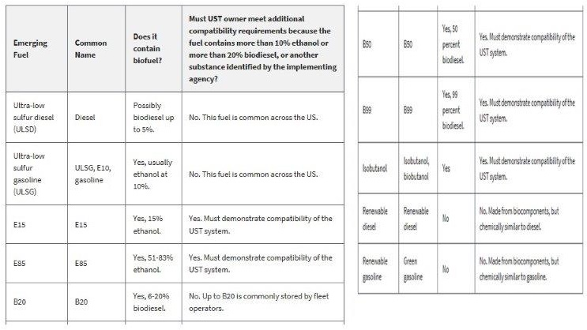
Compatibility Continued…
https://www.epa.gov/ust/emerging-fuels-and-underground-storage-tanks-usts
Notes:
https://www.epa.gov/ust/emerging-fuels-and-underground-storage-tanks-usts

Slide 23
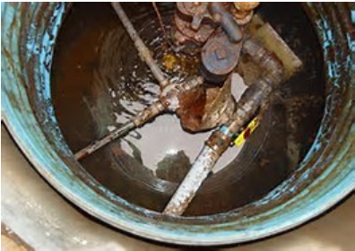
Other Changes Continued…
Interstitial Monitoring Results
  The old federal regulations
  implicitly covered interstitial
  monitoring when reporting suspect releases
  because it was a method of leak detection.
  The updated regulations now explicitly cover interstitial monitoring with regard to suspect releases.
    Liquid in interstitial spaces of secondarily UST systems is now an unusual operating condition, as well as an ISM alarm
      Leaks must be investigated, addressed and as necessary, reported.

Slide 24
Link to our regulations:
On our website under Resources, Laws and Rules:
  http://mtrules.org/gateway/ChapterHome.asp?Chapter=17%2E56
Monthly walkthrough inspection checklist: http://deq.mt.gov/Portals/112/Land/UST/Documents/PDFfiles/WalkthroughInspectionForm.pdf

Slide 25

Questions?

